Slide 1
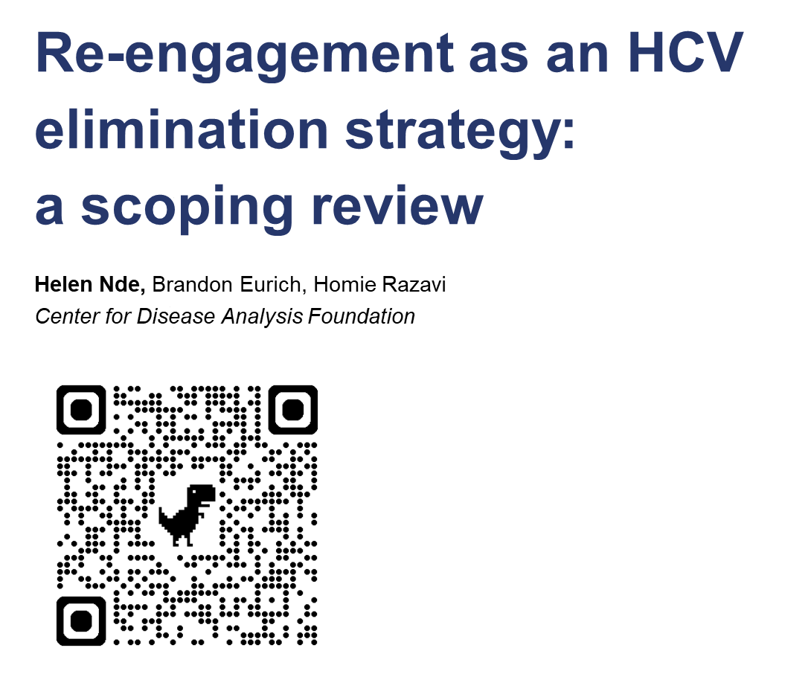

Slide 2

DISCLOSURE STATEMENT

Slide 3
AGENDA
BACKGROUND
METHODS
RESULTS
KEY FINDINGS
CALLS TO ACTION

Slide 4
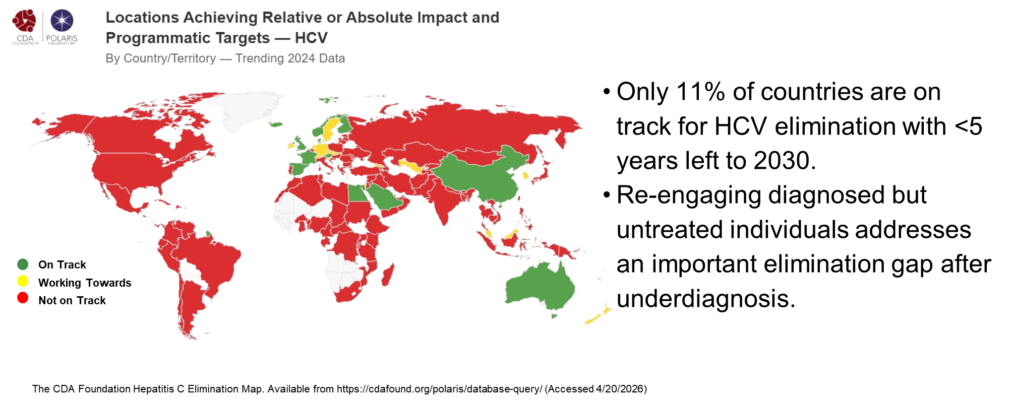
BACKGROUND

Slide 5
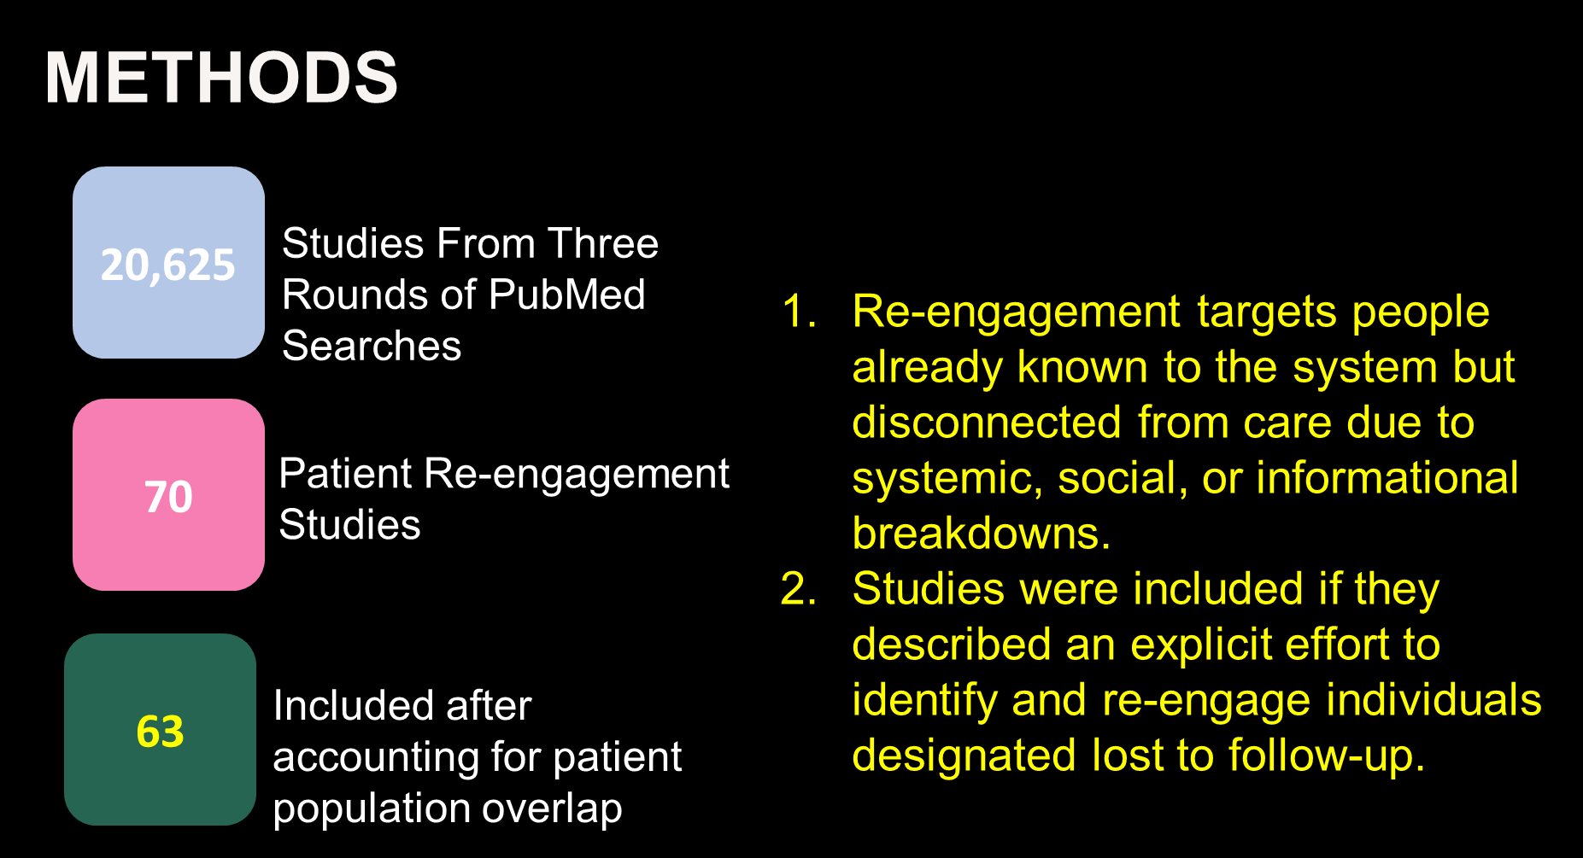

Slide 6


Slide 7
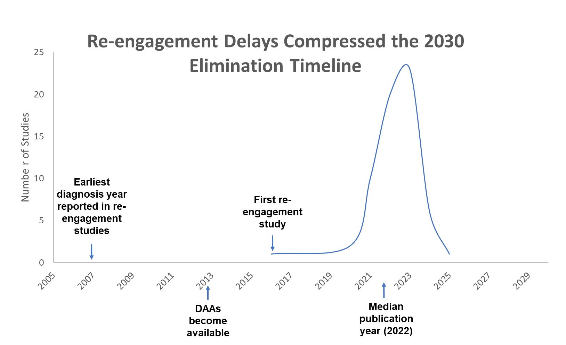
METHODS

Slide 8
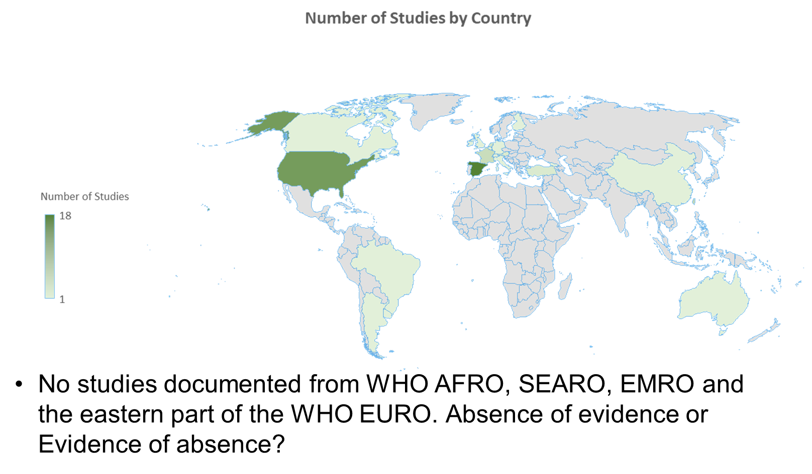
RESULTS

Slide 9
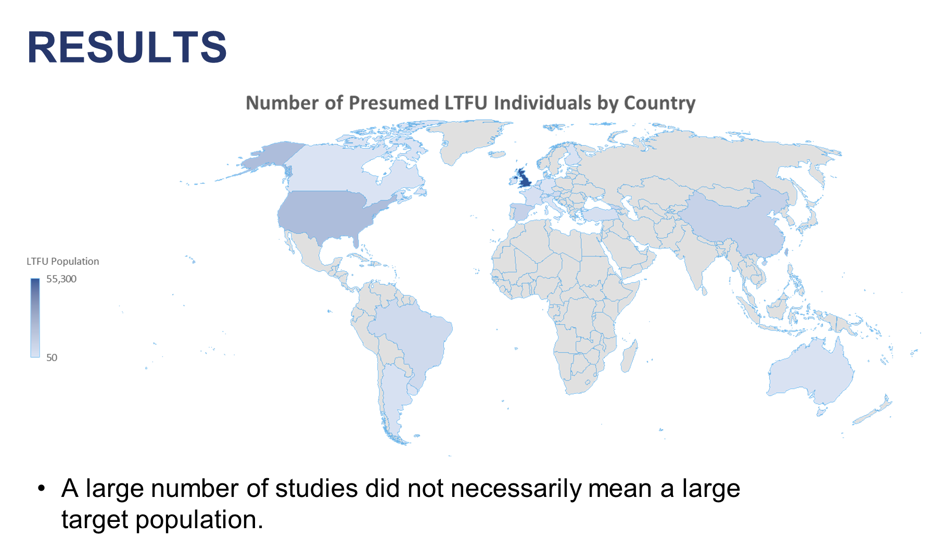

Slide 10
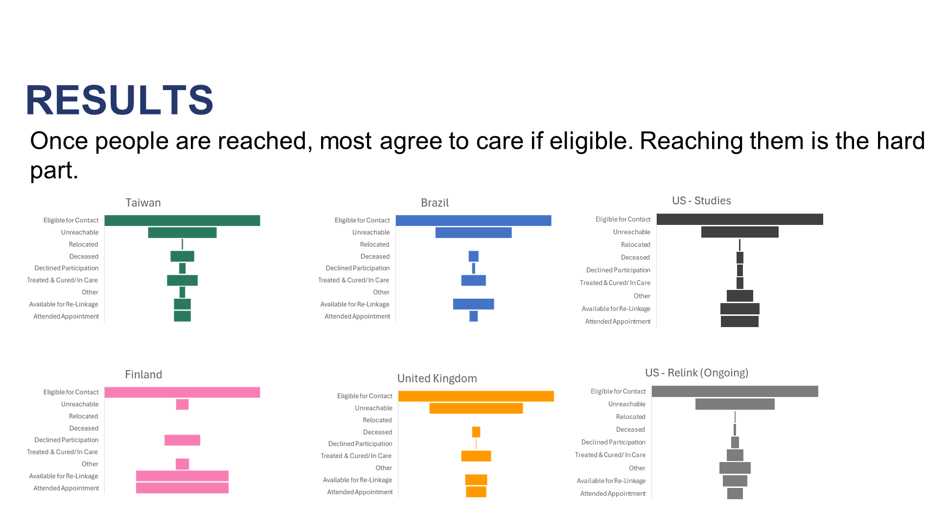

Slide 11
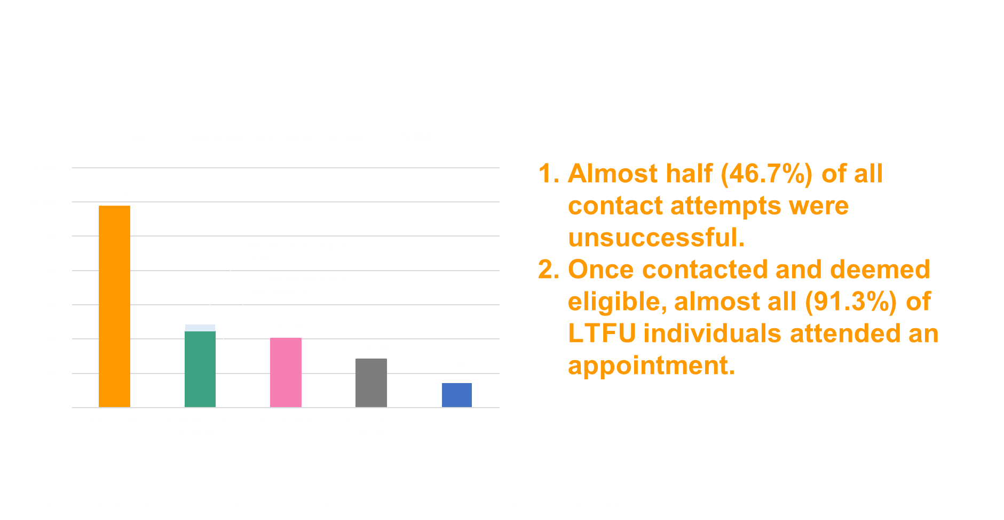

Slide 12

Notes:
- Strategies must be adapted to national legal, ethical, and data governance contexts.

Slide 13
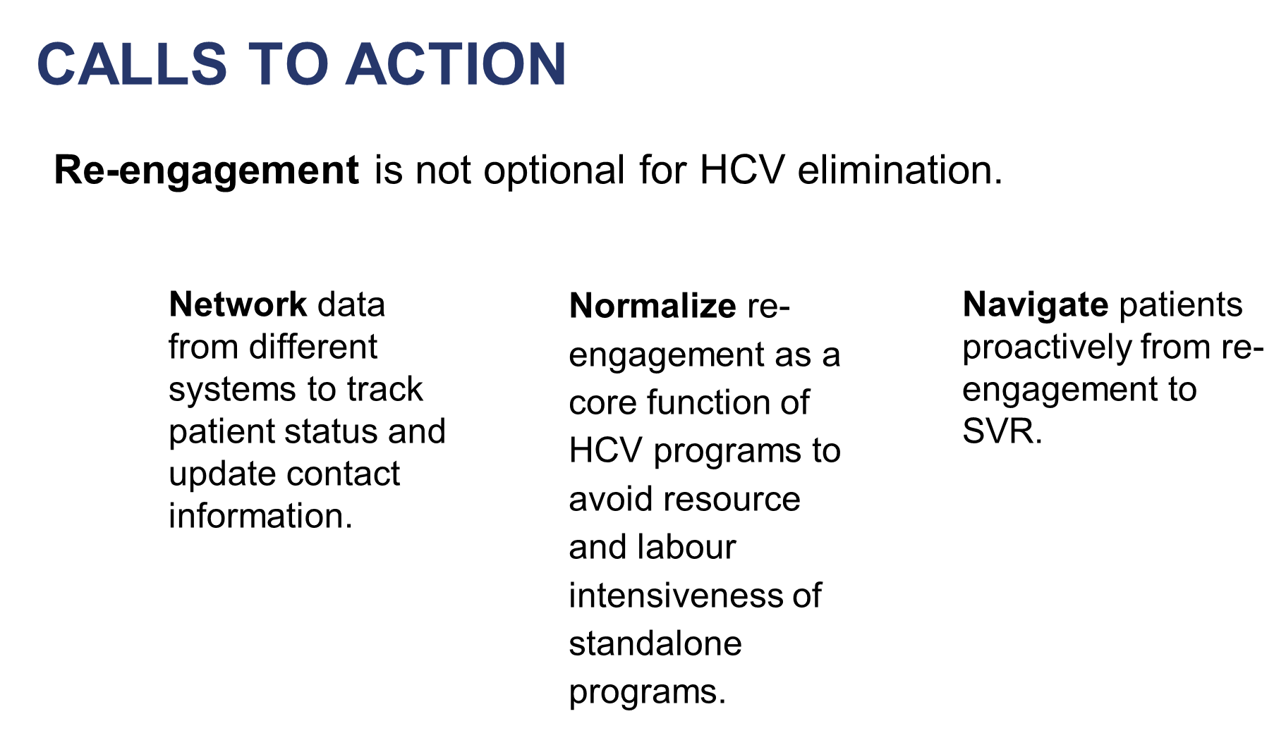
Notes:
- Re‑engagement strategies must be culturally appropriate, rights‑based, and community-informed. Mention Kamali study.

Slide 14
REFERENCES
Abbott, Mielle, et al. "A pilot project harnessing surveillance systems to support clinicians providing clinical care for people diagnosed with hepatitis C in Victoria, Australia, September 2021 to 31 March 2022." Eurosurveillance 29.29 (2024): 2400028.
Abergel, Armand, et al. "RECONVOCC: Can we reconvene chronic hepatitis C patients who were lost to follow-up?." Journal of Hepatology. Vol. 75. Radarweg 29, 1043 NX Amsterdam, Netherlands: Elsiever, 2021.
Aguilera V, González-Grande R, Pena MJ, Bono A, Granados R, Jiménez-Pérez M, Serrano M, Cantero H, González-de-Adalid C, Sainz M, Espinoza-Cámac N. Efficiency of the Relink C strategy: identification and retrieval of chronic HCV patients full and partial diagnosed but unlinked to care. Medical Research Archives. 2024 Dec 24;12(12).
Almena Sereno JA, et al. Active Search for HCV Ab+ Patients Registered in the Hospital Lab: Retrieval of lost to follow-up patients from 1/2010 to 12/2020 in Badajoz, Spain AEEH 2023. 52
Alventosa Mateu, Carlos et al. “Outcomes of an automated alert system from Microbiology to link diagnosis to treatment in patients with hepatitis C virus.” Revista espanola de enfermedades digestivas vol. 115,4 (2023): 181-187. doi:10.17235/reed.2022.8716/2022
Balcar, Lorenz, et al. "A systematic PCR record‐based re‐call of HCV‐RNA‐positive people enables re‐linkage to care and HCV elimination in Austria—The ELIMINATE project." Liver International 44.12 (2024): 3151-3163.
Barda, Beatrice, et al. "A Retrospective Study on Hepatitis C Virus Infected Individuals Lost to Follow-Up in Ticino: The Hub and Spoke Approach." Open Journal of Internal Medicine 12.4 (2022): 194-198.
Burgui, Cristina, et al. "Recapture of patients with an incomplete diagnosis of hepatitis C virus infection." Revista Espanola de Enfermadades Digestivas (REED) 112.7 (2020): 525-532.
Caldwell, Sylvia A. B., et al. “Year-to-Year comparison of Virginia’s Hepatitis education and patient connection referral on release program outcomes for those recently released from incarceration.” HPHR. 2022;56.10.54111/0001/DDD1
Campos-Gonzaga L, et al. Identification of Patients Diagnosed with HCV But Not Seen by Specialists: Review of patients diagnosed with HCV and not followed up with specialists from 2006-2021 in Jerez, Cadiz, Spain. GEHEP 2022
Chang, Li-Jen, et al. "Factors associated with the refusal of direct-acting antiviral agents for the treatment of hepatitis C in Taiwan." Medicina 58.4 (2022): 521.
Chelouah S, et al. Recall of HCV Patients in a Psychiatry Hospital by Non-Specialist Prescribers: Retrospective study to evaluate screening test and treat strategy. AFEF 2022.
Chen, Cheng-Jen, et al. "Hepatitis C micro-elimination through the retrieval strategy of patients lost to follow-up." BMC gastroenterology 23.1 (2023): 1-9.
Chien, Cheng-Hung, et al. "The Challenge of a Recall Program from a Community-Based Hepatitis C Screening Campaign: The Effectiveness in HCV Microelimination." Microorganisms 12.7 (2024): 1402.
Dever, John B., et al. "Engagement in care of high-risk hepatitis C patients with interferon-free direct-acting antiviral therapies." Digestive Diseases and Sciences 62 (2017): 1472-1479.
Diaz Munoz R, et al. Search for Active Patients with HCV: Retrospective review of medical records of patients from 2017 to 2021. AEEH 2023.
Dimmendaal, M., et al. "Retrieval of chronic hepatitis B patients in the Utrecht region in the Netherlands." The Netherlands Journal of Medicine 77.6 (2019): 199-203.
Dröse, Sandra, et al. "Retrieval of patients with hepatitis C who were lost to follow-up in Southern Denmark." Infectious Diseases 55.5 (2023): 361-369.
Etoori, David, et al. "Results from a retrospective case finding and re-engagement exercise for people previously diagnosed with hepatitis C virus to increase uptake of directly acting antiviral treatment." BMC Public Health 24.1 (2024): 2427.
Ferraz, Maria Lucia Gomes, et al. "Retrieval of HCV patients lost to follow-up as a strategy for Hepatitis C Microelimination: results of a Brazilian multicentre study." BMC Infectious Diseases 23.1 (2023): 468.
Freyre Carrillo C, et al. Search for Lost Patients Without HCV Diagnosis . Review of patients with positive HCV antibodies but without confirmatory RNA testing from 2011-2020 GEHEP 2022. P42
Gamkrelidze, Amiran, et al. "Innovative linkage model to re-engage lost-to-follow-up individuals in the national hepatitis C elimination program of Georgia." JOURNAL OF HEPATOLOGY 75 (2021): S643-S644.
Gormley, Mirinda Ann, et al. "No Patient Left Behind: A Novel Paradigm to Fulfill Hepatitis C Virus Treatment for Rural Patients." Open Forum Infectious Diseases. Vol. 11. No. 5. US: Oxford University Press, 2024.
Grande G, et al. Recovering Lost HCV Patients in the System: Locating and recovering HCV patients previously lost at the Hospital Regional Universitario de Málaga. AEEH 2023.
Guerra Veloz, María Fernanda, et al. "HCV microelimination strategies: an interventional study in diagnosed patients without access to the system." Liver International 41.5 (2021): 928-933.
Hernandez-Guerra M, et al. Effectiveness of ReLinking HCV RNA+ Patients to Care Through Regional Hospitals AASLD 2022. Poster #3427
Huang, Jee-Fu, et al. "Towards a safe hospital: hepatitis C in-hospital micro-elimination program (HCV-HELP study)." Hepatology International 16.1 (2022): 59-67.
Hyde, Zak, et al. "Evaluation of a pilot emergency department linkage to care program for patients previously diagnosed with Hepatitis C." Journal of viral hepatitis 30.2 (2023): 129-137.
Isfordink, Cas J., et al. "Hepatitis C Elimination in the Netherlands (CELINE): How nationwide retrieval of lost to follow-up hepatitis C patients contributes to micro-elimination." European journal of internal medicine 101 (2022): 93-97.
Kartal ED, Bayrak Ö, Demirbüken G. Approach to Hepatitis C Microelimination through Re-Engagement of Missing Patients Registered in Hospital Information Management System. Mikrobiyoloji bulteni. 2025 Apr;59(2):191-202.
Kemppinen, Juha, et al. "Expanding access to hepatitis C treatment by improving linkage to care: Establishing a cascade of care and active linkage program for the South Karelia region in Finland." Health Science Reports 3.4 (2020).
Keymeulen, Hannah, et al. "Patients with chronic hepatitis C virus infection are at high risk of being lost to follow-up: focused interventions can increase linkage to care." Acta gastro-enterologica Belgica 83.1 (2020): 94-94.
Lange, Sarah, et al. "ReLink strategy in diagnosed-but-untreated hepatitis C-positive patients in Germany: report from a single center." Zeitschrift für Gastroenterologie 62.10 (2024): 1701-1707.
Li S, Dong W, Yu Y, Yang Z, Luo Y, Cai Y, Zhu Y, Wu Q, Li Q, Su S, Yang R. A Government‐Led, Patient‐Centric Strategy to Re‐Engage Diagnosed but Untreated Hepatitis C Patients in Yunnan Province, China. Journal of Viral Hepatitis. 2025 Jun;32(6):e70028.

Slide 15
REFERENCES
Mendizabal, Manuel, et al. "Implementation of a re‐linkage to care strategy in patients with chronic hepatitis C who were lost to follow‐up in Latin America." Journal of Viral Hepatitis 30.1 (2023): 56-63.
Mendoza, Denise, et al. "2503. Re-engagement in Care for Patients with Positive Hepatitis C Virus Antibody Test: A Descriptive Study at a Large University Hospital." Open Forum Infectious Diseases. Vol. 10. No. Supplement_2. US: Oxford University Press, 2023.
Metivier, Sophie, et al. "Recall of HCV Patients Lost to Follow-Up. RELINK Study in Two Expert Centres in France." The Liver Meeting Digital Experience™. AASLD, 2020.
Morales Arraez D, et al. Telemedicine and decentralized treatment dispensation to rescue patients in a hepatitis C micro-elimination program based on onsite driedblood spot testing in drug addiction centers. EASL 2020. THU348
Morales-Arraez, Dalia, et al. "Reengagement strategies for hepatitis C patients lost to follow-up: A randomized clinical trial." Hepatology Communications 7.6 (2023): e0080.
Moreno P, et al. Recovery of HCV Patients Using an Interdisciplinary Team: Retrieval of lost to follow-up patients from Tenerife, Spain. AEEH 2023. 96
Nance, Anna R., et al. "Hepatitis C treatment at a rural Navajo health clinic using project ECHO." Online Journal of Rural Nursing and Health Care 20.2 (2020): 133-155.
O’Connell, Sarah, et al. "Opt-out panel testing for HIV, hepatitis B and hepatitis C in an urban emergency department: a pilot study." PloS one 11.3 (2016): e0150546.
Otegui, Juan, et al. "P-84 Implementation of a step-by-step strategy based on the treatment cascade to eliminate Hepatitis C virus infection in the Hospital Central de las Fuerzas Armadas from Uruguay. Preliminary Report. Annals of Hepatology 24 (2021): 100447.
Ponziani, Francesca Romana, et al. "Missed linkage to care for patients who screened positive for Hepatitis C in a tertiary care centre: Results of the Telepass project." Journal of Viral Hepatitis 28.4 (2021): 651-656.
Rammal, J-A., et al. "273 Use of an Electronic Medical Record Flag to Reconnect with Patients Lost to Follow-Up in a Hepatitis C Virus Screening Program." Annals of Emergency Medicine 80.4 (2022): S119.
Remy, André-Jean, et al. "Find out HCV patients: systematic study of 2013–2020 HCV files of a MDT viral hepatitis expert unit on the future of patients has made it possible to find out the lost ones and put them into treatment." Journal of Hepatology 77 (2022): S542.
Ruffner, Andrew H., et al. "Identifying ED patients with previous abnormal HIV or hepatitis C test results who may require additional services." The American Journal of Emergency Medicine 38.9 (2020): 1831-1833.
Sampedro Andrada B, et al. Letter Sending Program for Confirmation and Treatment of Patients with Chronic HCV: AEEH 2023. 78
Sotera, Gisela Fabiana, et al. "P-35 Relinkage of Patients With Chronic Hepatitis C Infection in the Context of the COVID-19 Pandemic" Annals of Hepatology 28 (2023): 100937.
Stafylis C, Hernandez-Tamayo C, Bhardwaj L, Shah R, Becerra T, Bruce D, Saini R, Saremi N, Thomas I, Manansala-Tan K, Vij AP. Project HCV Connect: Using a County Surveillance Registry to Link Hepatitis C Virus-Infected Residents to Cure—Los Angeles County, April 2023 to March 2024. Journal of public health management and practice: JPHMP. 2025 Jul 1;31(4):610-3.
Steininger, Lisa, et al. "Direct patient-physician communication via a hepatitis C hotline facilitates treatment initiation in patients with poor adherence." Wiener klinische Wochenschrift 133 (2021): 452-460.
Strebe, Joslyn, et al. "Patient navigation increases linkage to care and receipt of direct-acting antiviral therapy in patients with hepatitis C." Clinical Gastroenterology and Hepatology 21.4 (2023): 988-994.
Tandon, Saniya, et al. "Successes and challenges of best practice alerts to identify and engage individuals living with hepatitis C virus." Frontiers in Public Health 12 (2024): 1281079.
Torner, Maria, et al. "HCV micro-elimination strategy in a tertiary hospital: identification of lost cases and linkage to care." Journal of Hepatology 78 (2023): S1192-S1193.
Türkoğlu, Emine, Zafer Parlak, and Hüseyin Şener Barut. "Assessment of HCV-RNA test results and access rates to antiviral treatment in patients with anti-HCV positivity-a 10-year analysis." Turkish journal of medical sciences 52.6 (2022): 1984-1990.
Urda, José Luis Castro, et al. "The efficiency of artificial intelligence for management and clinical decision-making in the identification of patients with undiagnosed HCV infection (Intelligen-C strategy)." Gastroenterología y Hepatología (2025): 502362.
Vargas‐Accarino, Elena, et al. "Enhancing linkage to care for hepatitis B, D, and C patients: a retrospective‐prospective study." Alimentary Pharmacology & Therapeutics 60.10 (2024): 1308-1314.
Vázquez, Pablo Parada, et al. "Artificial intelligence-assisted identification and retrieval of chronic hepatitis C patients lost to follow-up in the health area of Pontevedra and O Salnés (Spain)." Gastroenterología y Hepatología (English Edition) 48.1 (2025): 502226.
Webster, Rachel et al. “Health Department Efforts to Increase Hepatitis C RNA Testing Among People Appearing Out of Care: Comparison of Outreach Approaches, New York City, 2017.” Public health reports (Washington, D.C. : 1974) vol. 135,6 (2020): 823-830. doi:10.1177/0033354920952068
Wegener, Maximilian, et al. "Observational pilot using a Data to Care intervention strategy to promote HCV re-engagement and cure for persons with HIV/HCV co-infection who are out of care." BMC Health Services Research 25.1 (2025): 140.
Wyatt, Brooke, et al. "A Digital Case‐Finding Algorithm for Diagnosed but Untreated Hepatitis C: A Tool for Increasing Linkage to Treatment and Cure." Hepatology 74.6 (2021): 2974-2987.
Yang, Anita, Debbie Zachary, and Jane Giang. "Impact of a nurse care coordinator supporting a clinical pharmacist practitioner in further managing HCV-infected patients." Gastroenterology Nursing 44.1 (2021): E11-E17.
Yen, Hsu-Heng, et al. "Retrieval of lost patients in the system for hepatitis C microelimination: a single-center retrospective study." BMC gastroenterology 21.1 (2021): 209.

Slide 16


THANK YOU!

