Slide 1
REDCap Change User Access

Slide 2
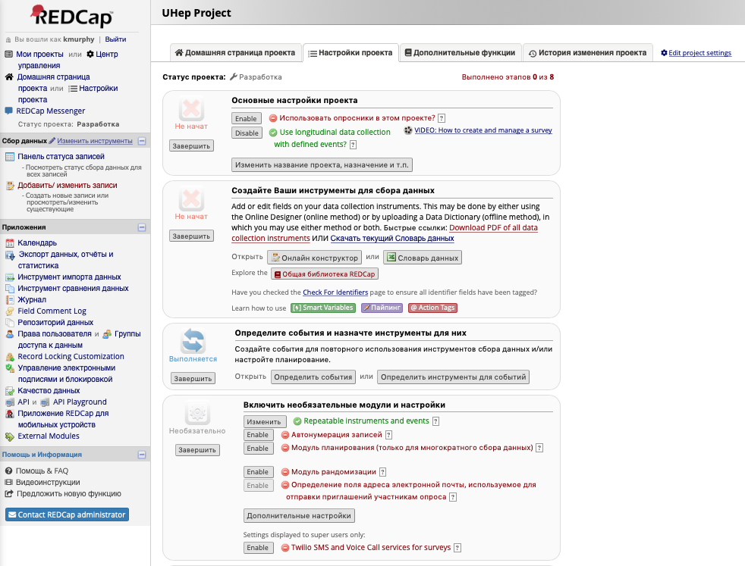
Open the Project and select “User Rights”

Slide 3
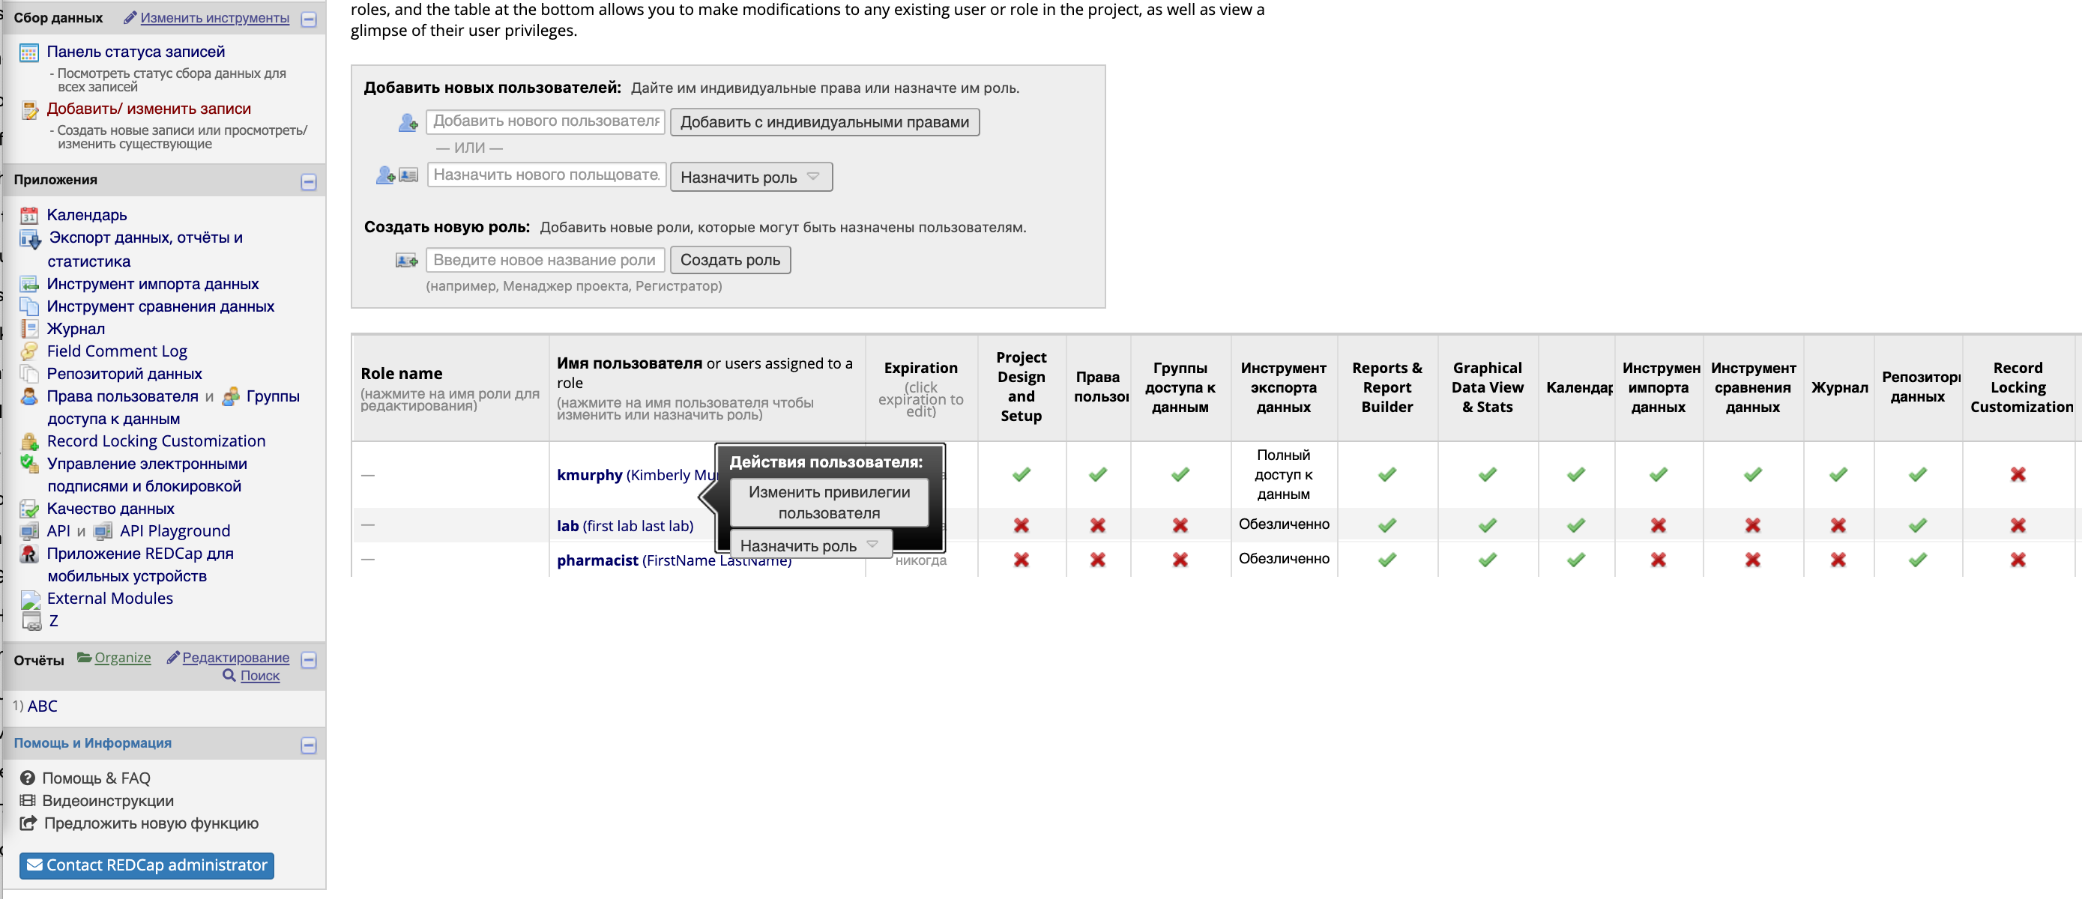
Select the Laboratory user (how ever this has been defined for your project)
and select “Change user privileges”

Slide 4
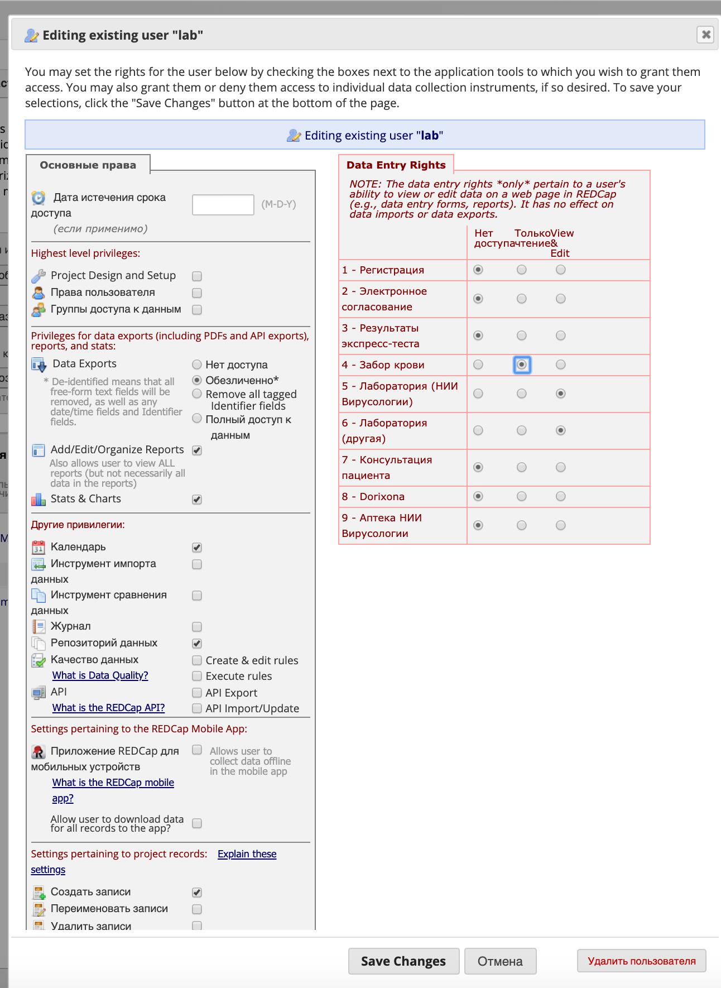
Ensure the Laboratory technician has access to Forms 4,5,6 (so that they can search for patient by barcode) Hit “Save Changes”

Slide 5
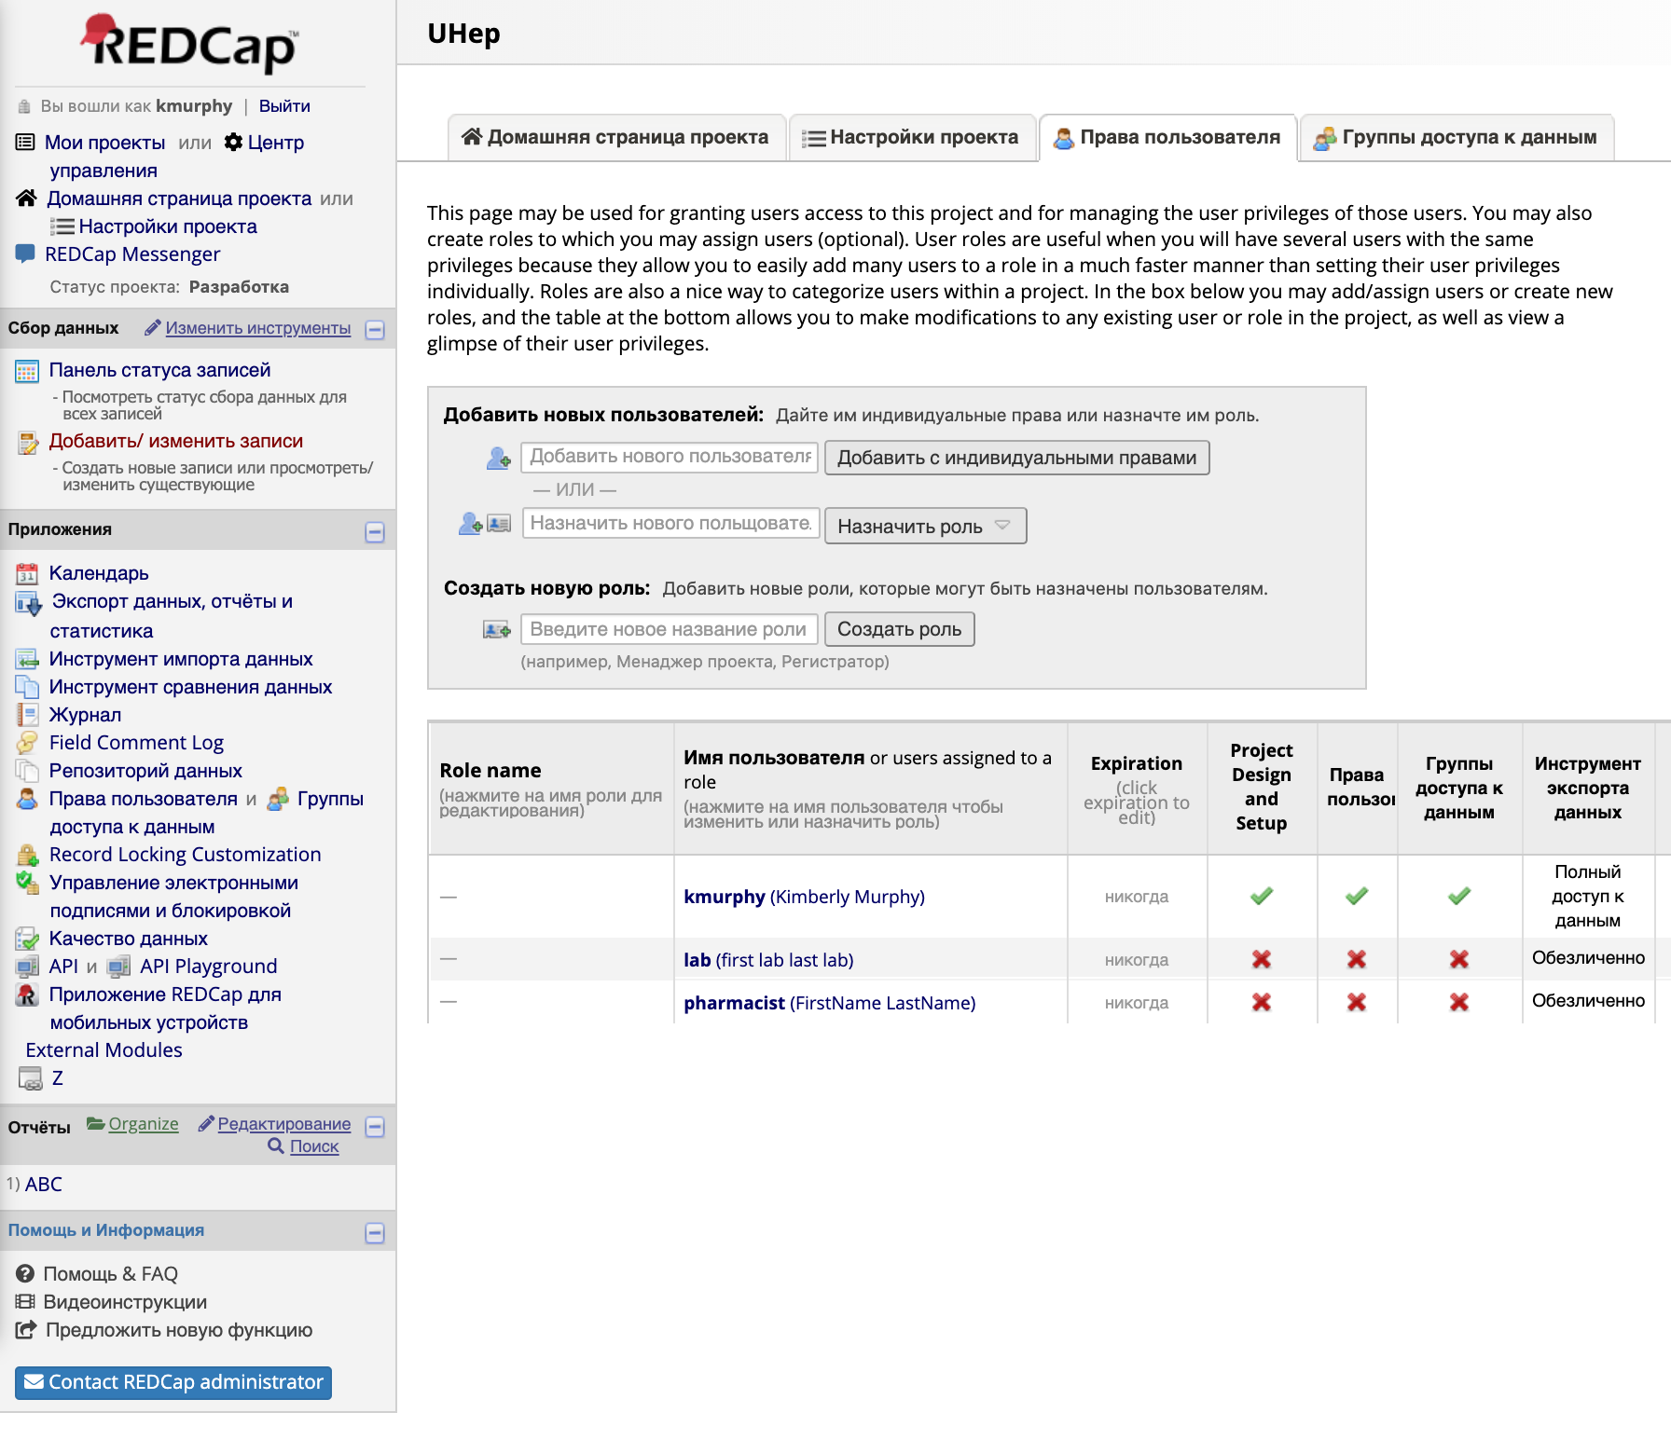
Log-out as Administrator user

Slide 6
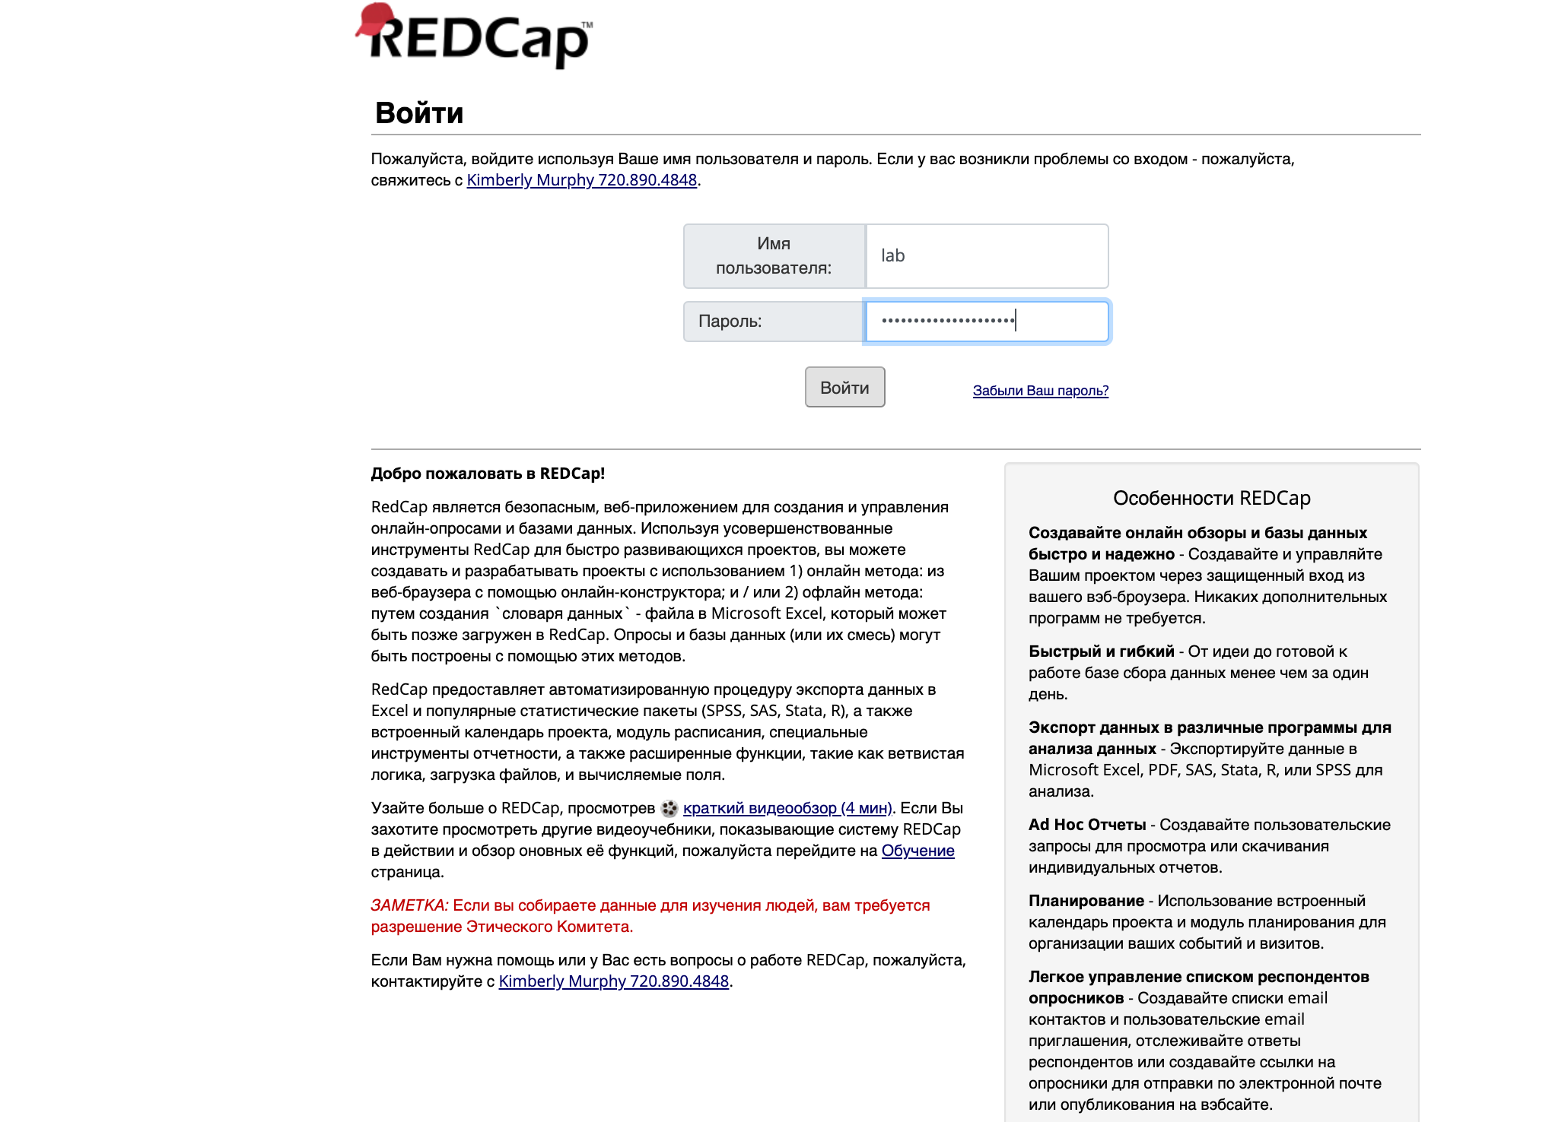
Log-in as as Laboratory user

Slide 7
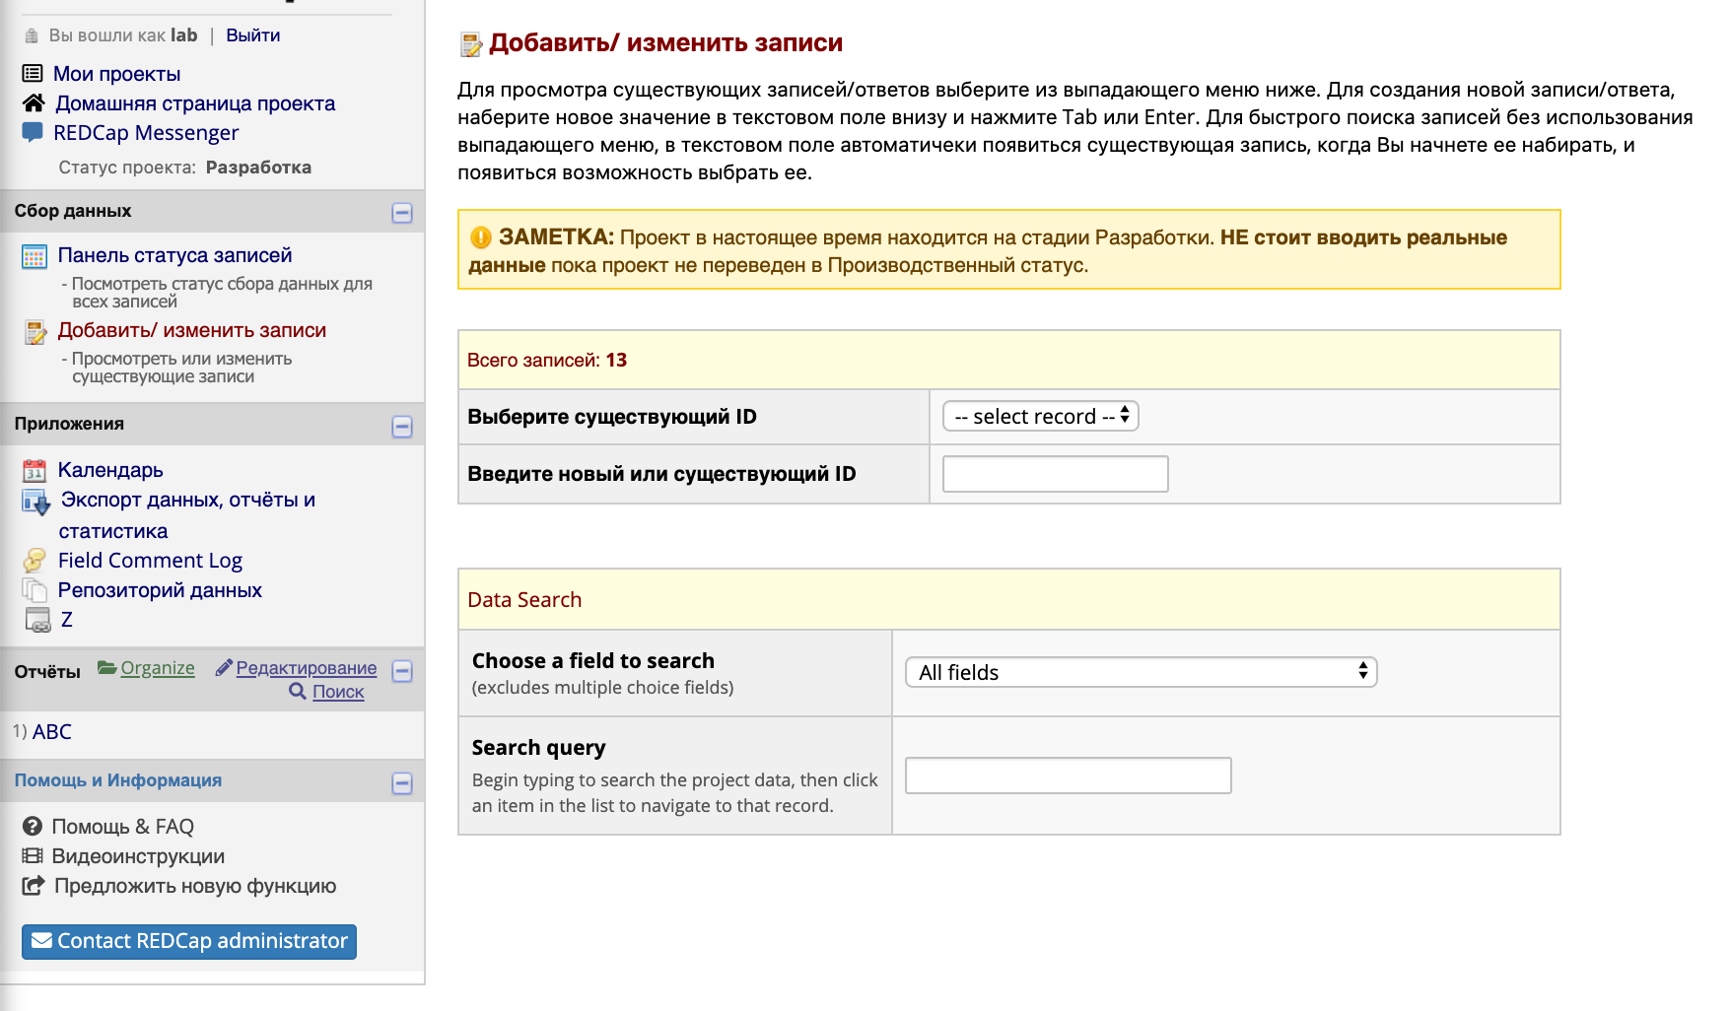
Go to “Add / Edit Entries”

Slide 8
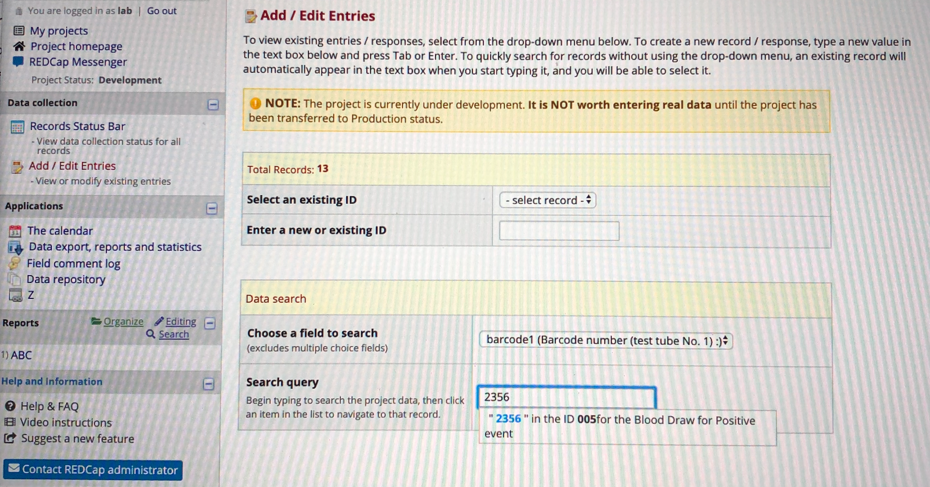
The Laboratory user now can enter the barcode to find the correct Patient ID record

