Slide 1
REDCap System Training

Slide 2
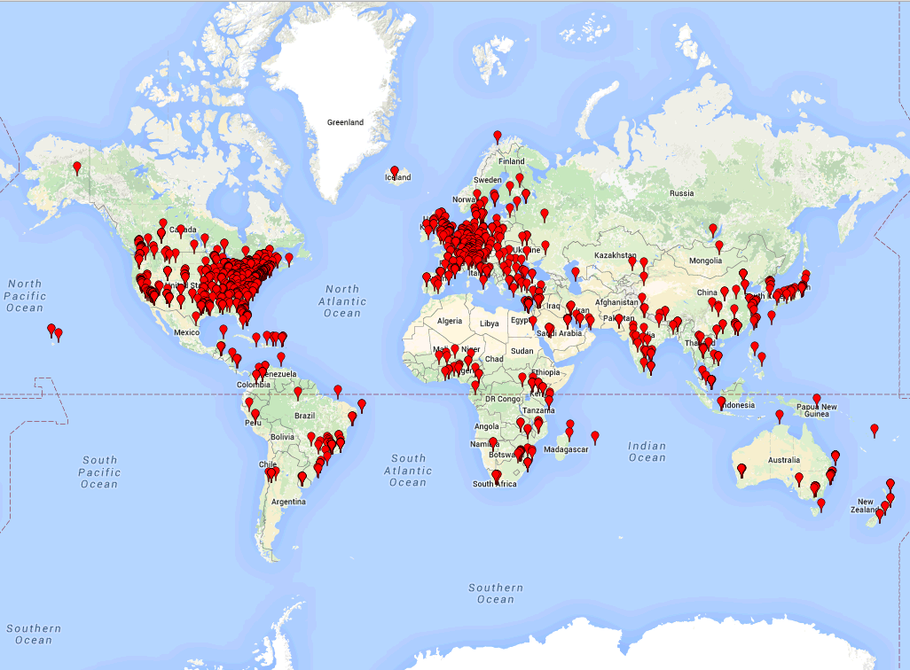
What is REDCap?
REDCap (Research Electronic Data Capture) is a data collection tool created and developed by Paul Harris at Vanderbilt University Medical Center for the Institute for Clinical and Translational Research
It originally supported a small group of clinical researchers who needed a secure data collection tool that met HIPAA compliance standards.
REDCap quickly became their go-to method for supporting both single and multi-site research studies.
It is a toolset available to non-profit partners that has seen widespread adoption
The Consortium, initially launched in 2006, now consists of over 1875 Partner Institutions in 130 countries on six continents (www.project-redcap.org)

Slide 3
Why Use REDCap?
Provides non-profits and the medical field a tool that:
Most importantly the system protects and encrypts personally identifiable and sensitive data and controls user access to that information
Defines forms/data relevant to doctors and health-care professionals to monitor a patient’s healthcare
Validates fields/ performs data queries
Safely stores and backs up data
Supports exporting data for progress & analysis
Includes a functional Mobile App
REDCap
Define Forms/Instruments
Define Procedure/Events
Set User Access/Permissions
Capture Data
Query/Analyze Data

Slide 4
REDCap – General Purpose Database Developed for Clinical/Patient Data
Activity Logging
PDF of Blank or Completed forms
Web Surveys
Data
Import / Export
De-Identified Data Export
Data Forms
User Management
Data Access Groups /
Multi-Site Access
REDCap Project
Custom Reports
Data Quality Queries / Resolution
API Interface /
Custom Programs
PHI Field Restriction
Formatted Export
(SAS, SPSS, R, Excel)
Branching / Skip Logic
REDCap Application

Slide 5
REDCap Features
Multiple Databases supported per project
Study design and analysis services designed specifically for epidemiology and biostatistics information
Scheduling tools
Include a graphical Form designer
Many data types supported with built-in data validation for special text fields as well as as numeric calculated outputs
Branching Logic to conditionally show/hide collection fields identified as relevant to a patient
Configurable user permission levels
Record Locking and Record Change Confirmation
Secure (with encrypted field logging and identifiable data stripping)

Slide 6
REDCap Features (continued)
Report Builder with graphical data viewing tool
Simple data Import / Export mechanisms
Data quality query system for checking data integrity
API interface for integration
Detailed logging routines for monitoring users’ data creation, modification, deletion and viewing.
User grouping for multi-site data access restrictions
Data queries
Data Error Detection
Data Resolution Work Flow
Data entry triggers

Slide 7
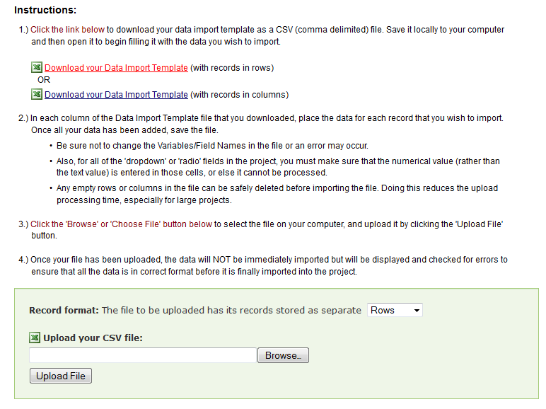
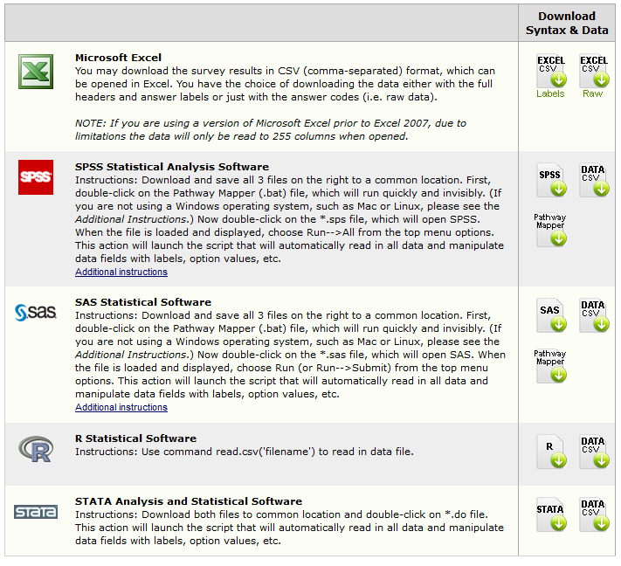
REDCap Helps Meet Project Goals
Provides expanded methods of import/export to facilitate integration with existing systems, processes and analyses:
Import (CSV)
Export (CSV, SAS, SPSS, STATA, R)
Easy to use; metadata driven
Secure, Scalable and Flexible
Adaptable Features with Data entry validation
It is a proven self-service user-driven tool, but most critically, it will ease in the ultimate transition of important Uzbek Health data to an MoH System/Server

Slide 8
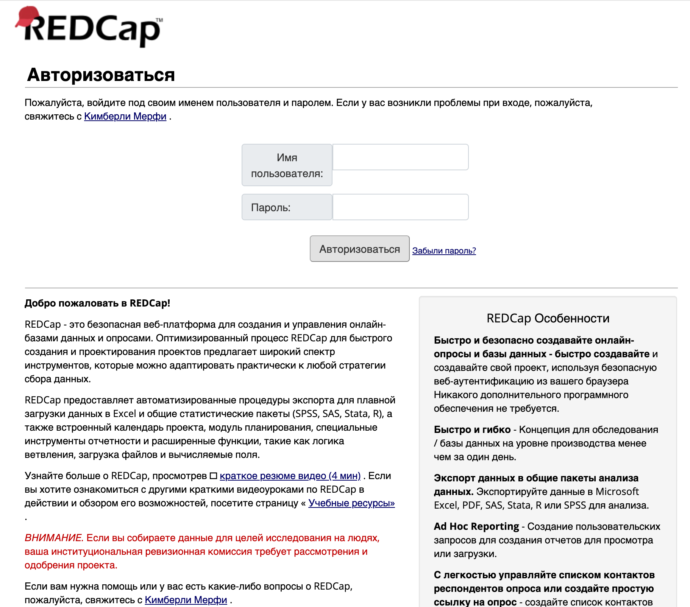
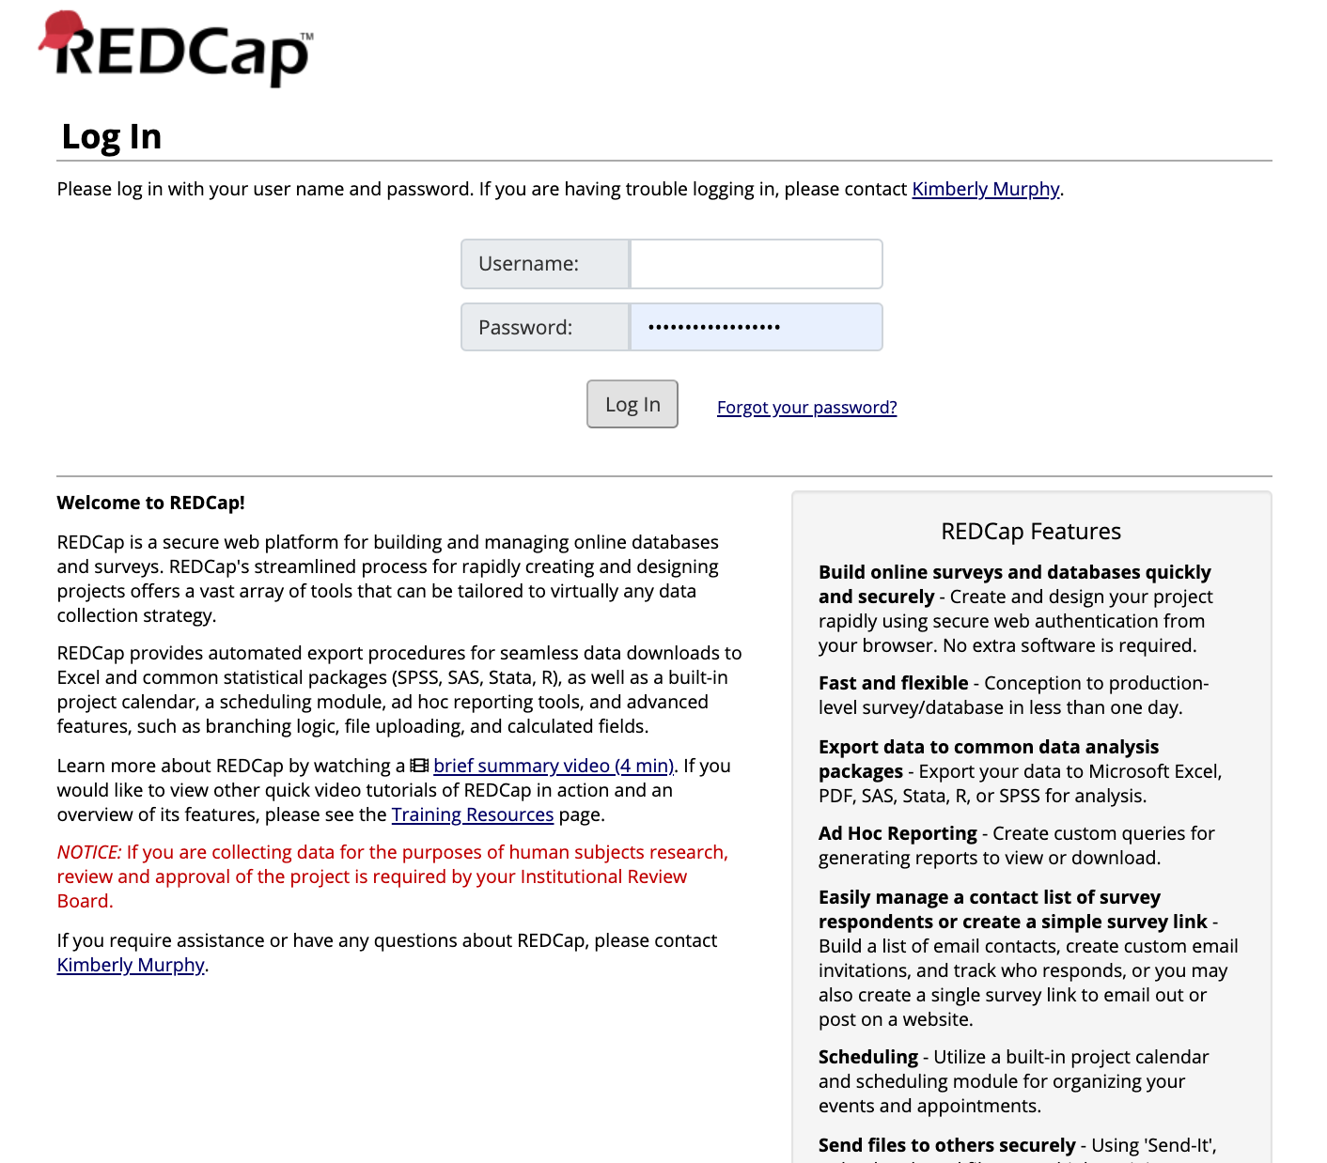
First, a User (Doctor, Nurse, Lab Technician, or Receptionist) logs-in
to obtain access to information in accordance with their designed user Privileges

Slide 9
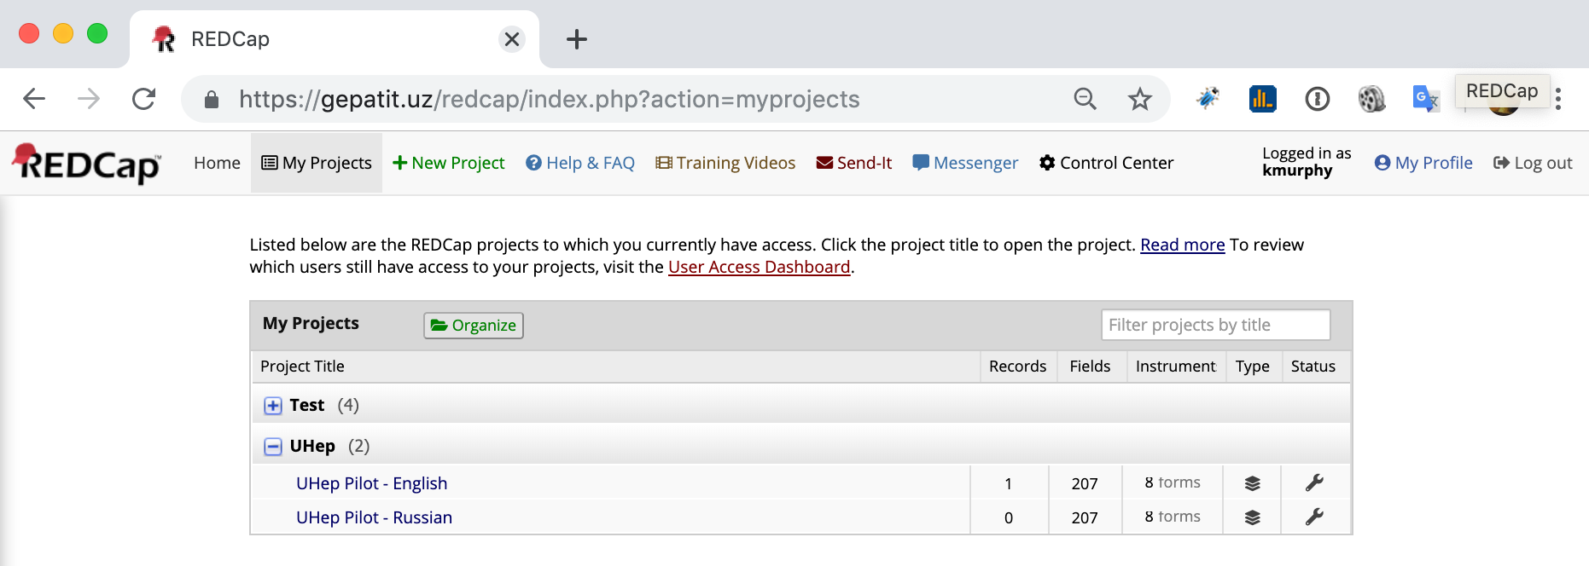
The My Projects page lists the accessible Projects
A User selects the relevant Project for Data Collection by clicking it

Slide 10
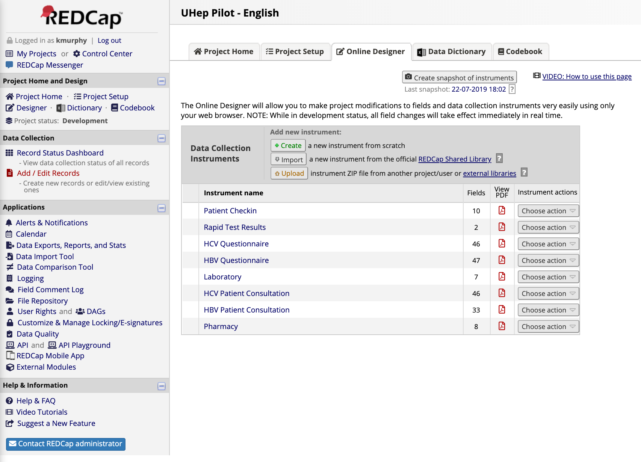
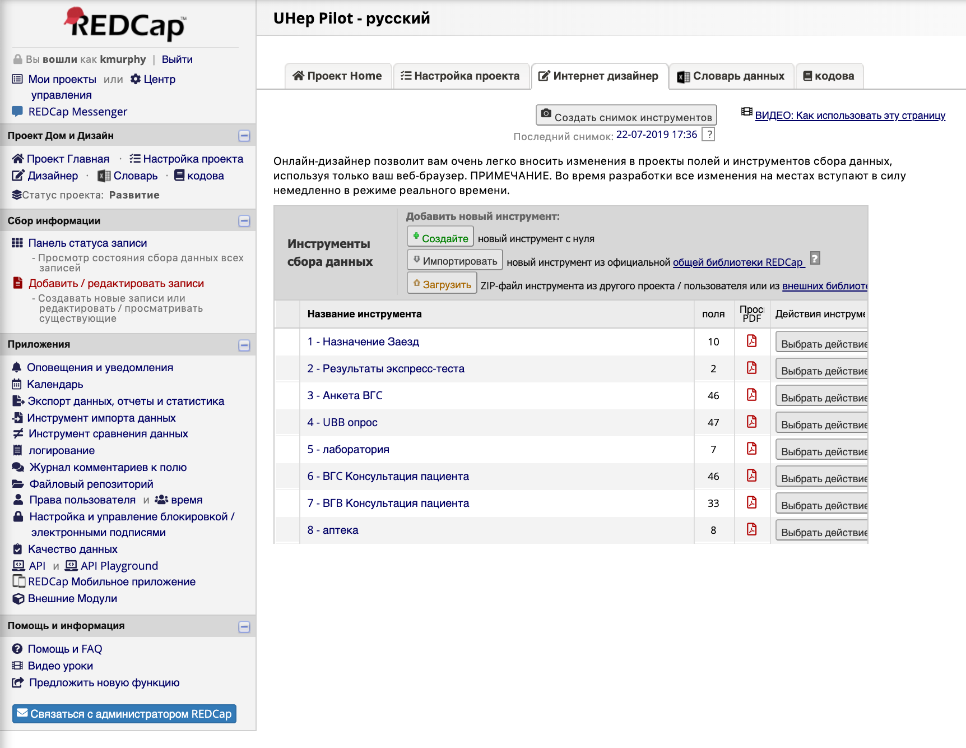
The Project Consists of Instruments of Data Collection for the Pilot and they are summarized on the Dashboard
The standard use case is to select “Add/Edit Records”
from the left panel under “Data Collection”

Slide 11
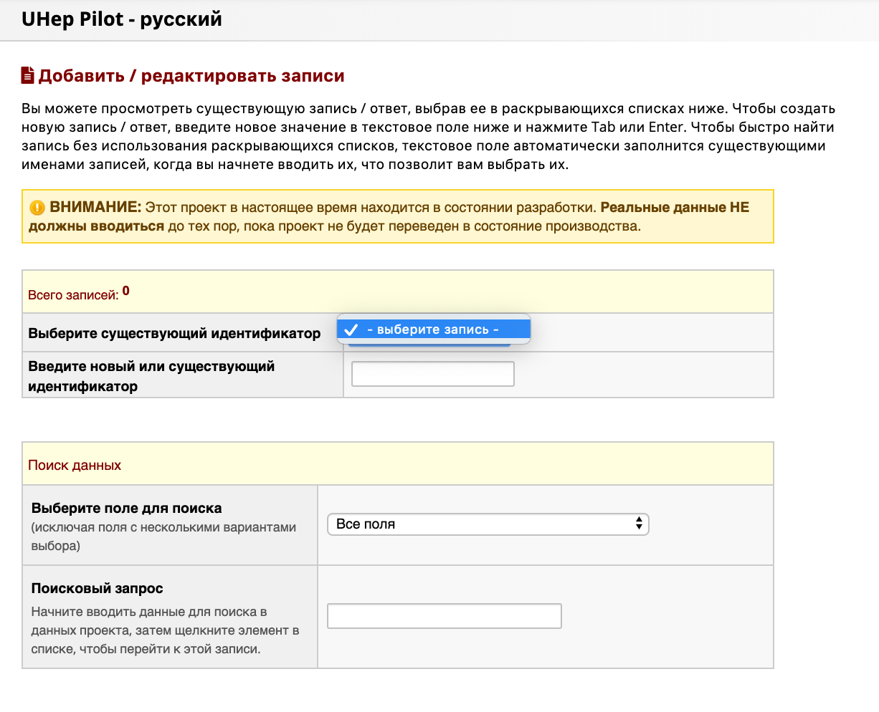
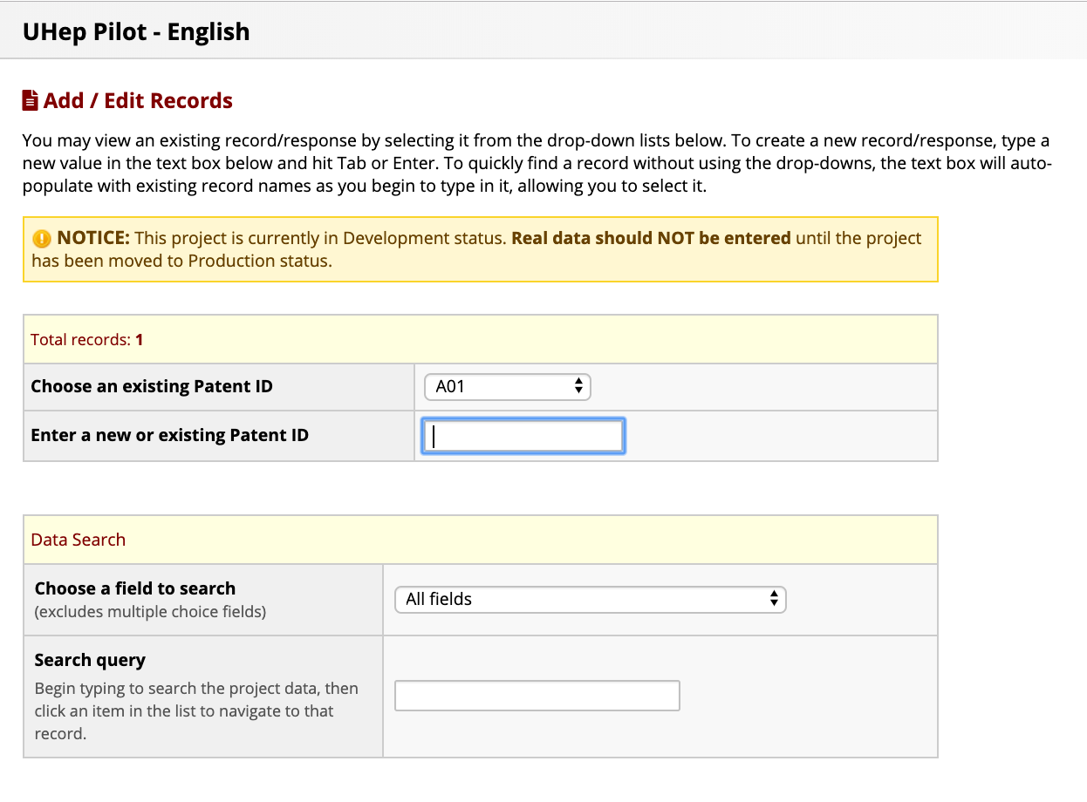
New Patients are Added to the System or
Existing Patients’ data Edited with new information
and Forms as needed/relevant

Slide 12
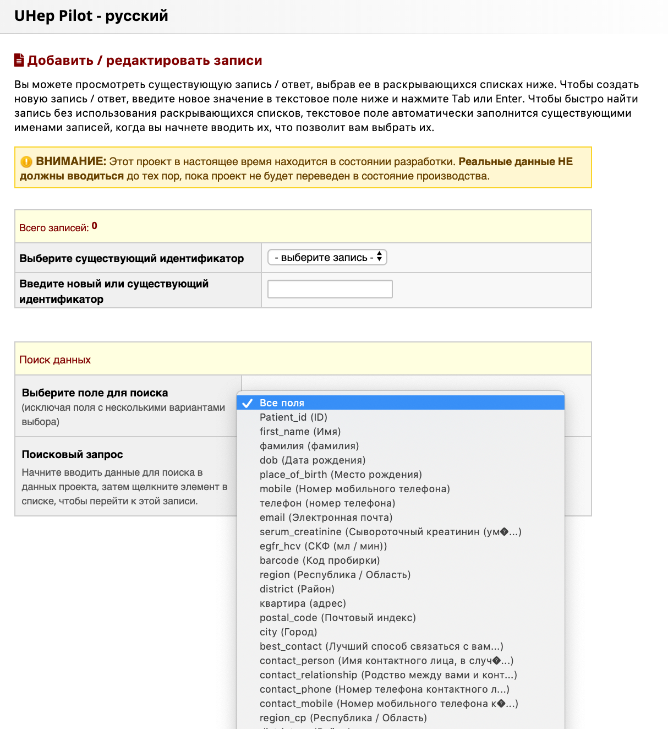
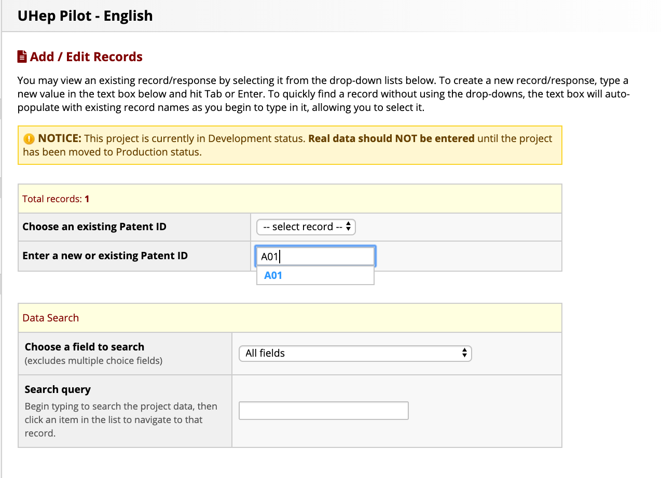
Based on the Privileges of the currently logged-in user, data may be entered, edited or deleted as necessary for Patients participanting

Slide 13
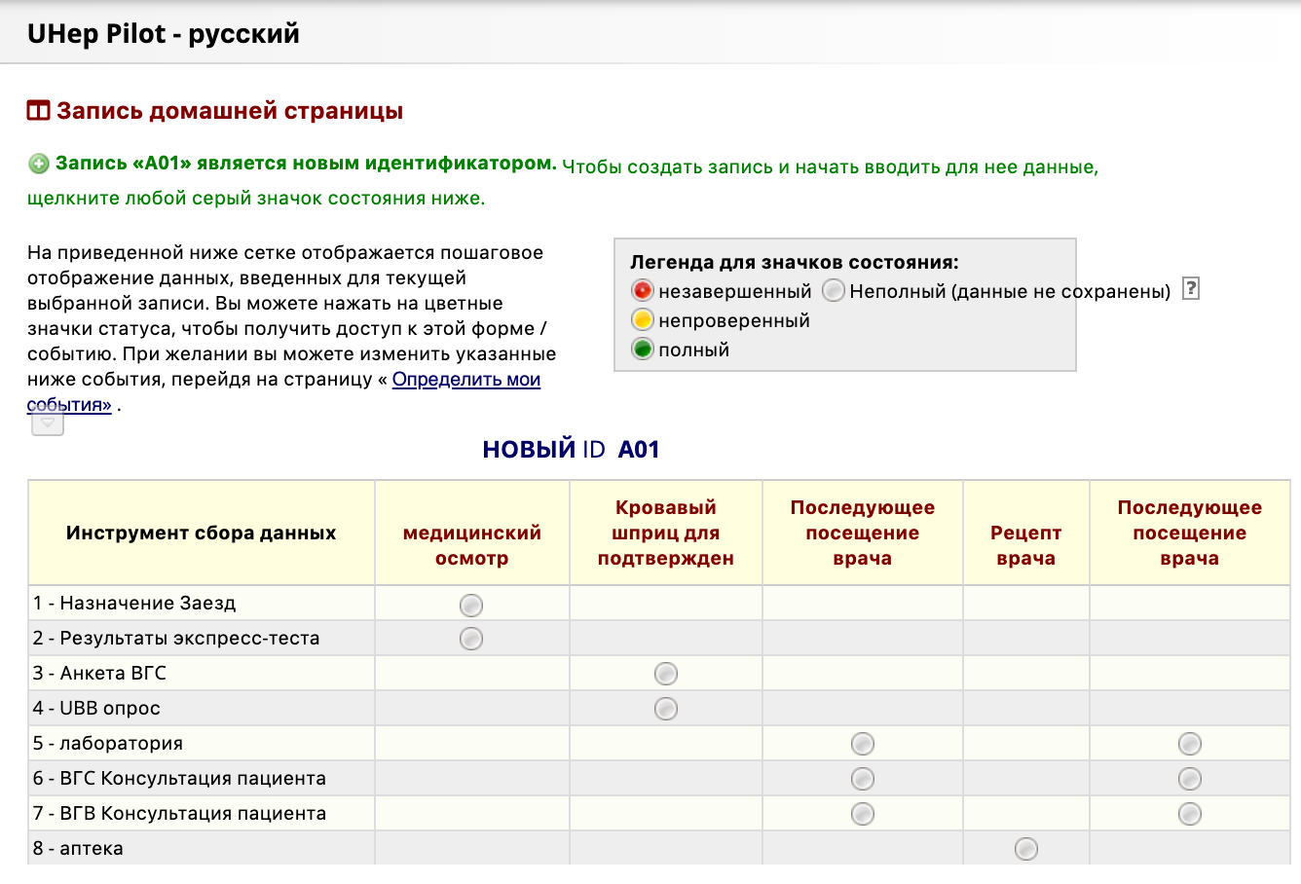
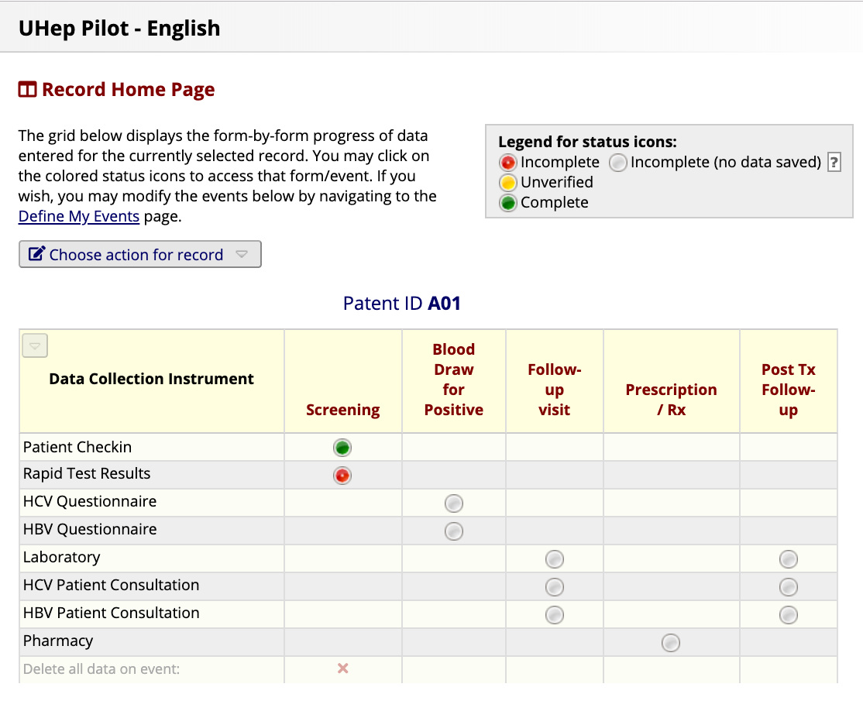
When a Patient is located by ID, data can be edited or added after selecting the radio button for the corresponding instrument & event

Slide 14
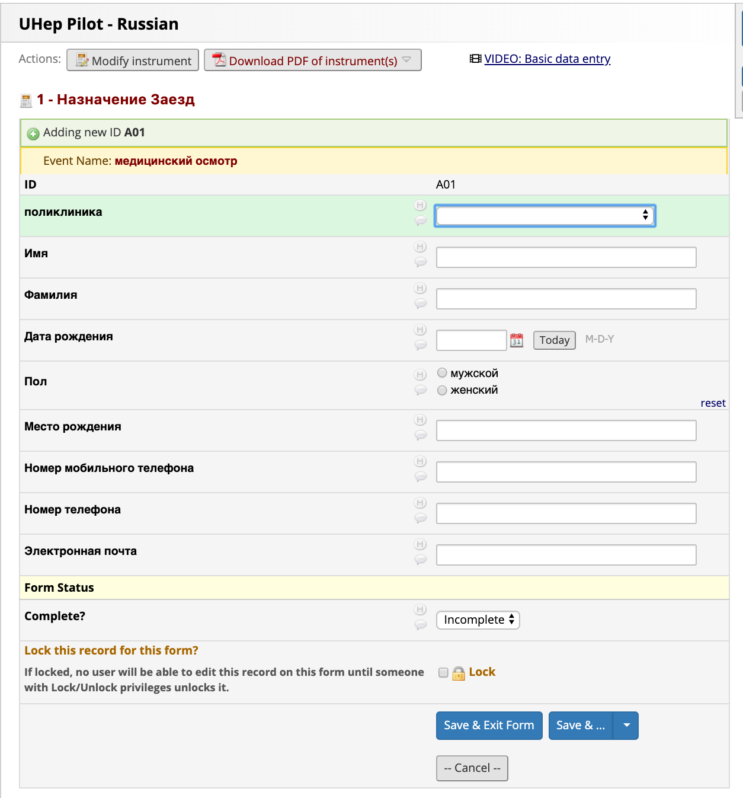
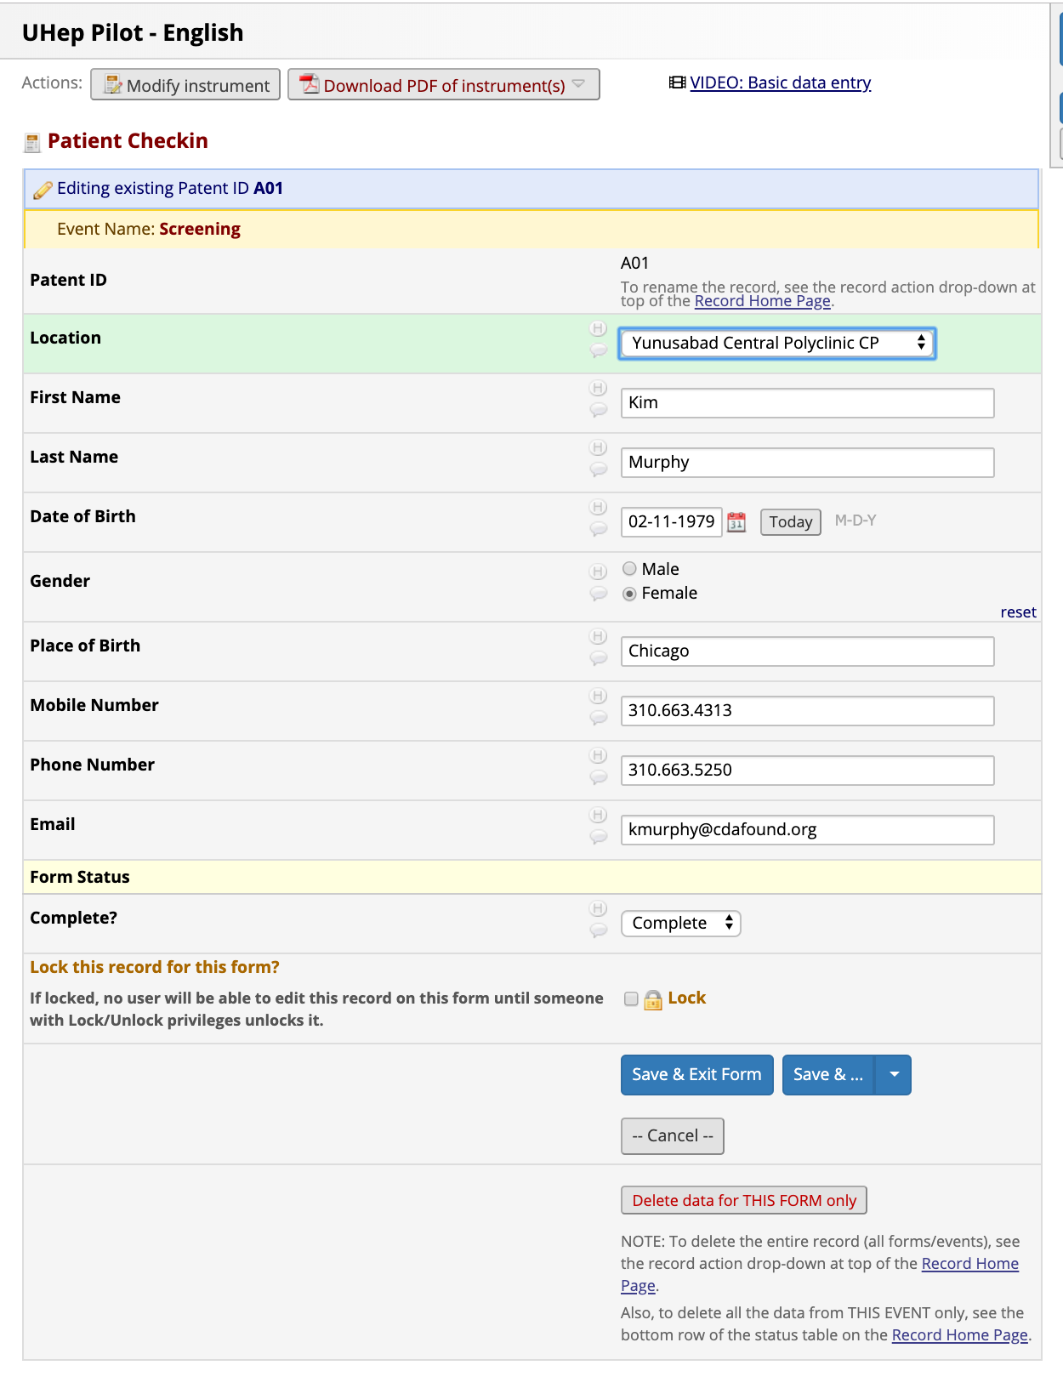
Initially, basic Program Participant information is provided

Slide 15
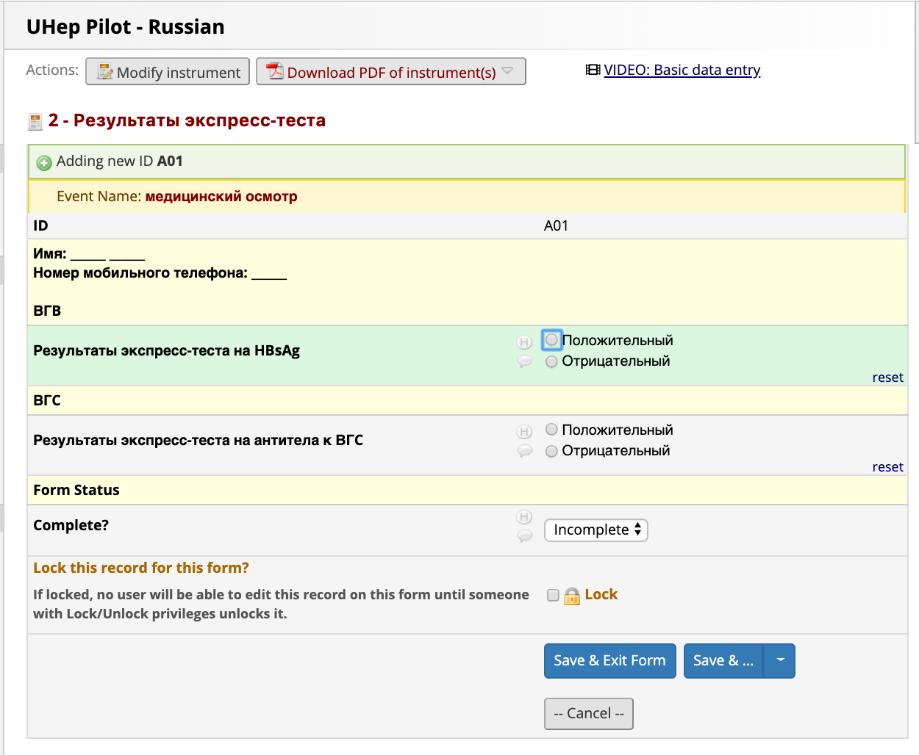
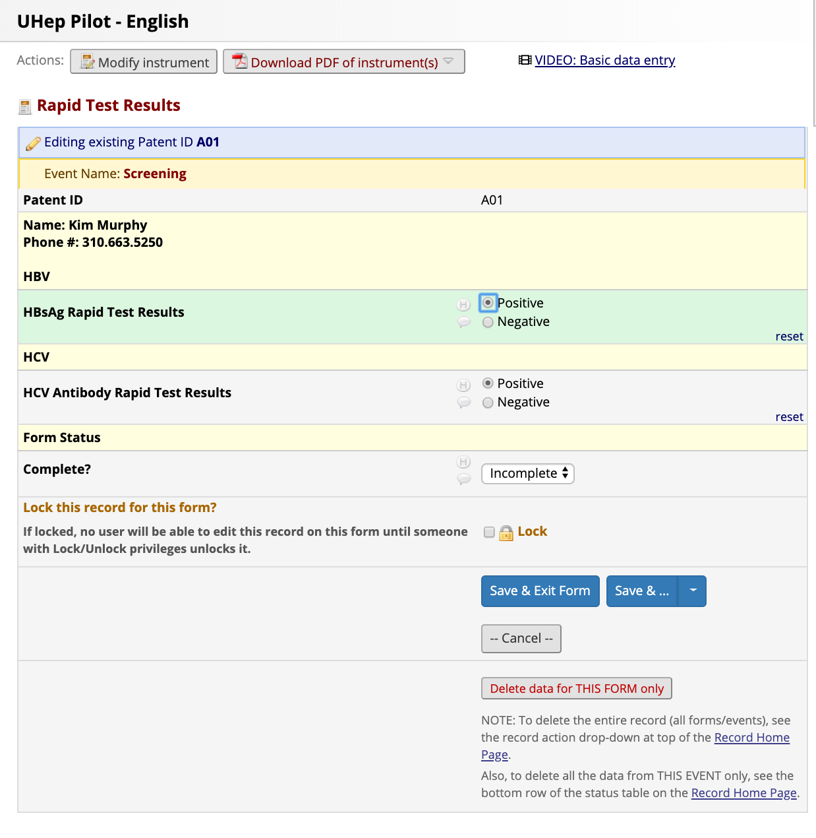
Then the Patient is screened using a Rapid Test and the results of that test are recorded by a Technician

Slide 16
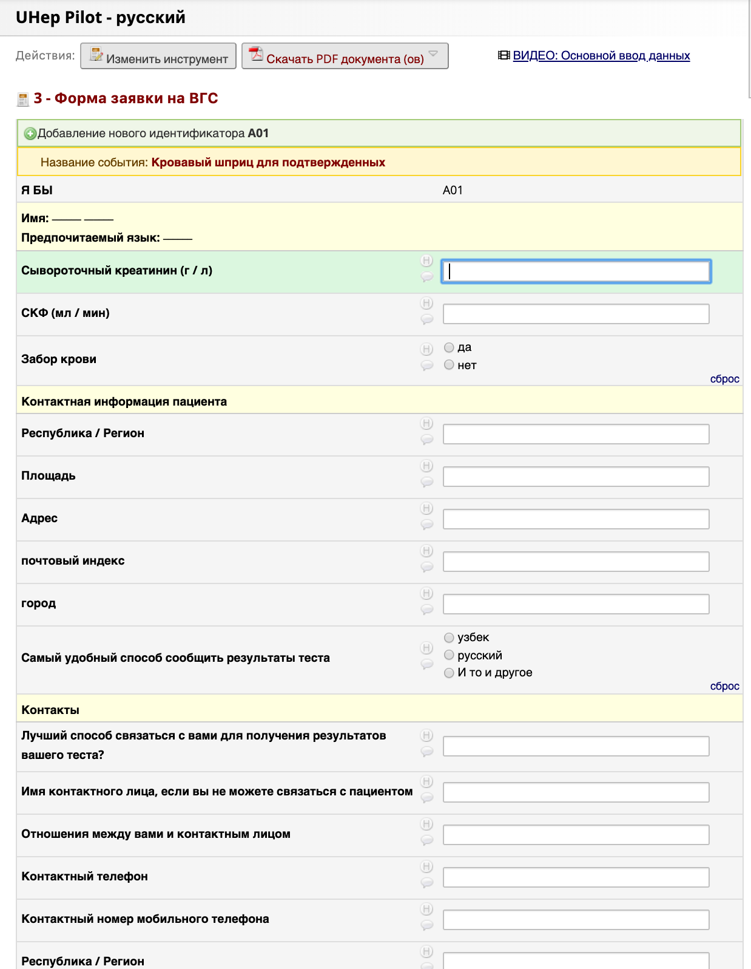
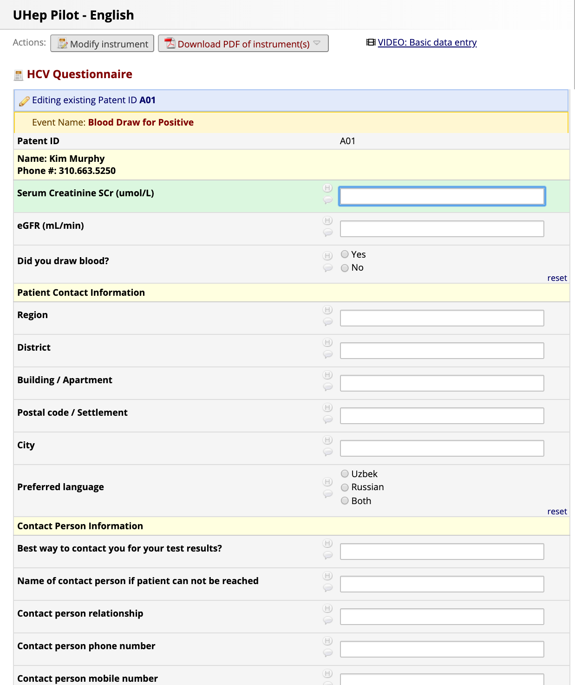
If the a Patient screens Positive for the HCV Rapid Test, they will be referred to have blood drawn and complete a questionnaire

Slide 17
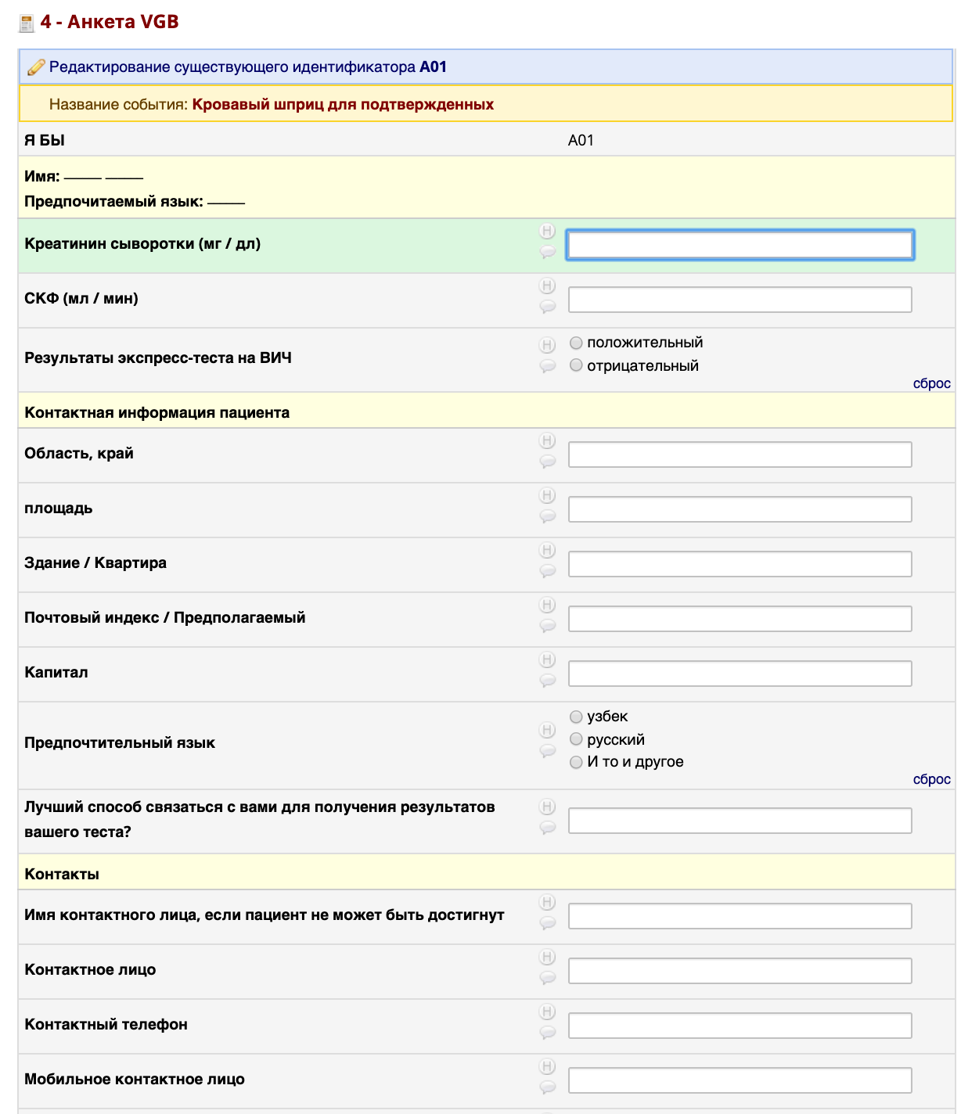
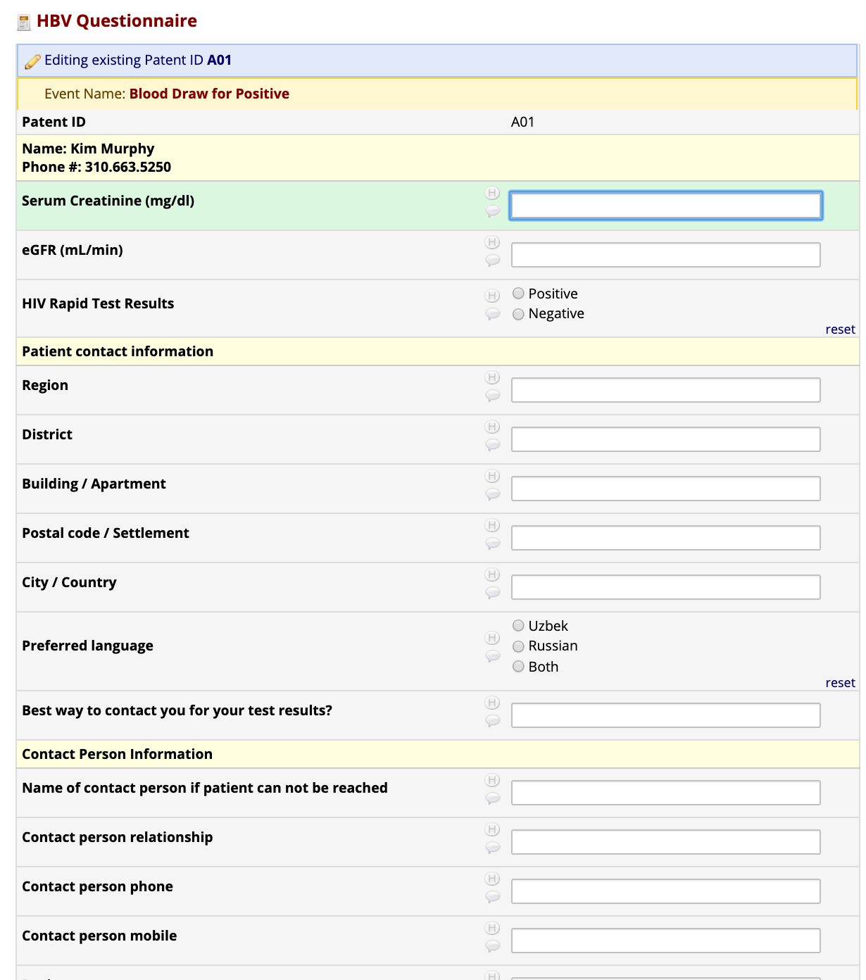
There is a separate form if the patient screens Positive for HBV

Slide 18
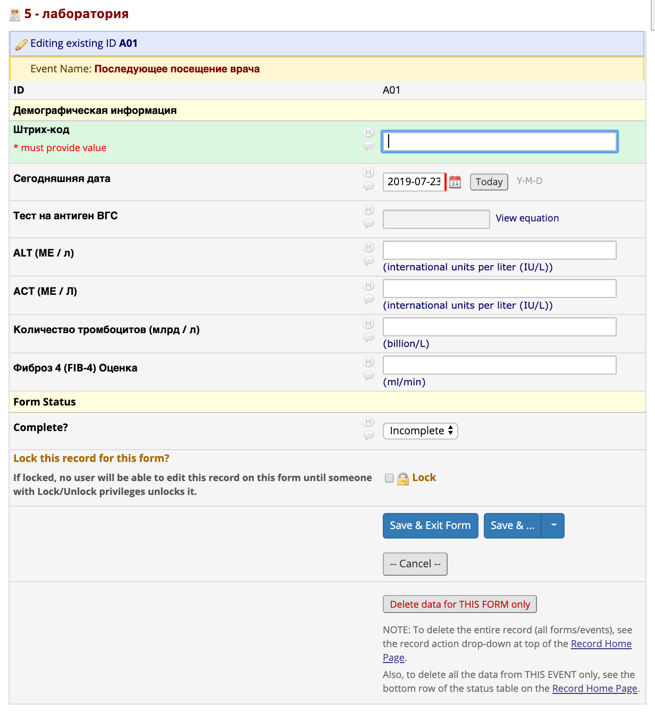
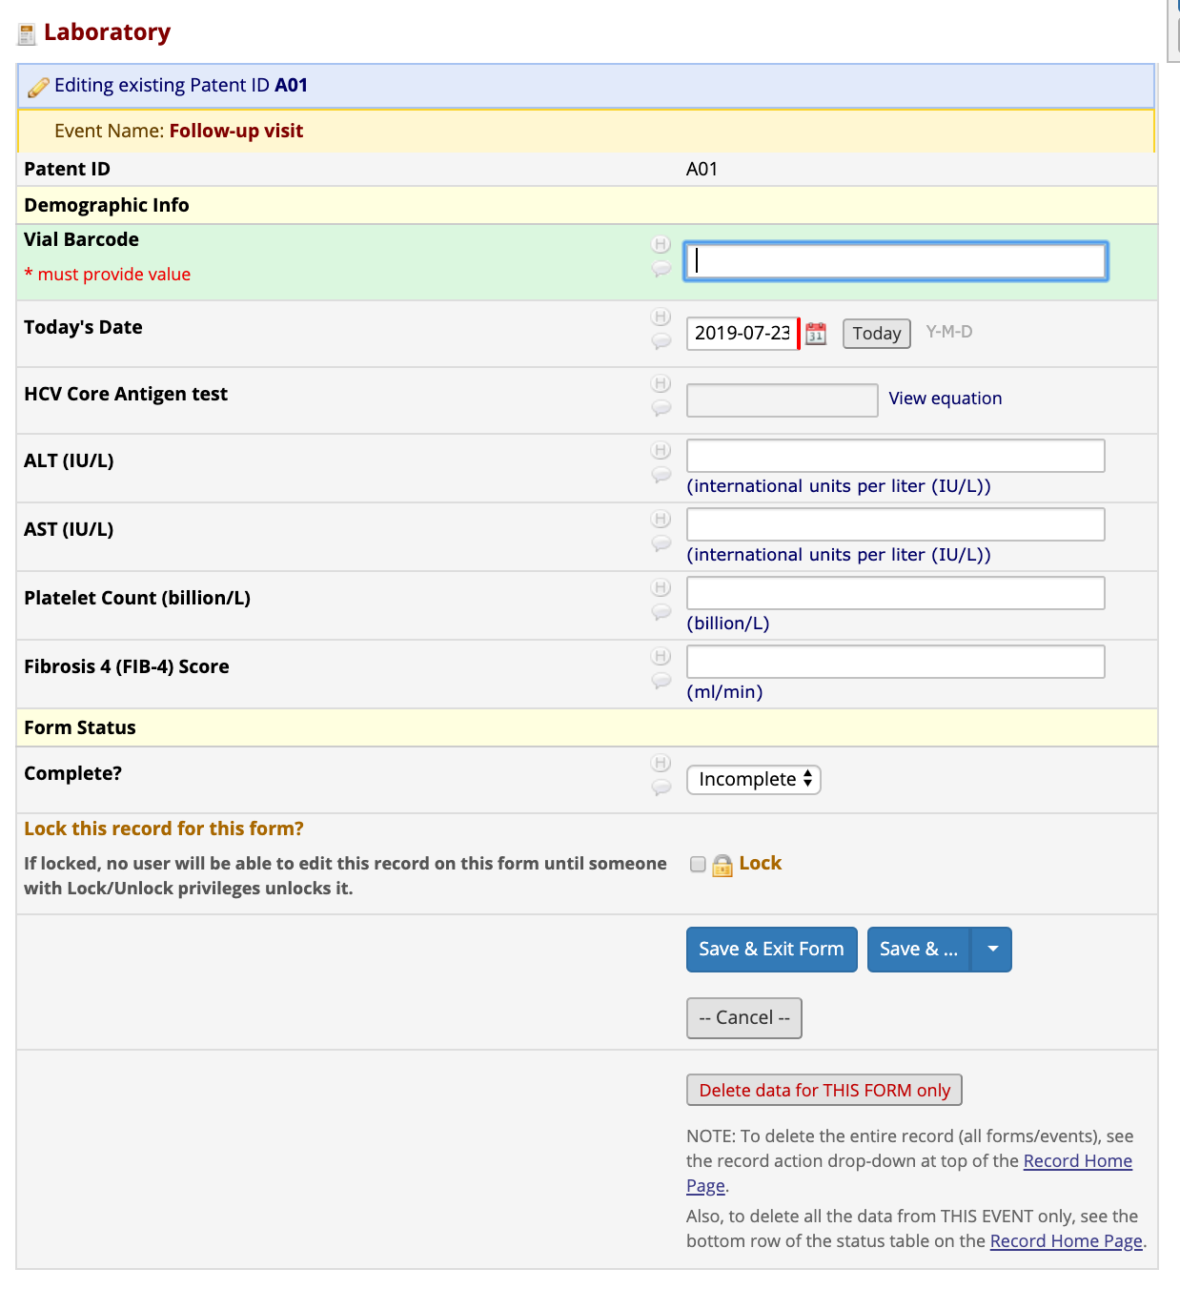
The Lab Technician receives the Barcoded Blood sample and analyzes it. They will enter the results on another form using the barcode to find the appropriate record to catalog the labs

Slide 19
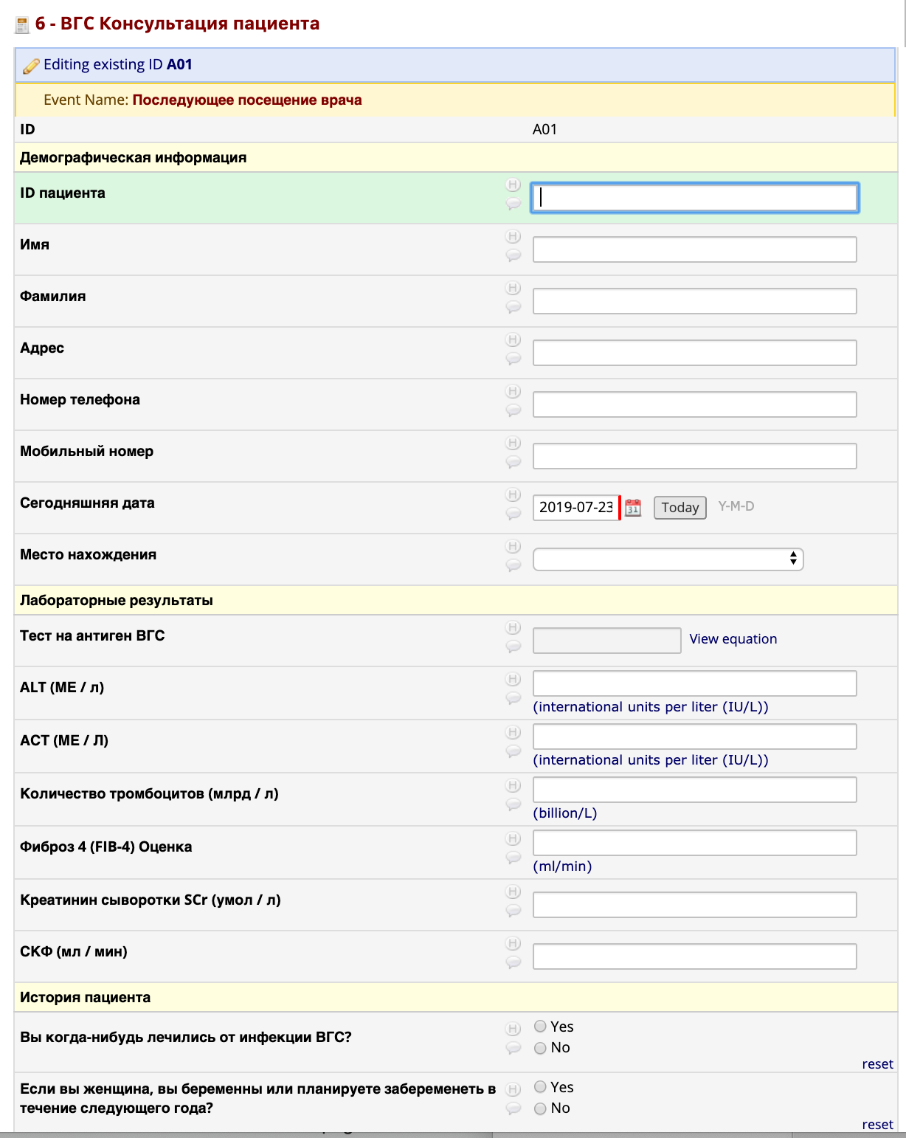
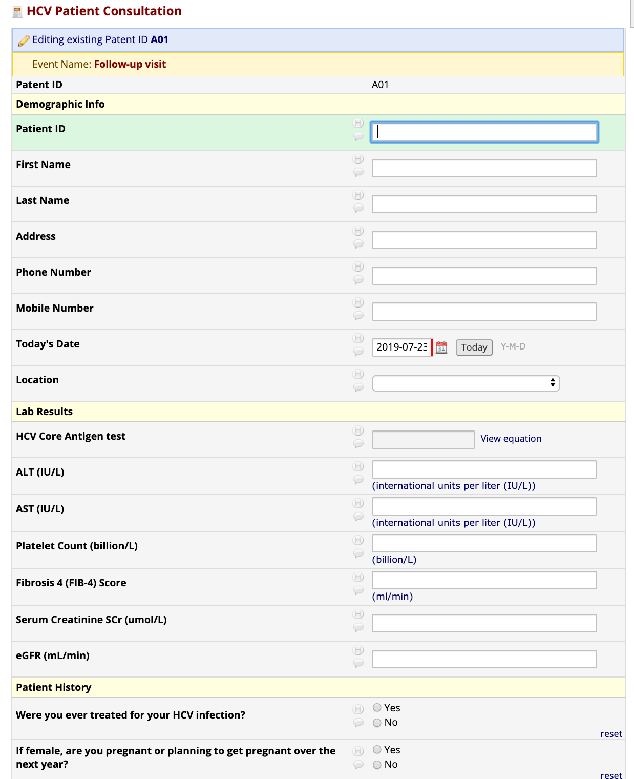
When a Patient who tested Positive arrives for their visit and blood results, they complete a follow-up Consultation for HCV

Slide 20
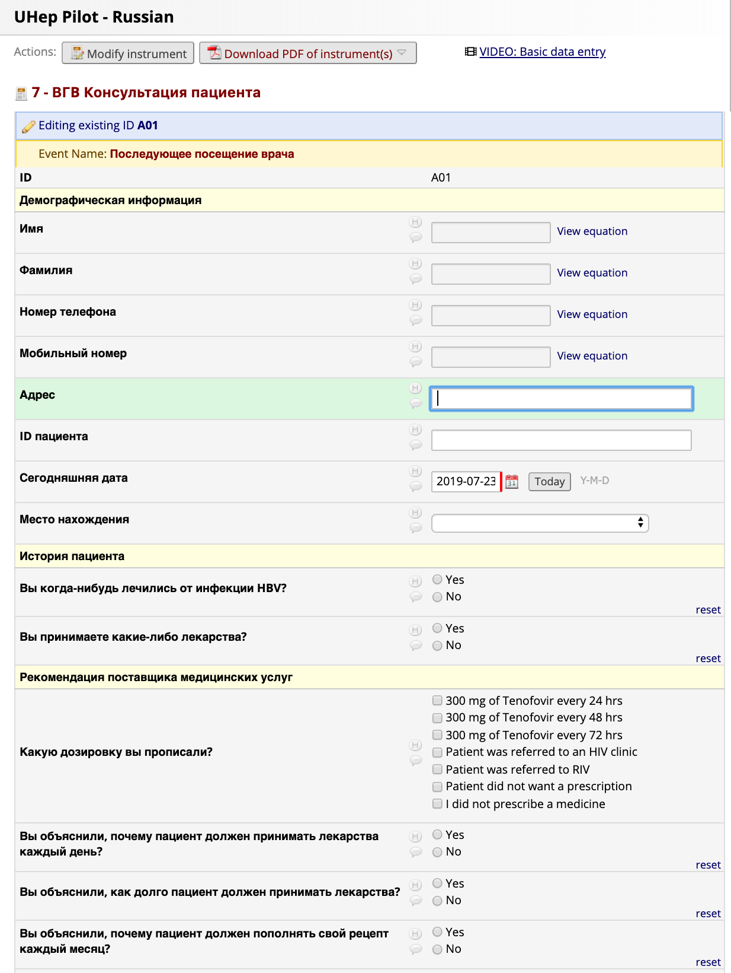
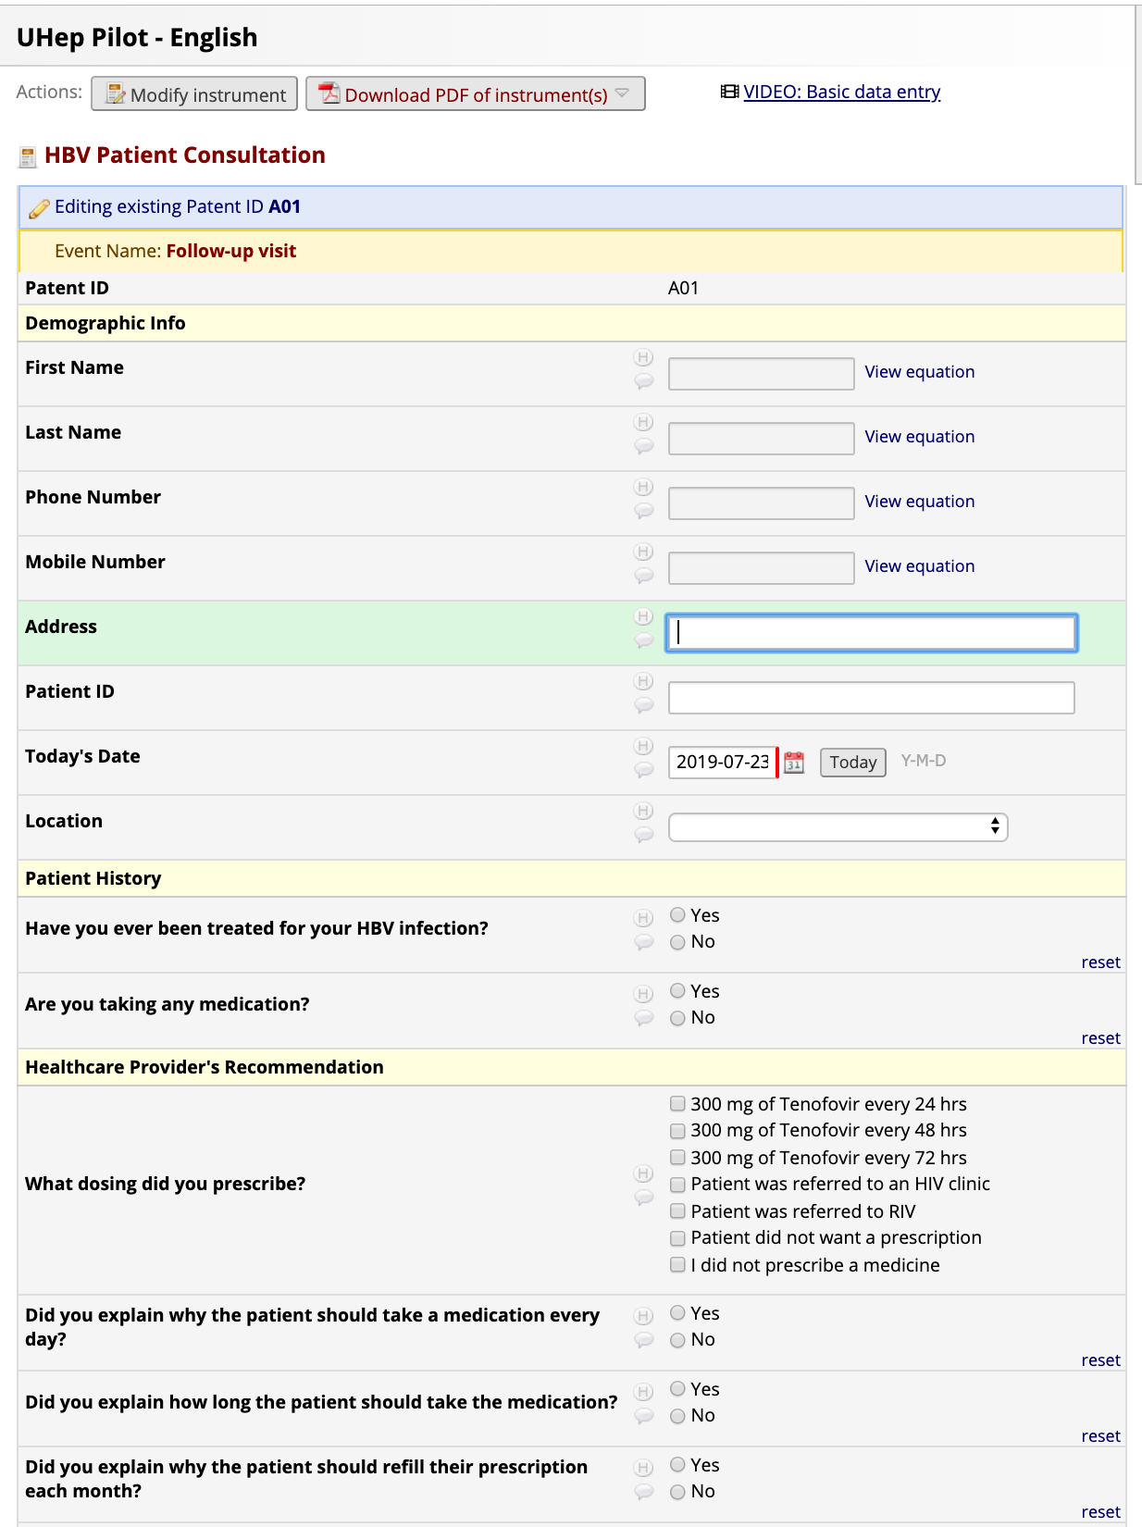
There is a separate form completed for Patients during the HBV follow-up Consultation

Slide 21
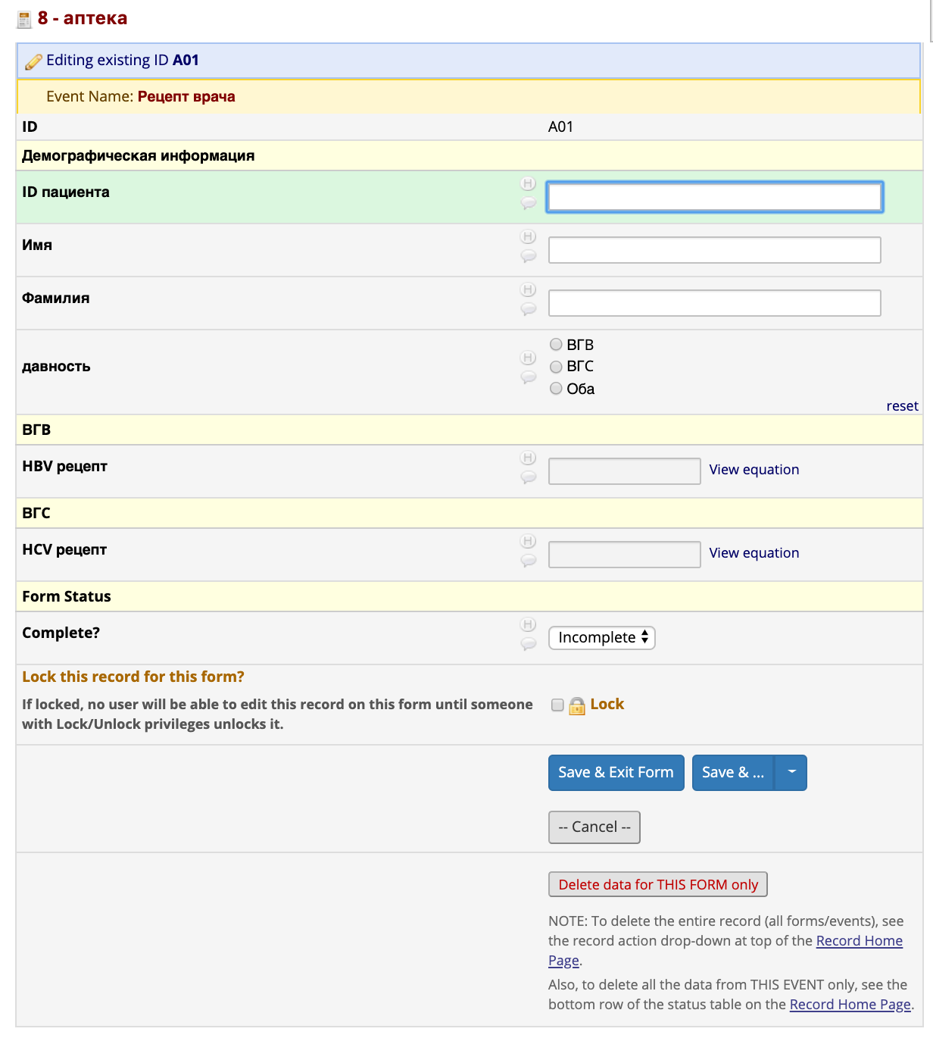
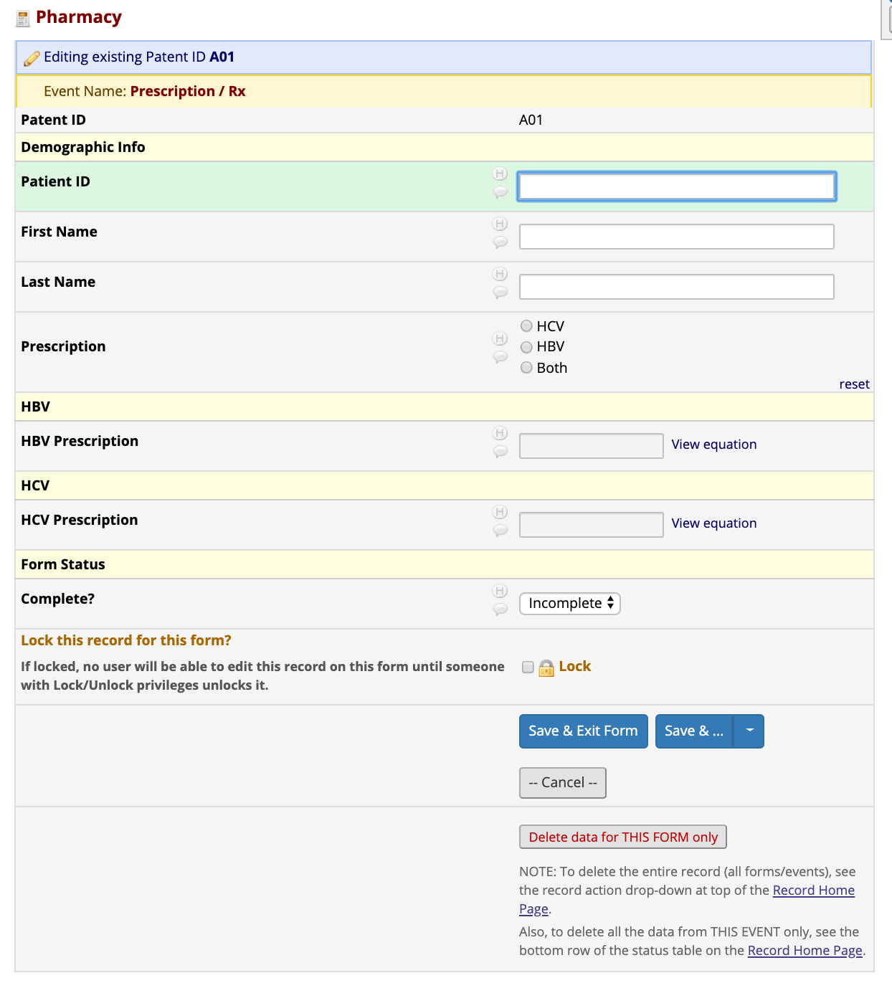
The Consultation includes information regarding a Patient’s Prescription
That information ties to a patient’s barcode so the Pharmacy is able to determine and correctly administer the appropriate therapies

Slide 22
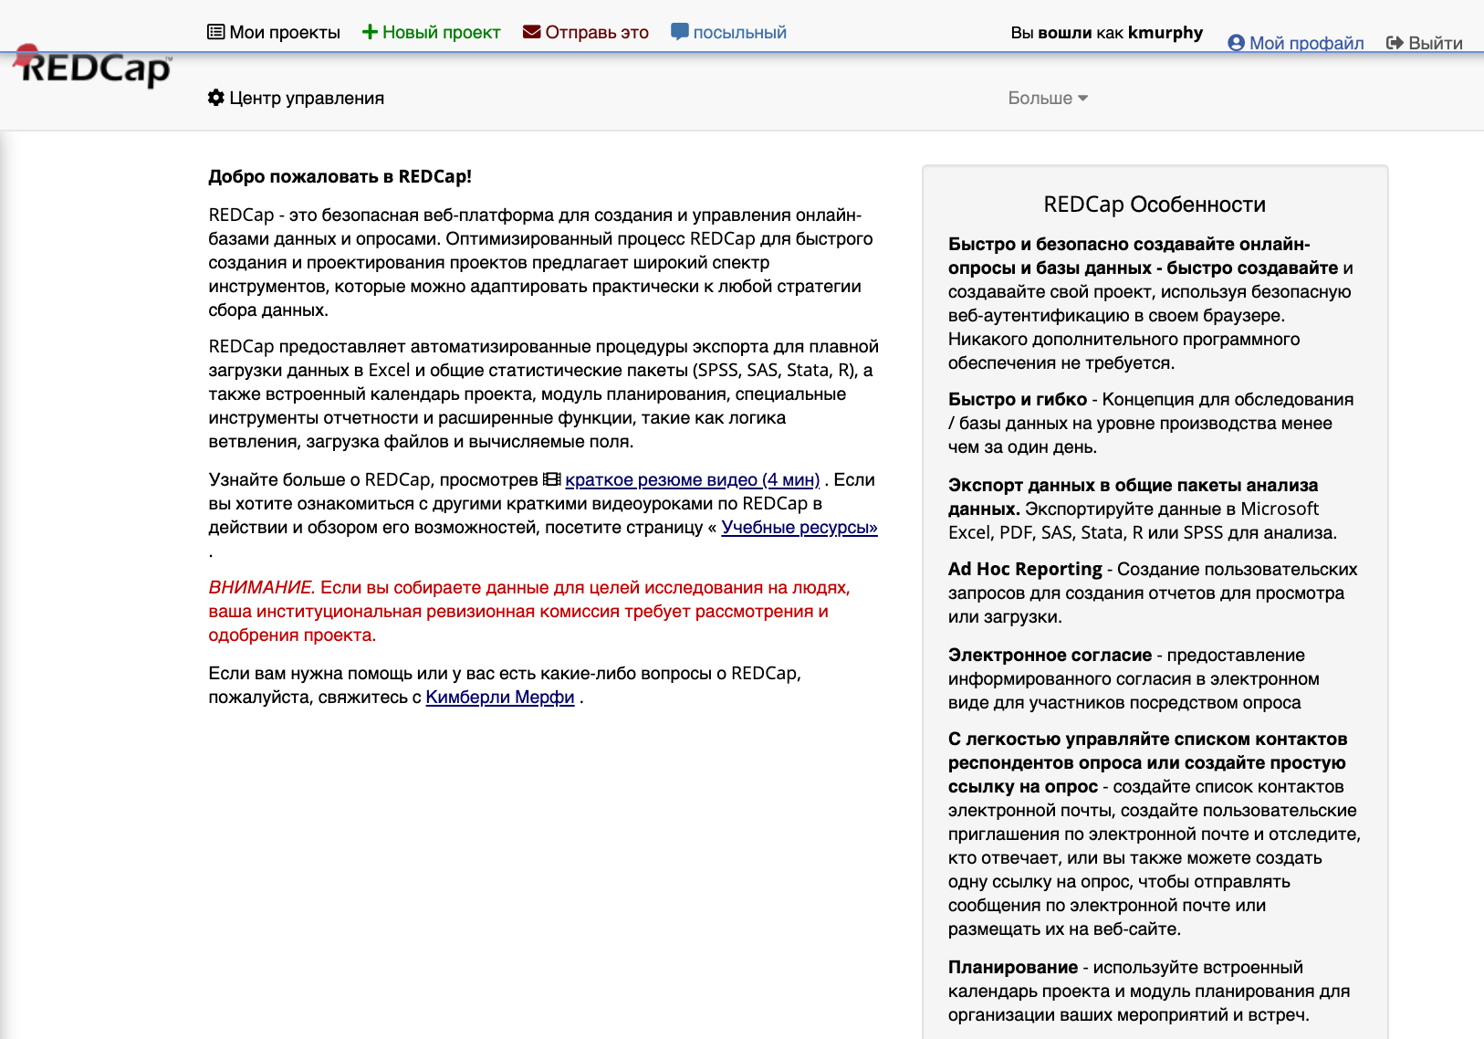
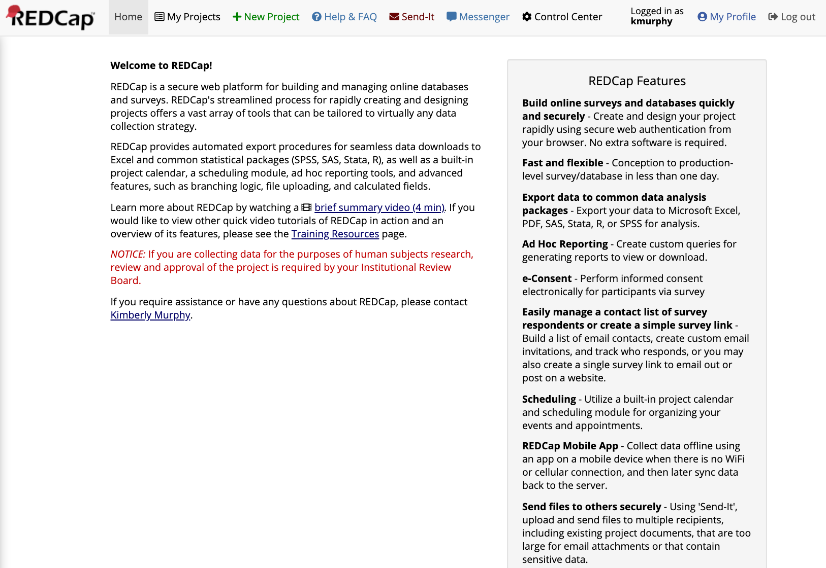
After a period of inactivity, a User is logged-out by REDCap
It is advisable to return to the REDCap Home and log-out for security purposes when finished entering a series of Patient data

Slide 23
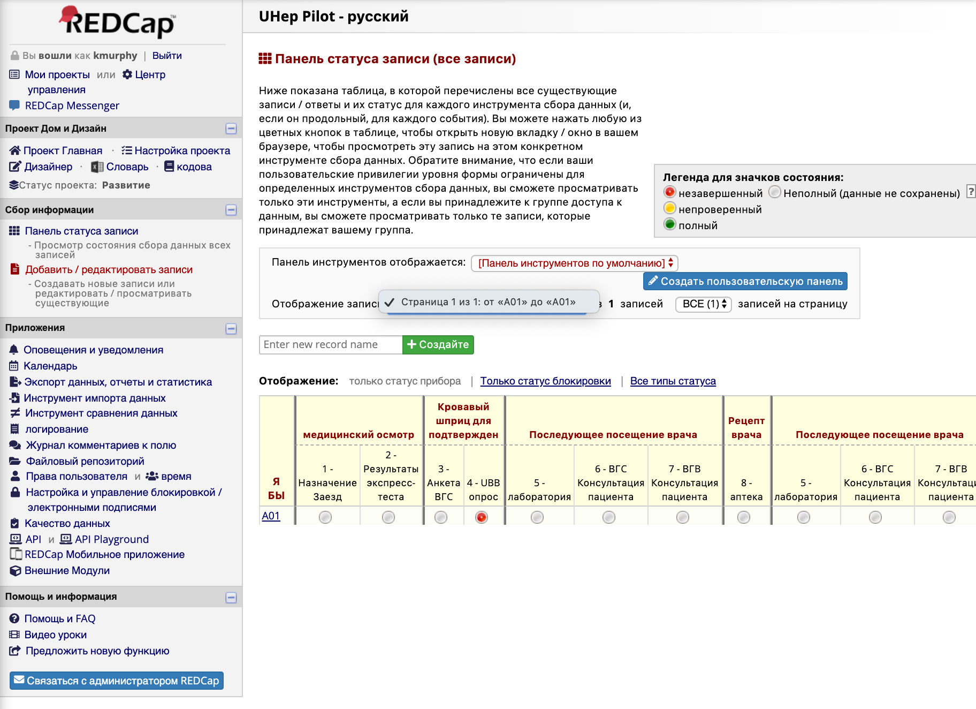
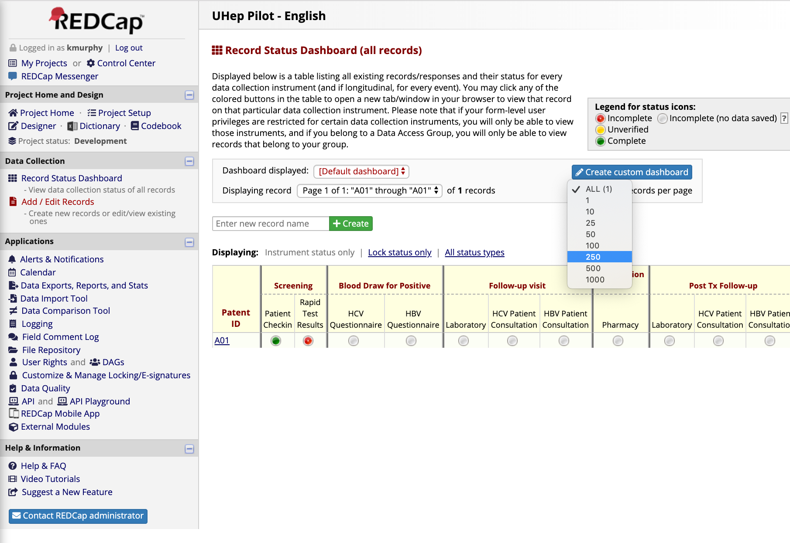
Doctor’s are able to monitor/access Patient Progress through the Record Status Dashboard or in the Reporting Applications which provide additional tools for reviewing the Patient population’s overall progress through the Pilot

