Slide 1
REDCap Move Field

Slide 2
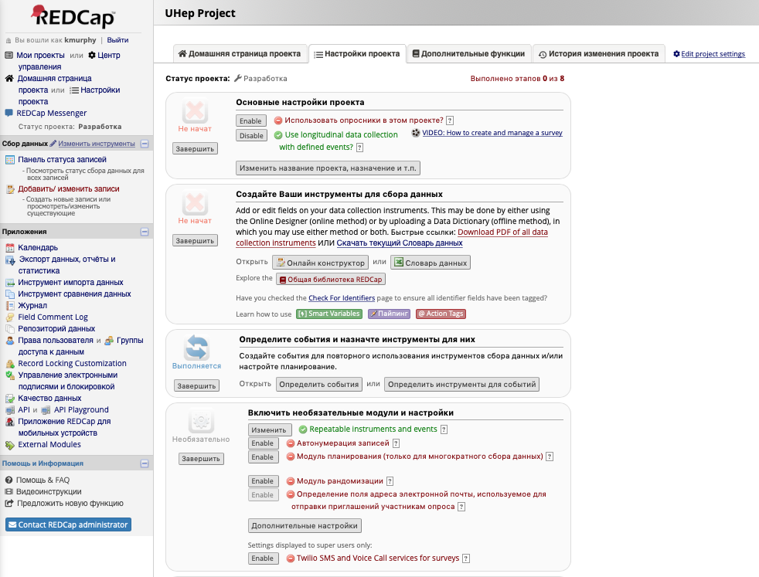
Open the Project and select Изменить инструменты

Slide 3
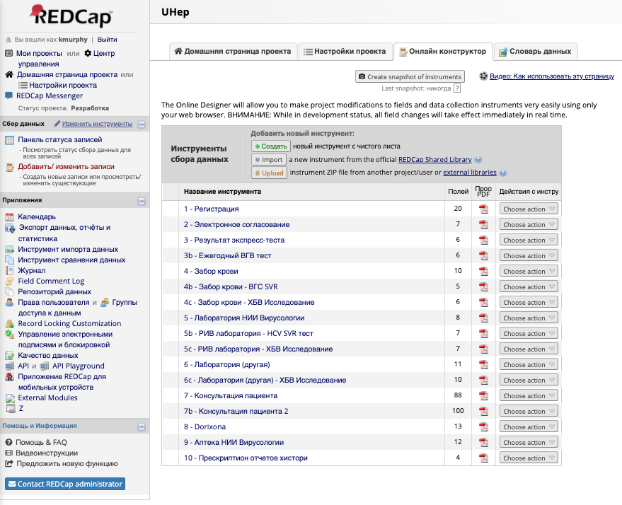
Select the 1st instrument

Slide 4
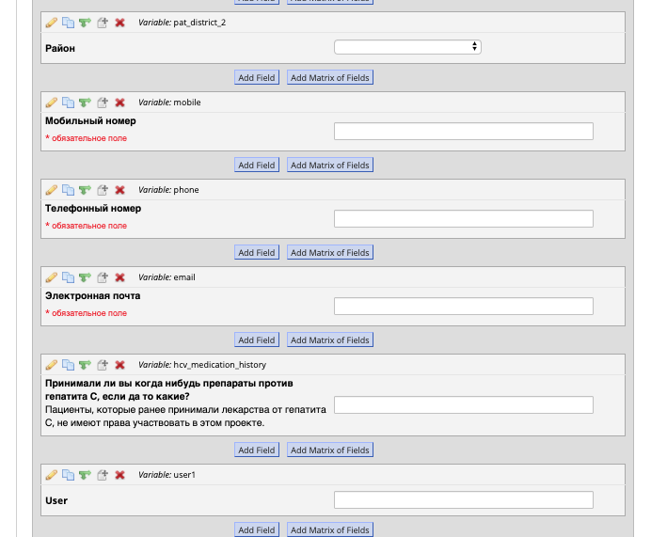
Scroll down to the variable “hcv_medication_history” and select the move button

Slide 5
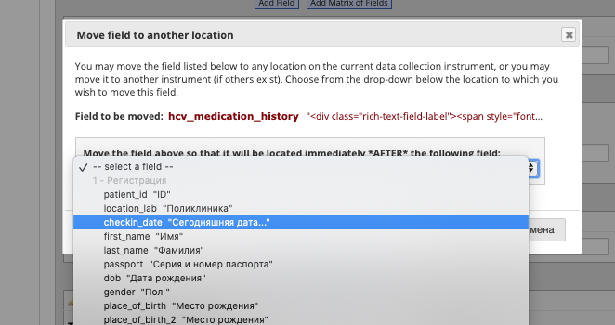
Please it to follow the checkin_date field

Slide 6
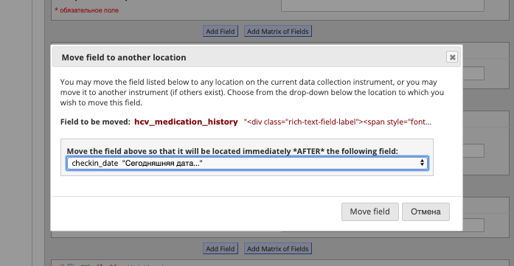
Hit “Move field” to complete the behavior

Slide 7
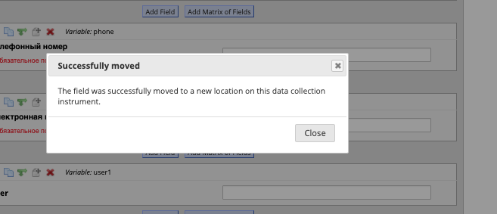
You should receive confirmation that the field was successfully moved

Slide 8
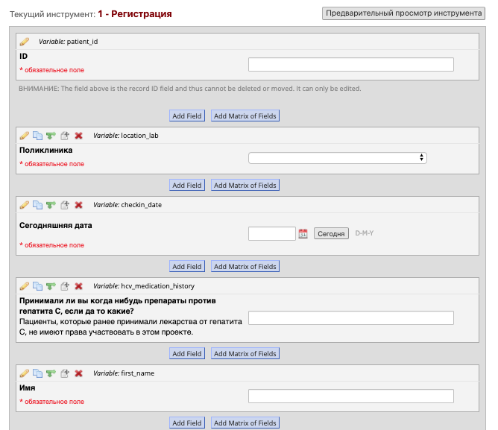
Verify it has been correctly placed below checkin_date

