Slide 1
REDCap Installation –
Software Set-up

Slide 2
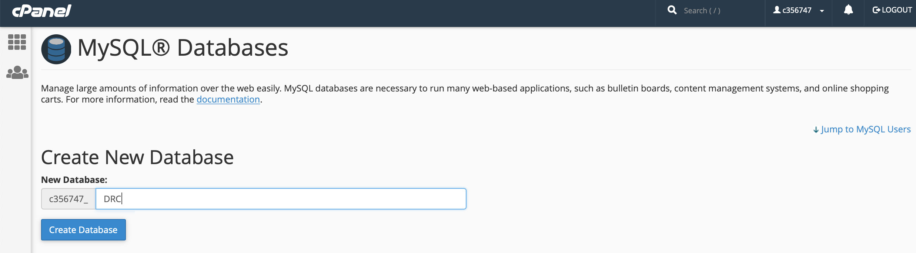
Create a Database for REDCap and add user permissions

Slide 3
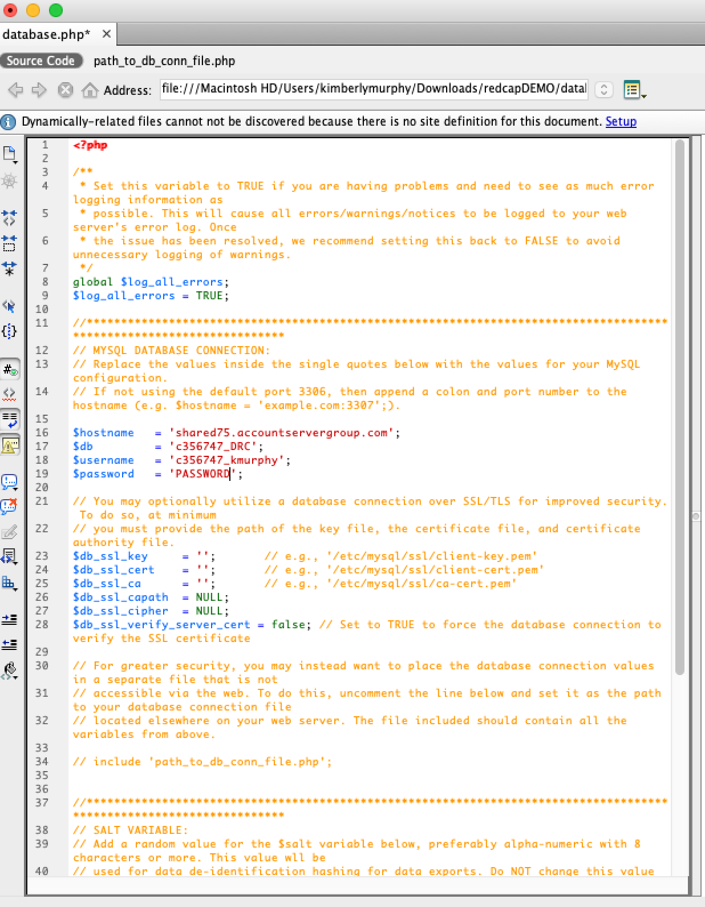
Modify the database.php with the host, DB, username and password and upload

Slide 4
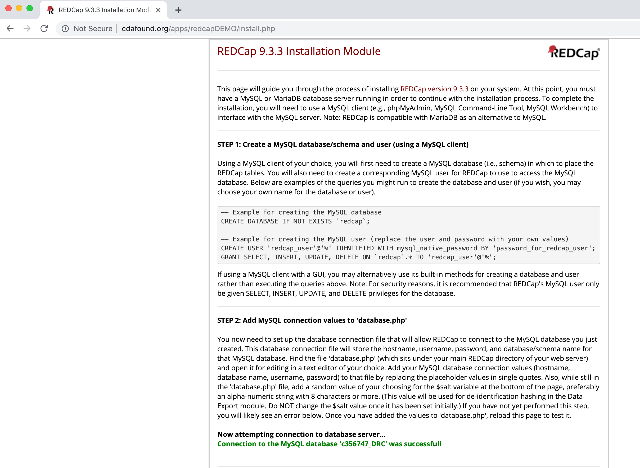
Navigate to the /install.php

Slide 5
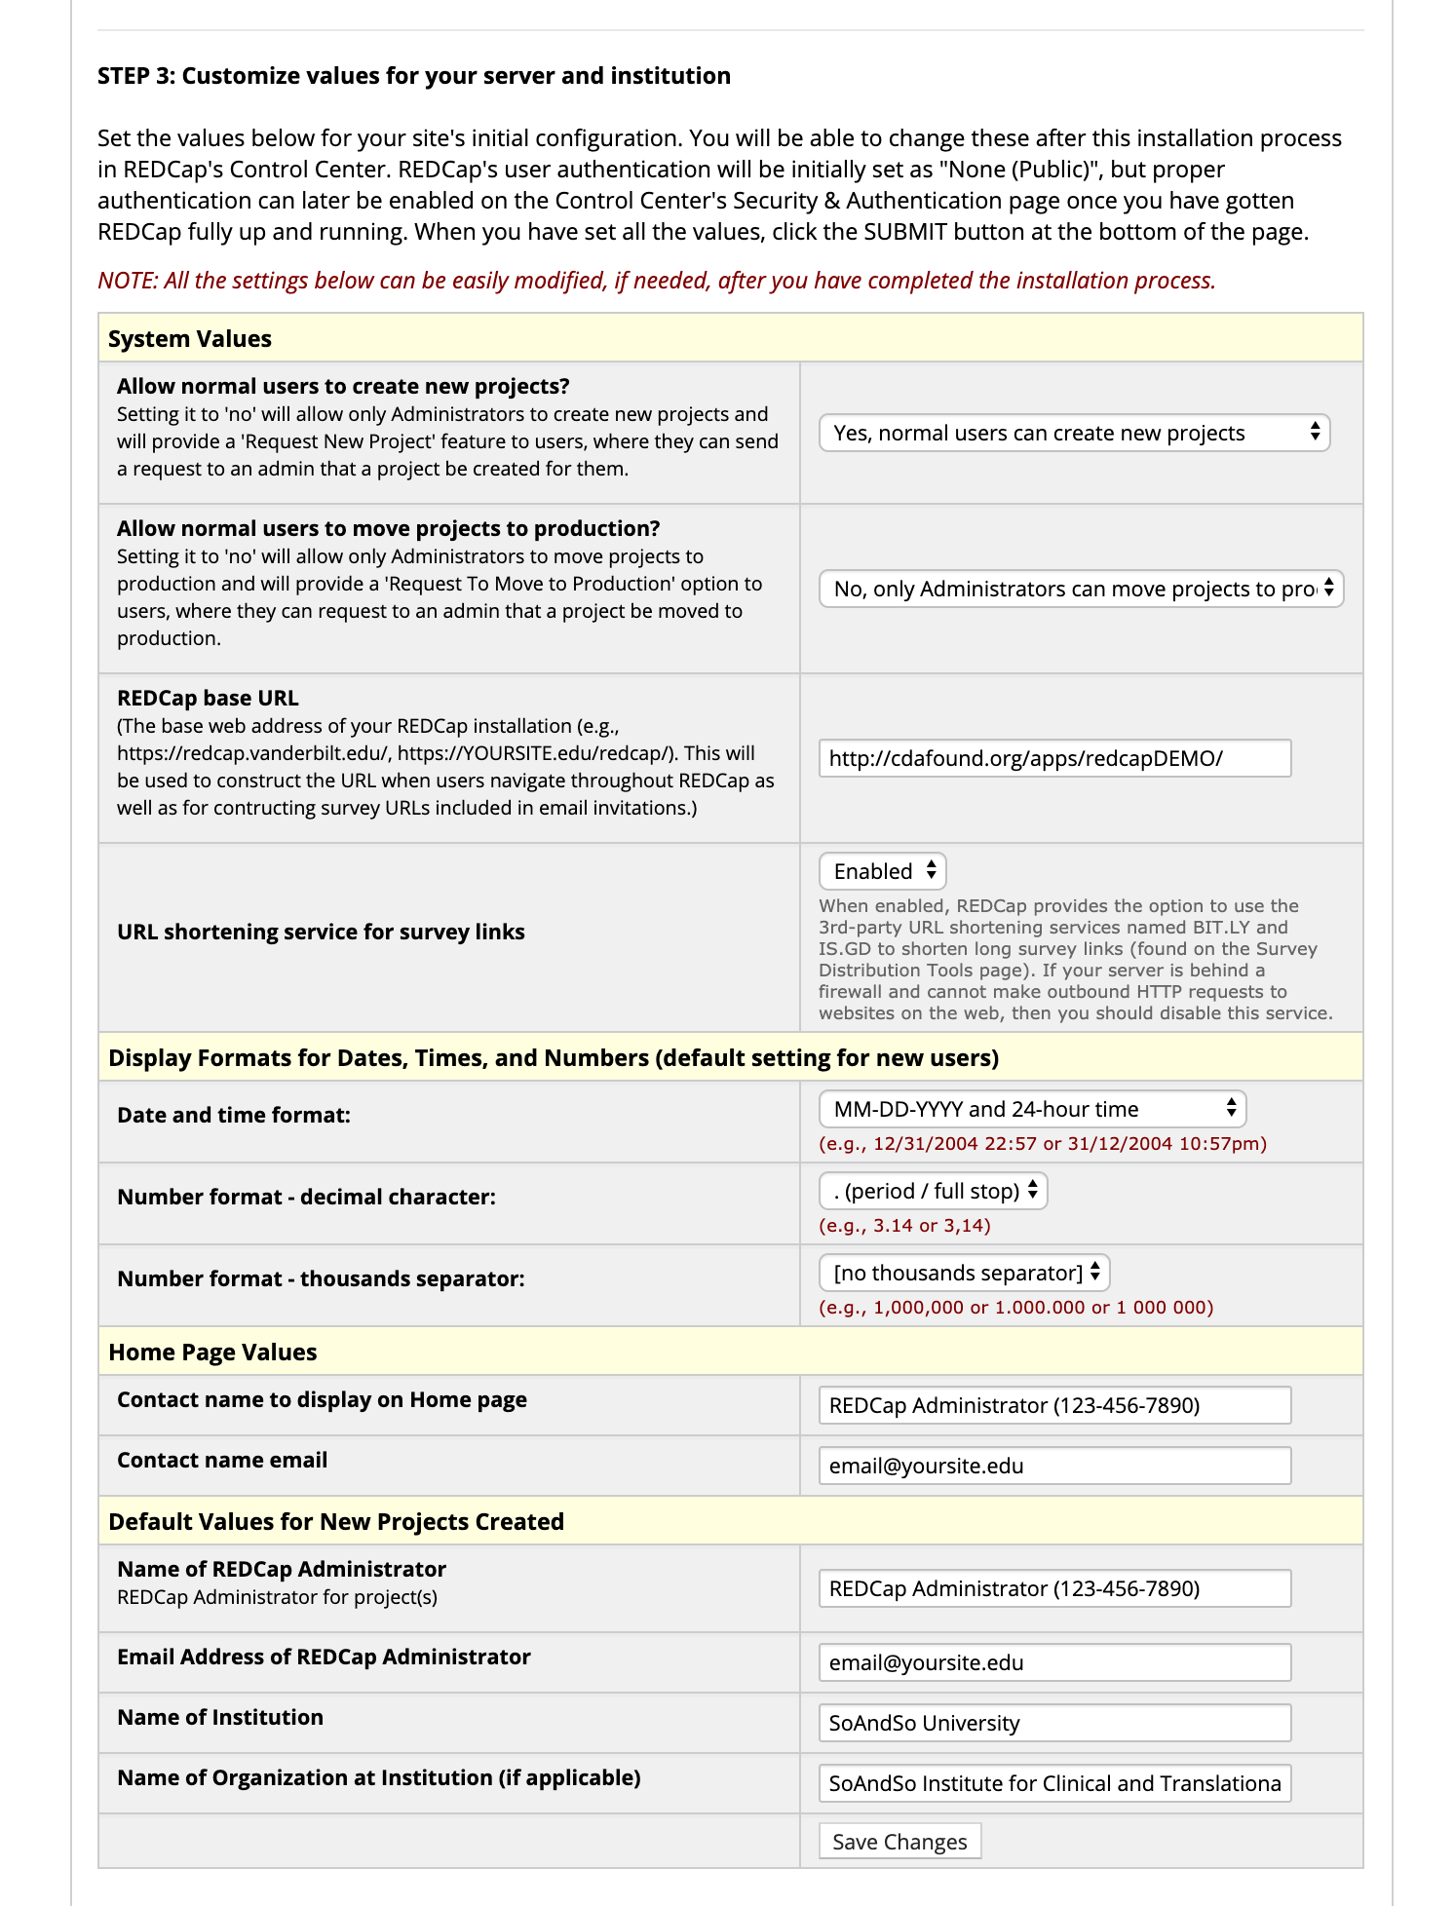
Customize settings

Slide 6
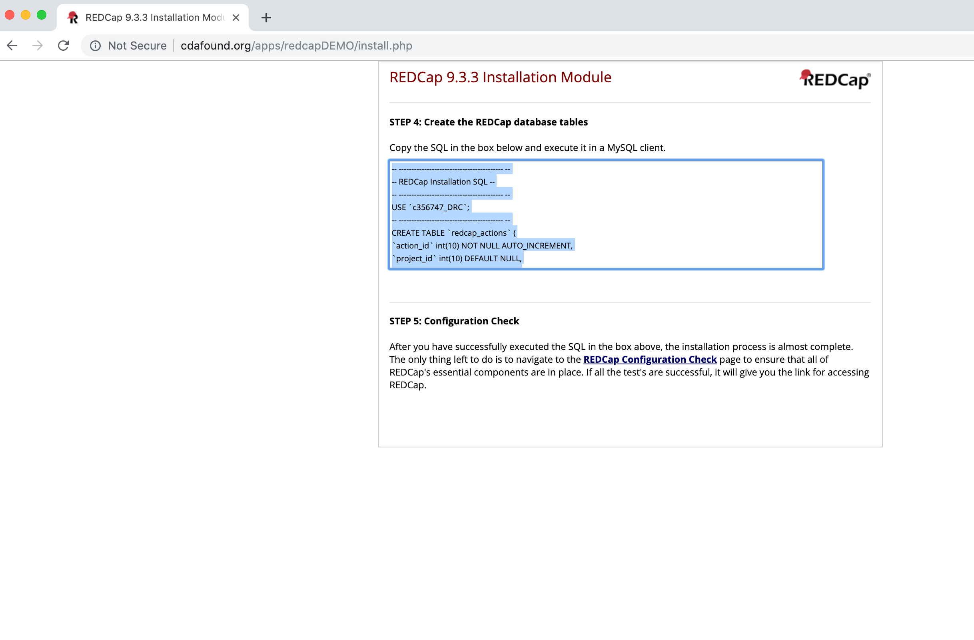
Copy SQL Commands for Creating the Database

Slide 7
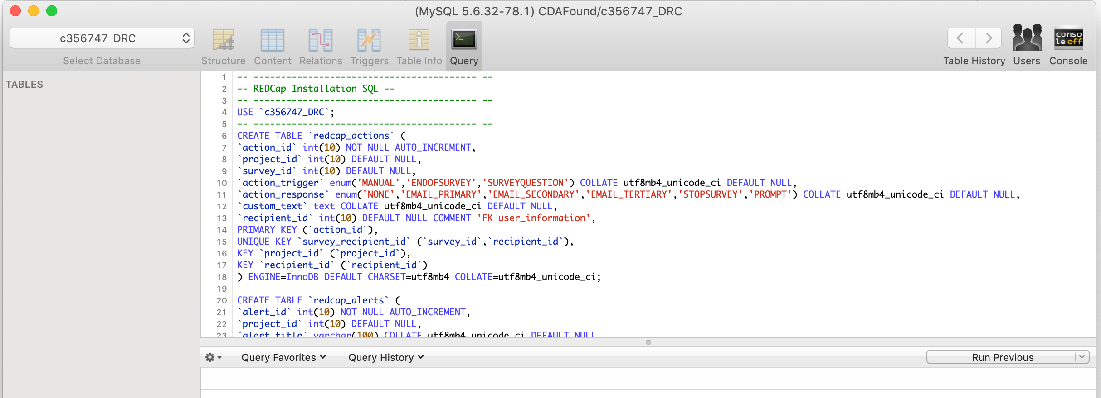
Paste the commands in MySQL

Slide 8
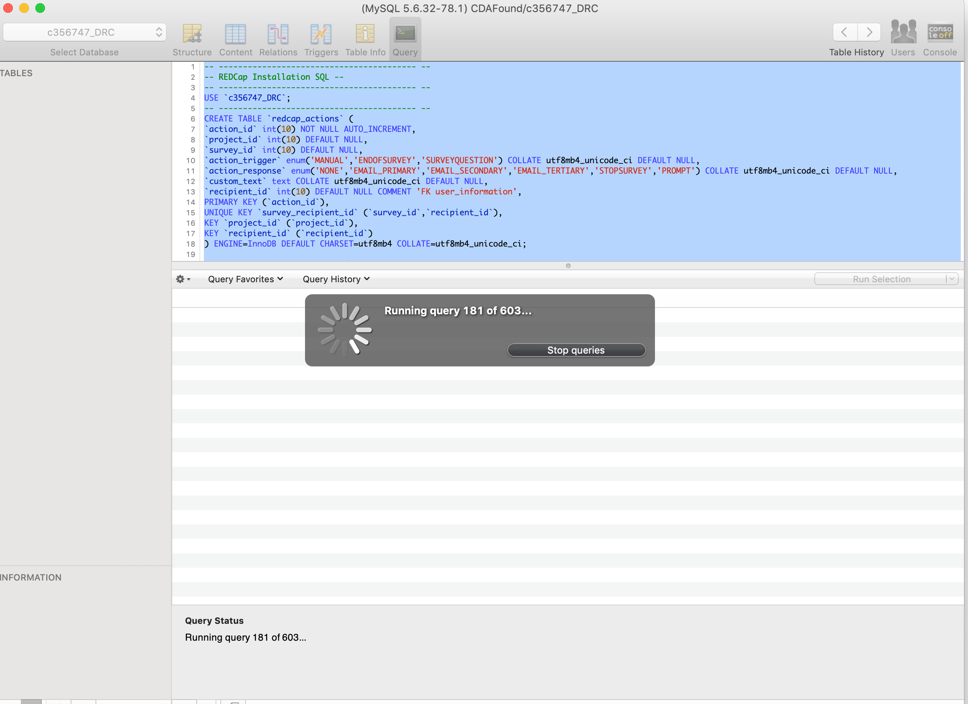
Run the commands

Slide 9
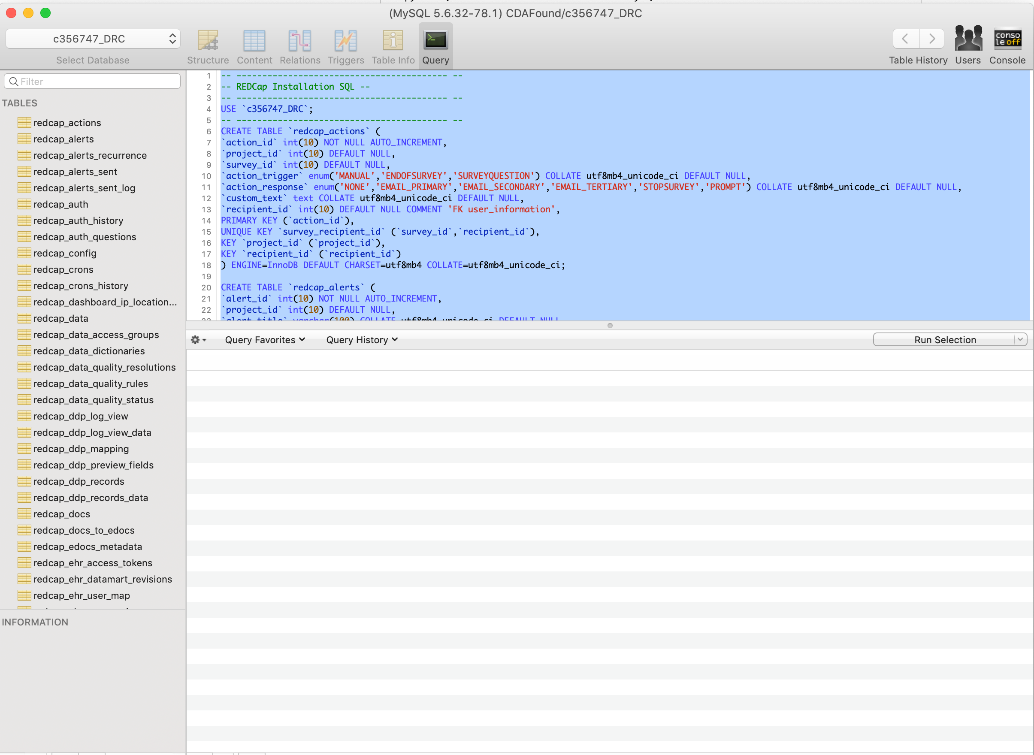
Confirm the table structure has been created

Slide 10
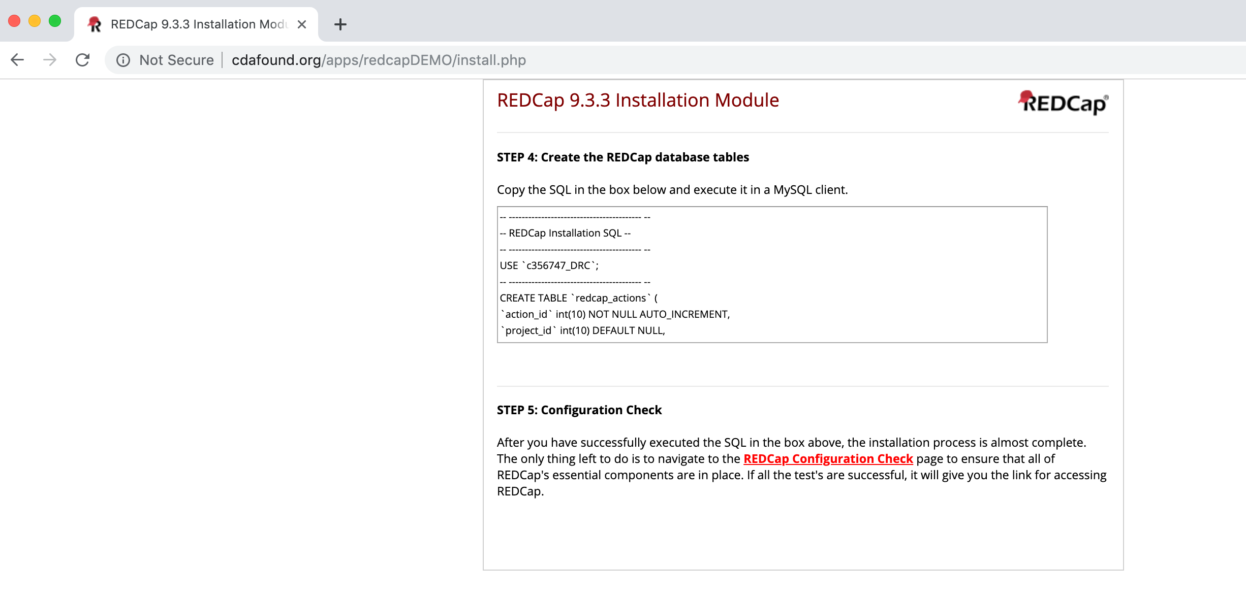
Run the configuration check

Slide 11
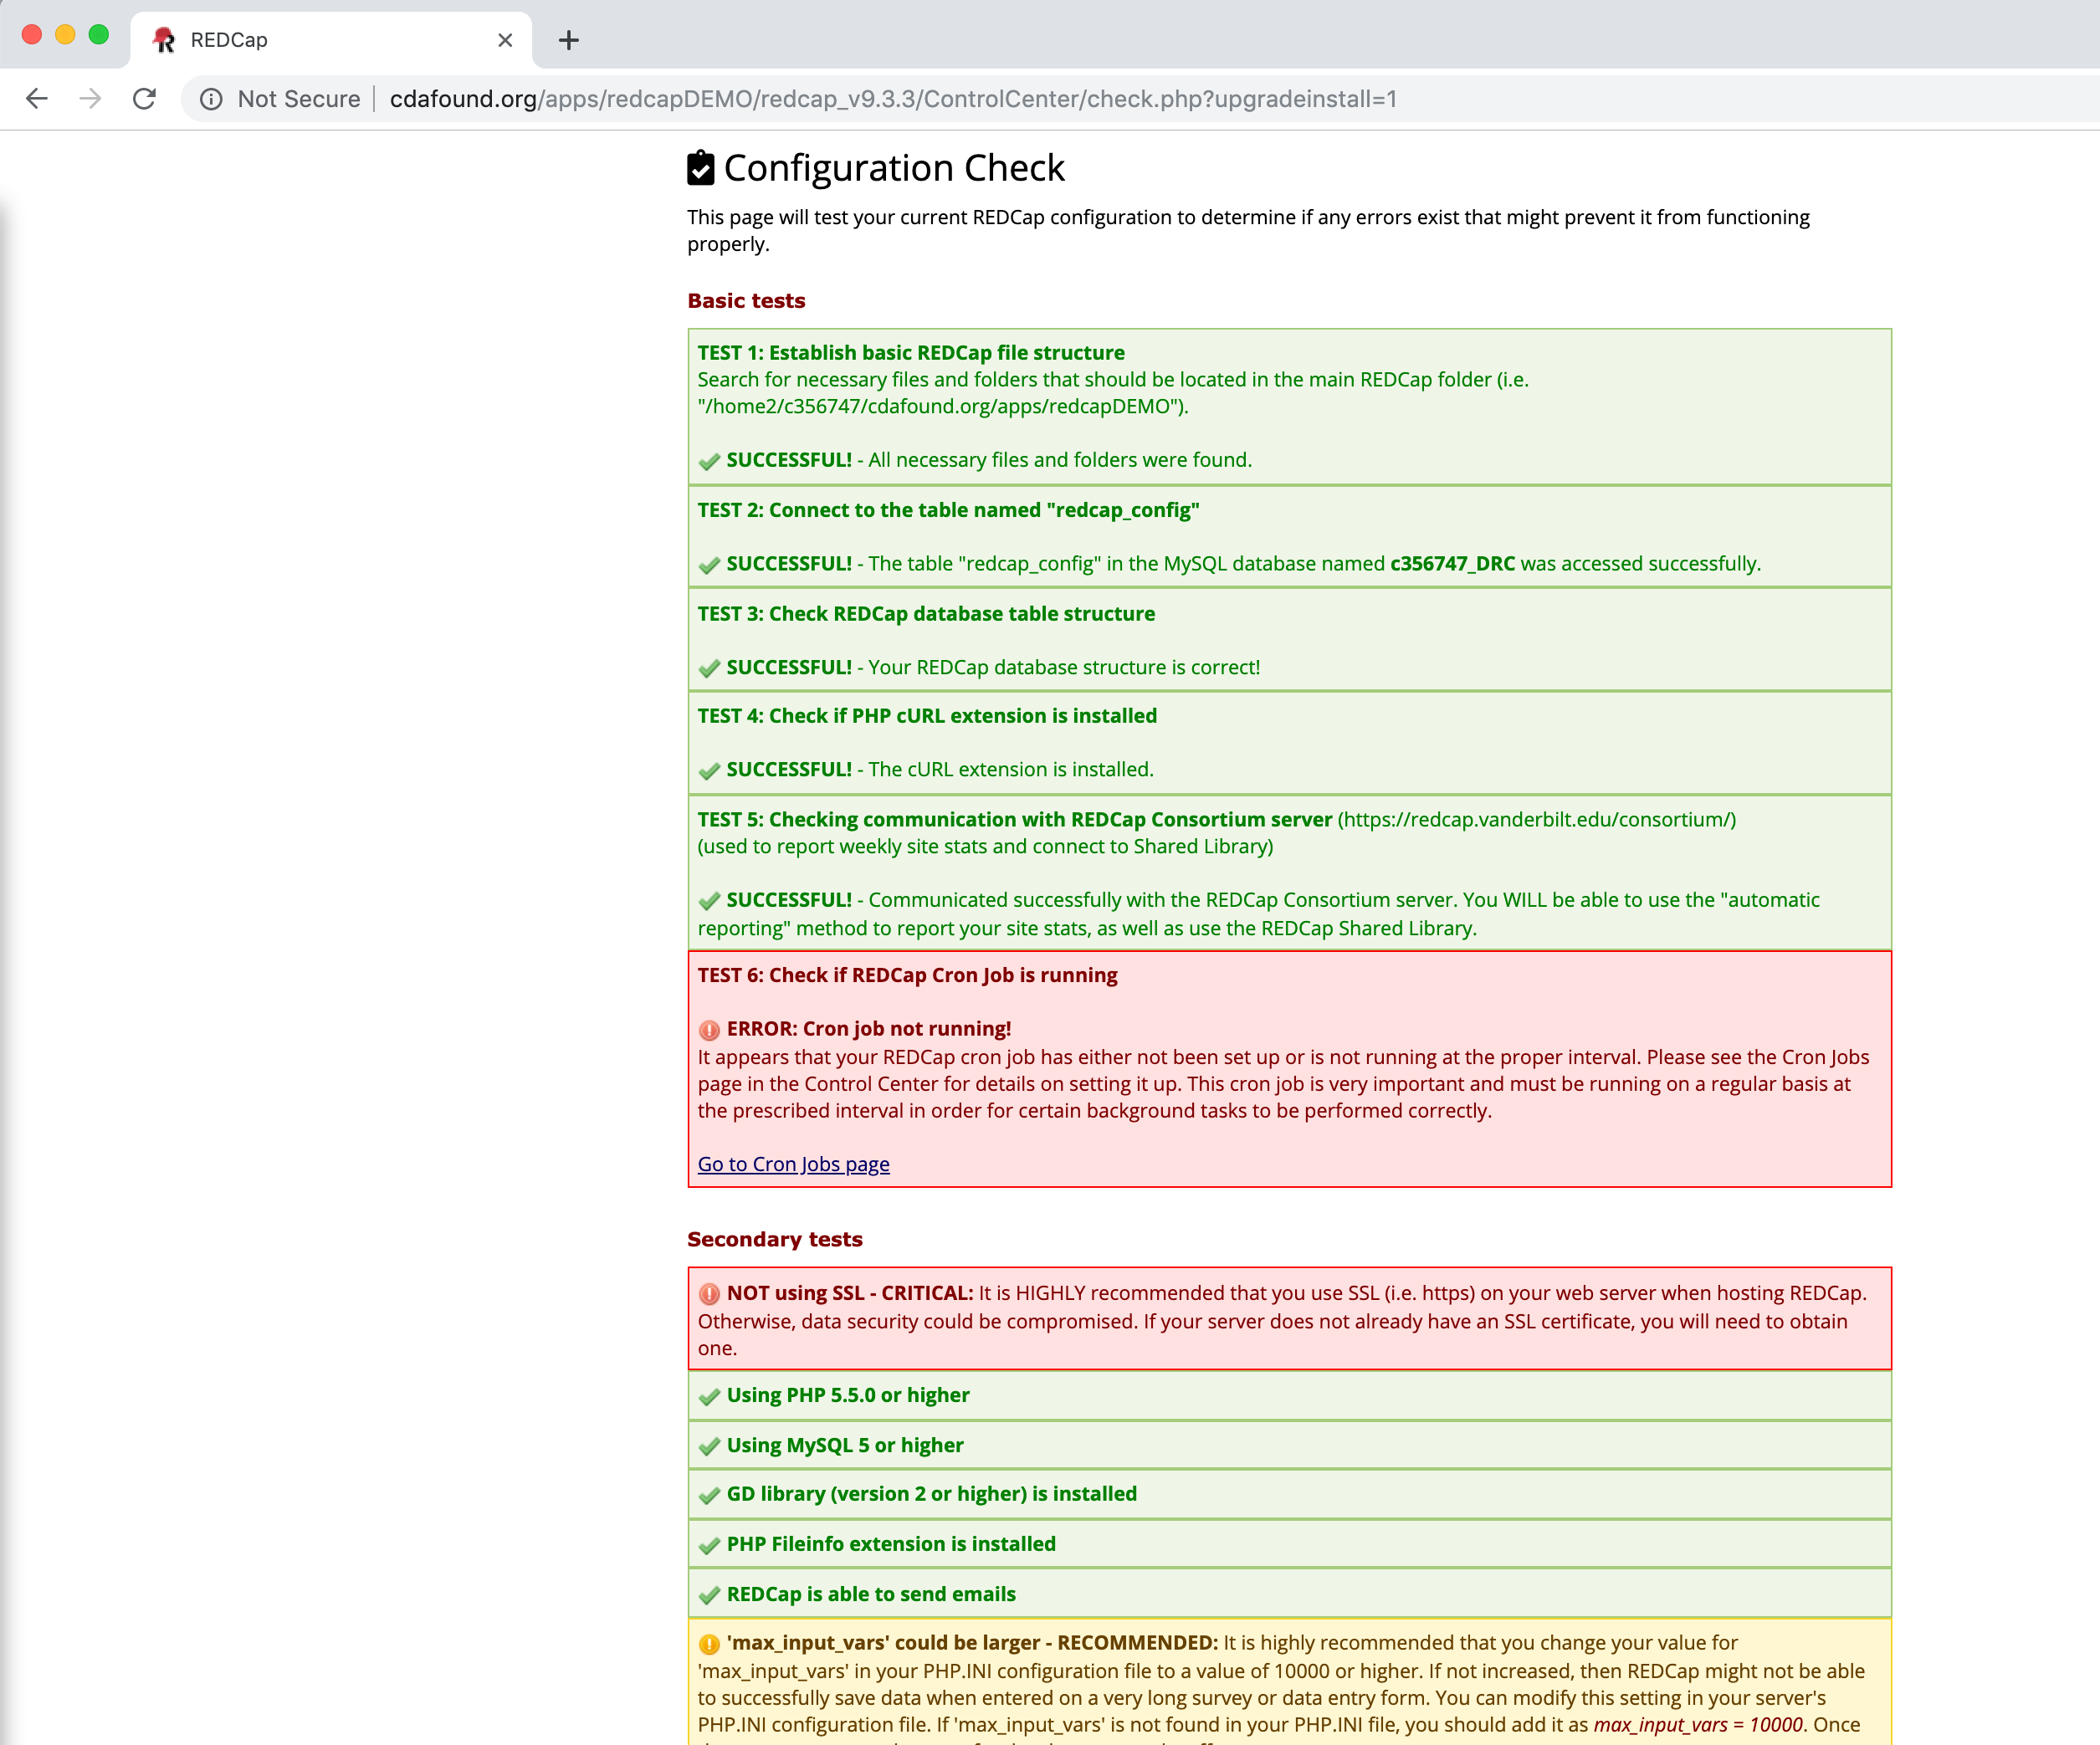
Review the Configuration

Slide 12
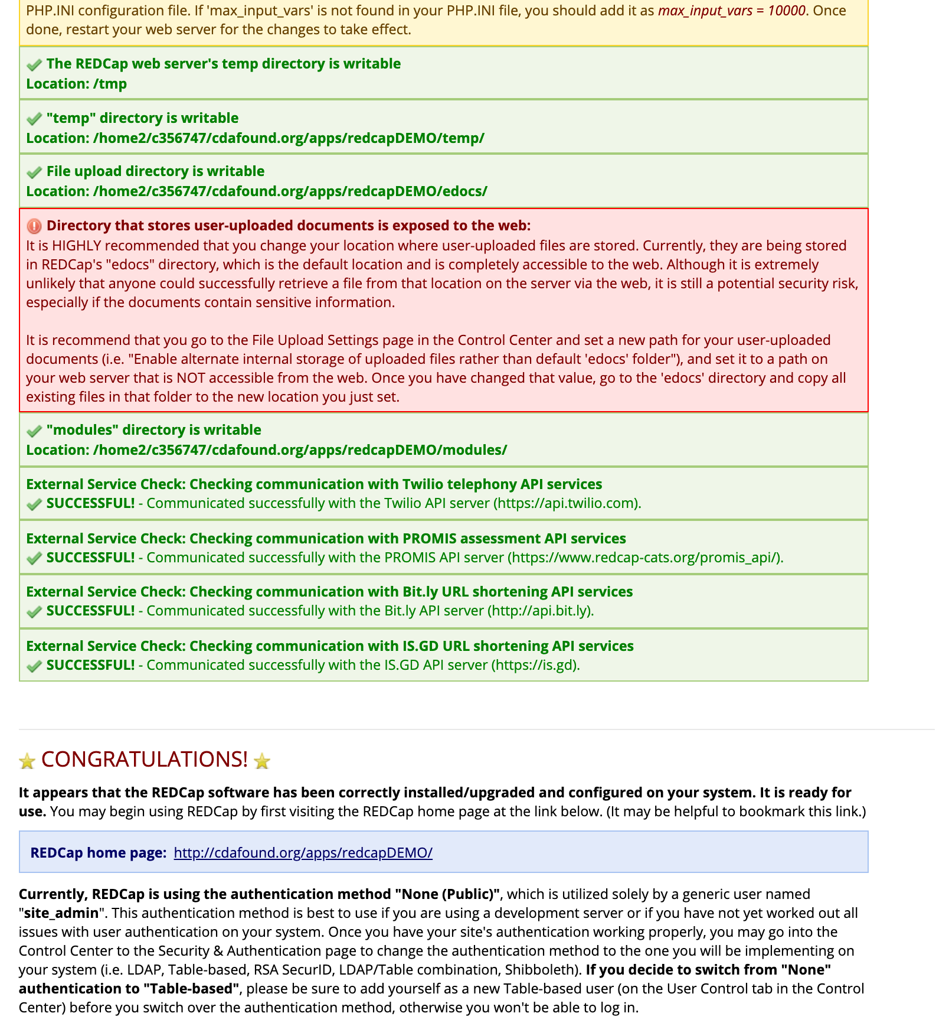
Review the Configuration (continued)

Slide 13
The Install is Complete
You are ready to configure users

Slide 14
Add the Administrator and Enable Authentication

Slide 15
Overview
How to change from "None (Public)" to "Table-based" authentication
Before simply changing the authentication method, you will first need to create for yourself a new Table-based user that you yourself will use to log in to REDCap. Navigate to the Create New User page in the Control Center and create a new user (you will have to decide what your username will be). Once created, it will send an email to you with your username and a link that will allow you to set your password.
Before looking in your inbox, go to the Designate Super User page in the Control Center and add your user as a super user. This ensures that you will be able to access the Control Center again when you log in with your new Table-based user in a minute.
Now go to the Security & Authentication page in the Control Center and change the authentication method to Tabled-based (at top of page) and save your changes on that page. Now click on any link/tab on the page, which will now force you to log in with your new Table-based username.
Log in to REDCap with your new username and the password sent to you in the email. It will then ask you to set your password.
Now that you have logged in with your new username, go back to the Designate Super User page and remove "site_admin" as a super user.
You're done and can now go and begin giving other users access to REDCap by creating them a username on the Create New User page.

Slide 16
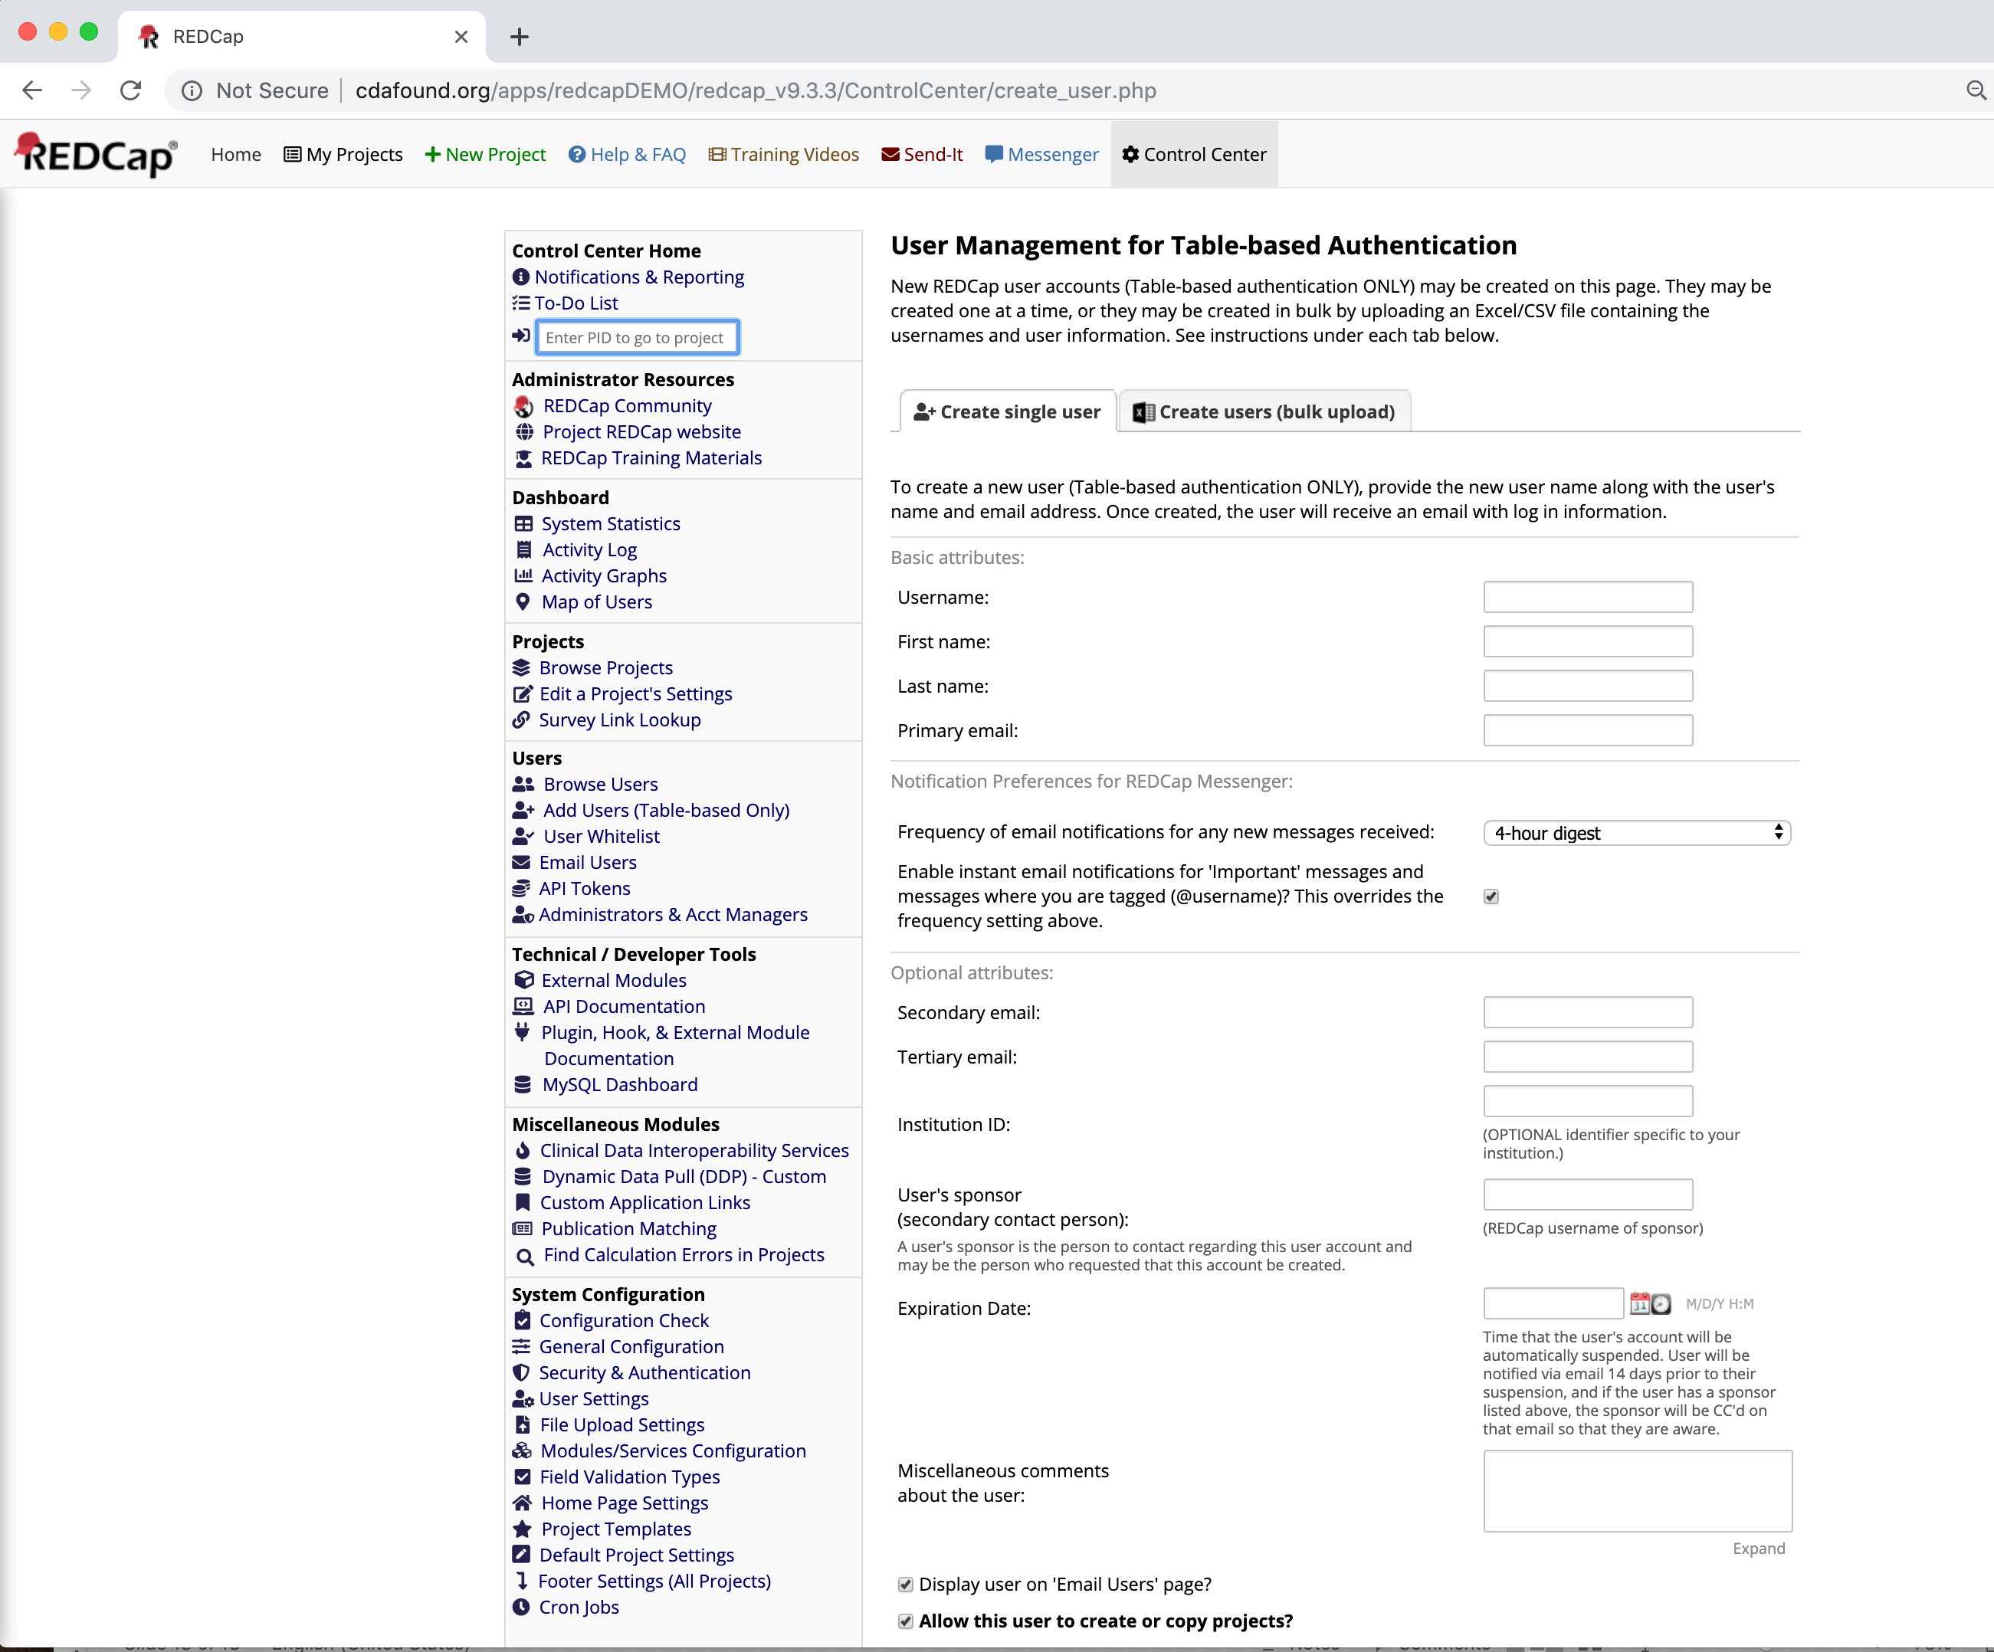
Users may be added under the Control Center “Add Users (Table-based Only)”

Slide 17
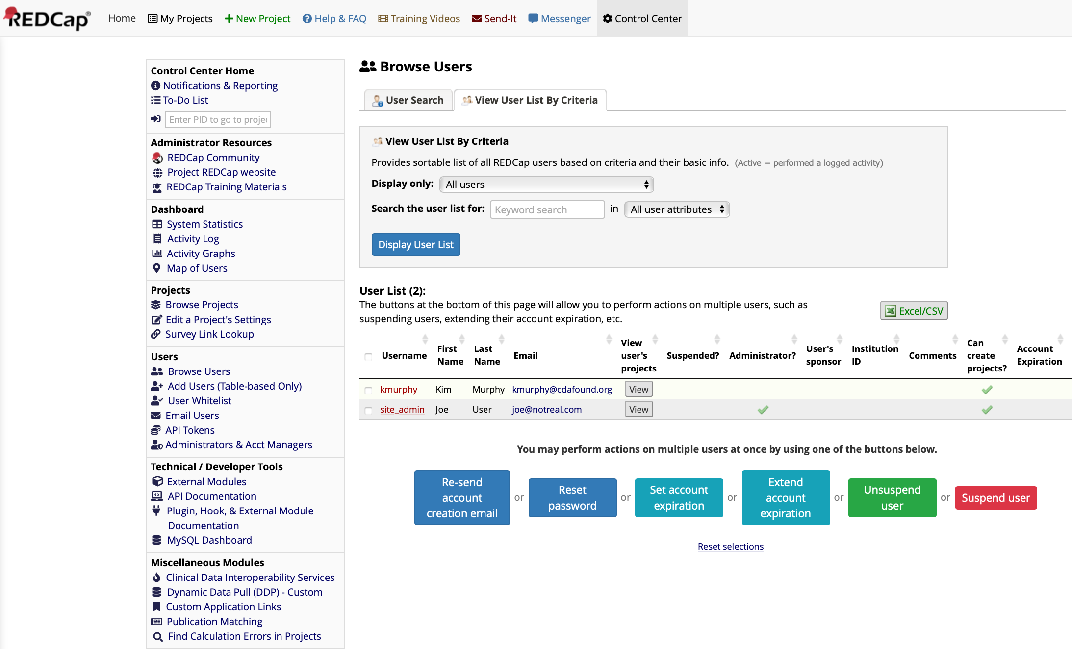
Add the User who will be the Administrator
(you will delete the default “site_admin” after granting necessary privileges)
We will make this new user the
Administrator and then delete the
default ”site_admin”

Slide 18
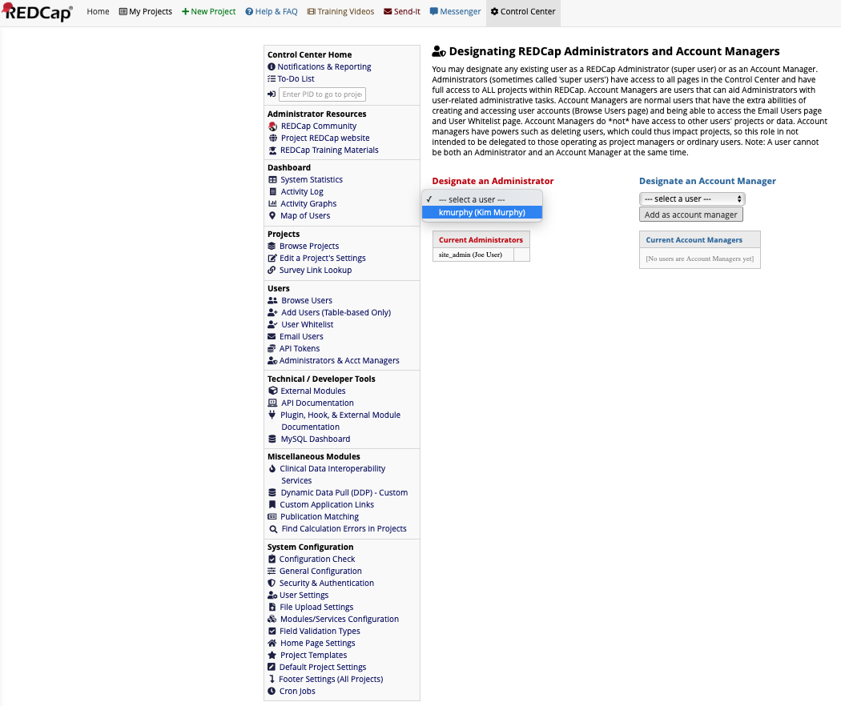
In Administration & Acct Managers,
Designate the new User an Administrator
Select the user and then hit the
button “Add as administrator”

Slide 19
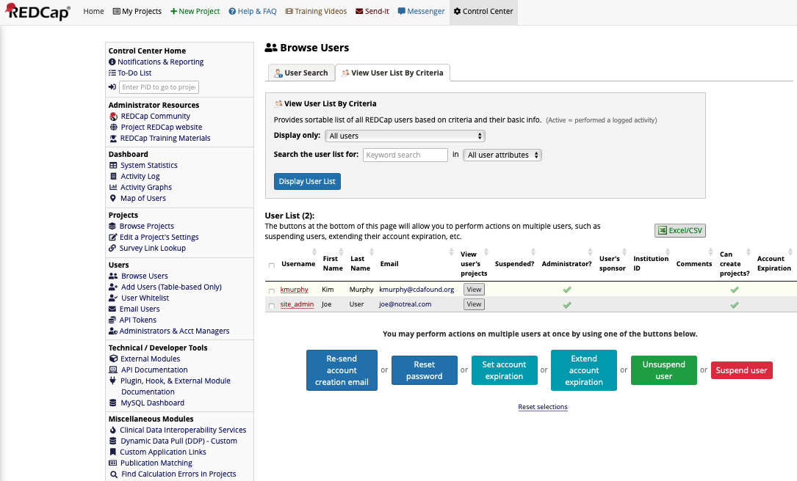
Verify the new user is now an Administrator
Check to make sure
there is a checkbox

Slide 20
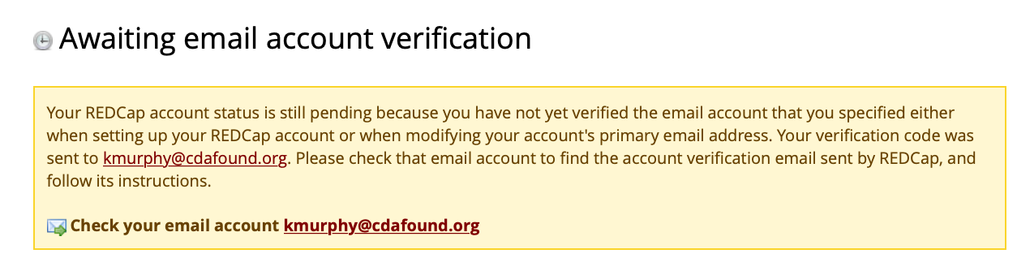
If the SMTP Sever is working correctly, the system will send a Verification Email

Slide 21
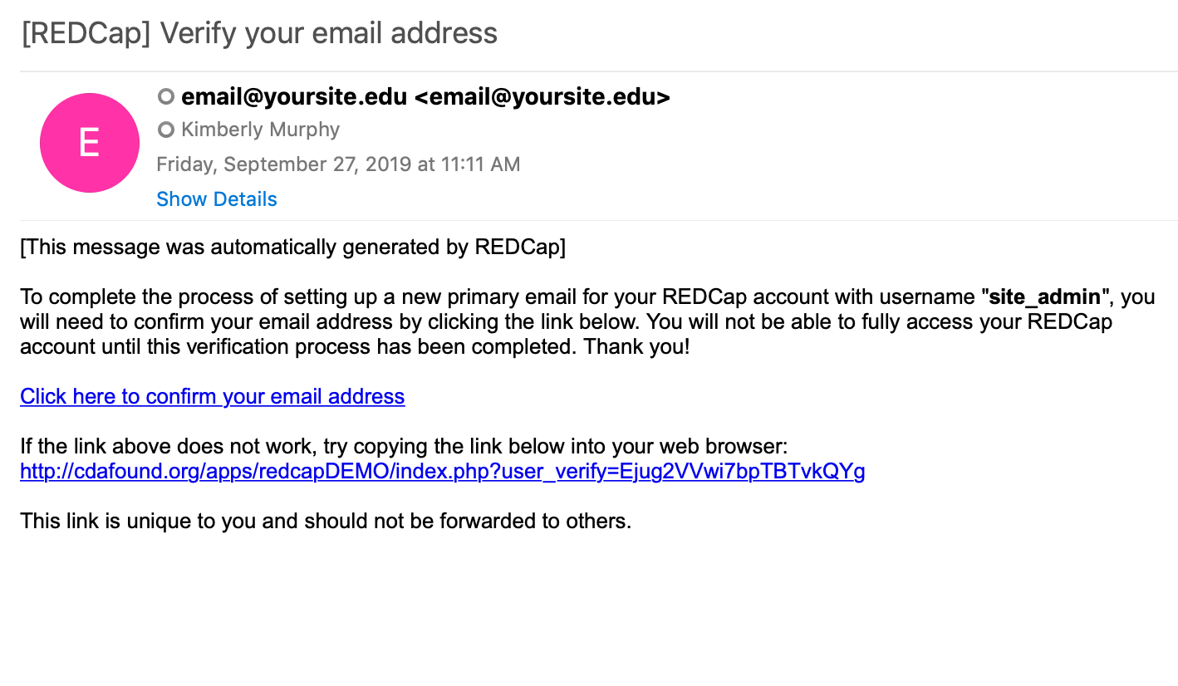
Once you receive the email, click the link inside to confirm and verify your email

Slide 22
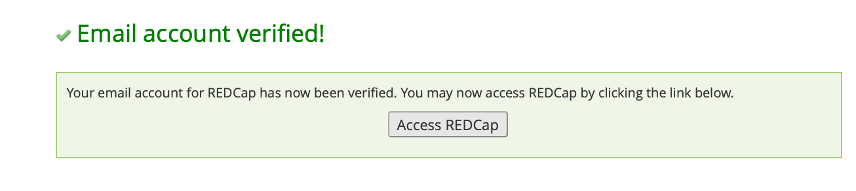
You should receive confirmation that the change has been verified

Slide 23
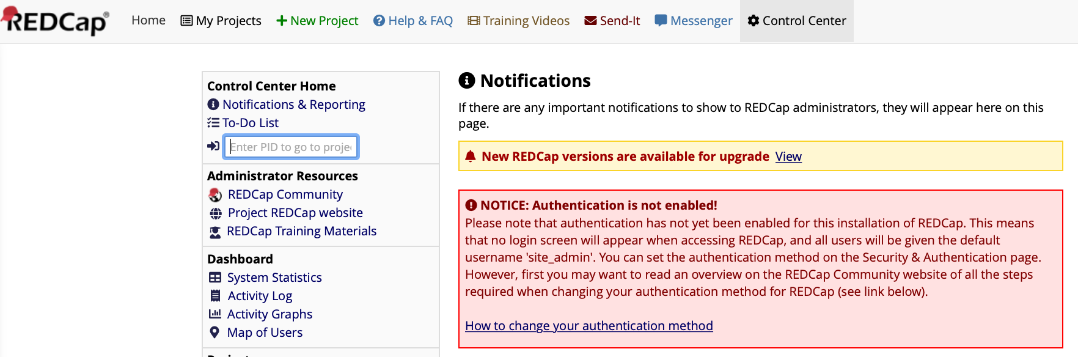
Now you must enable Authentication

Slide 24
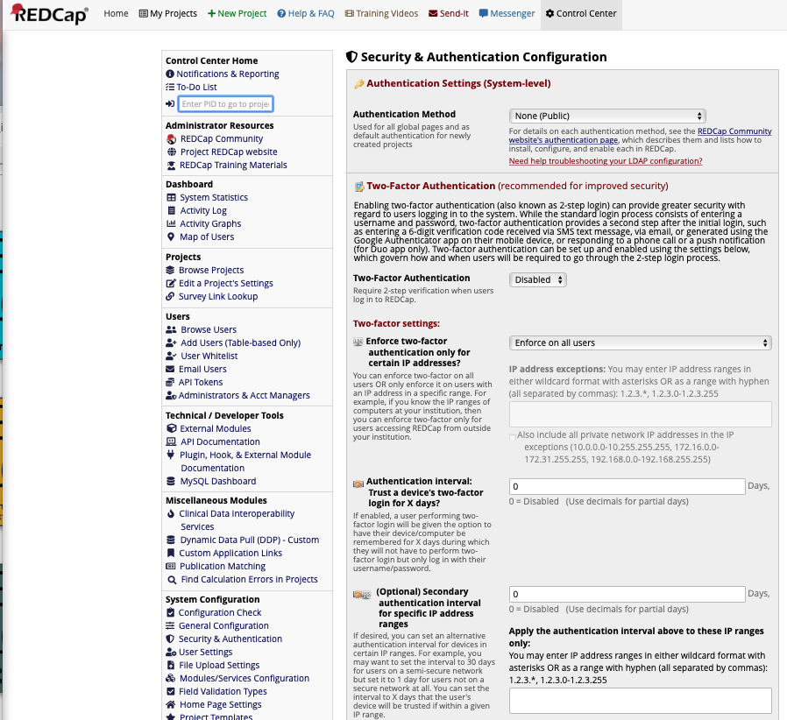
Navigate to “Security & Authentication”

Slide 25
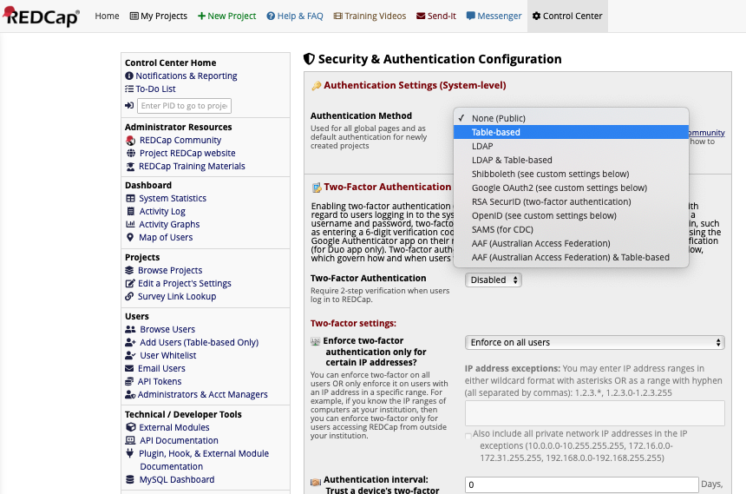
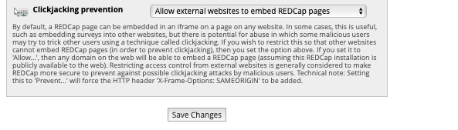
Select the Authentication Method and hit “Save Changes” at the bottom of the page

Slide 26
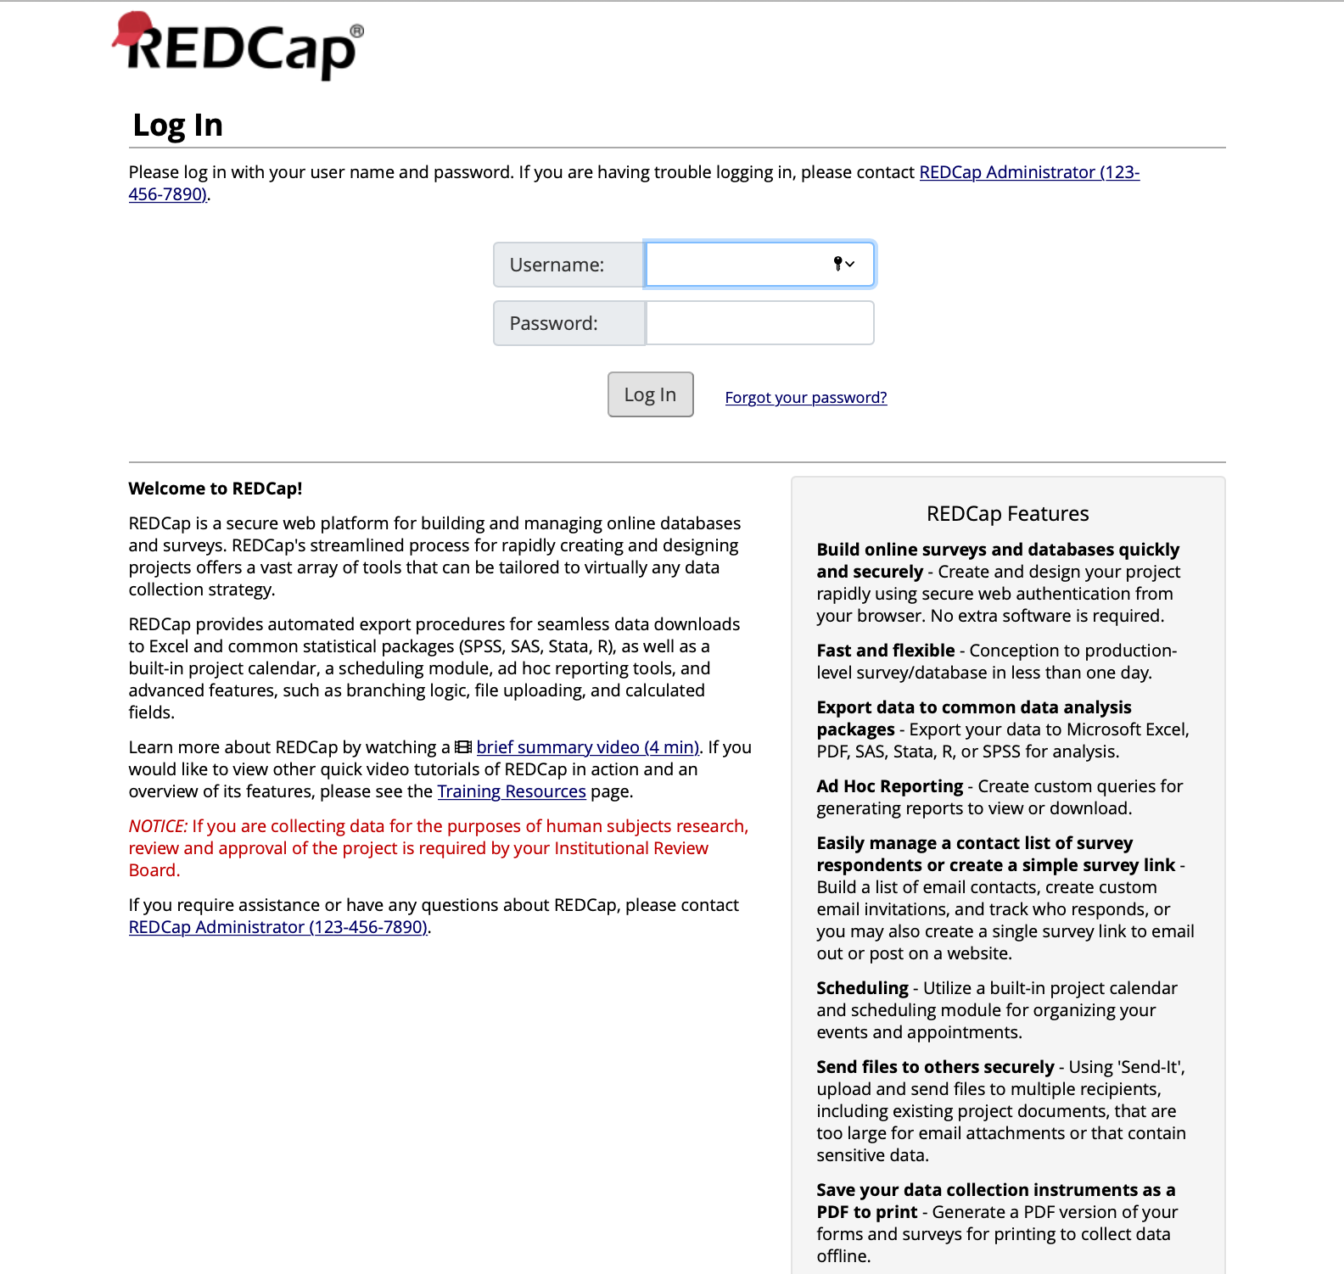
After enforcing Authentication, you must login with the username/password created for the new Administrator

Slide 27
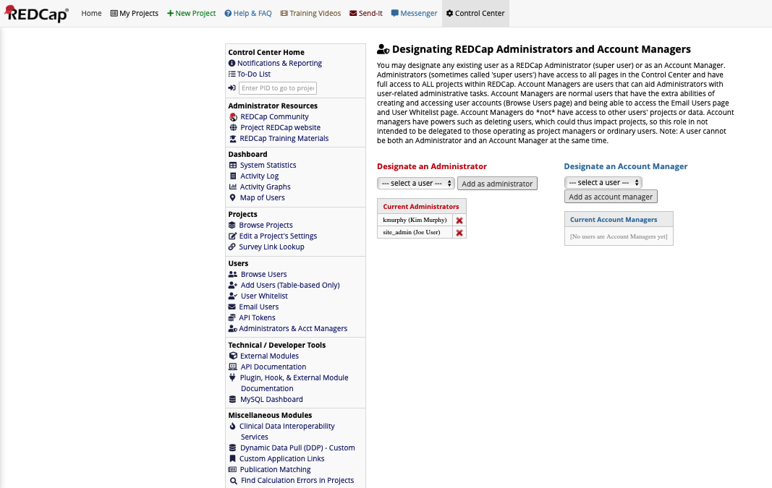
Go back to Administration & Acct Managers and delete the default “site_admin”
Delete and confirm

Slide 28
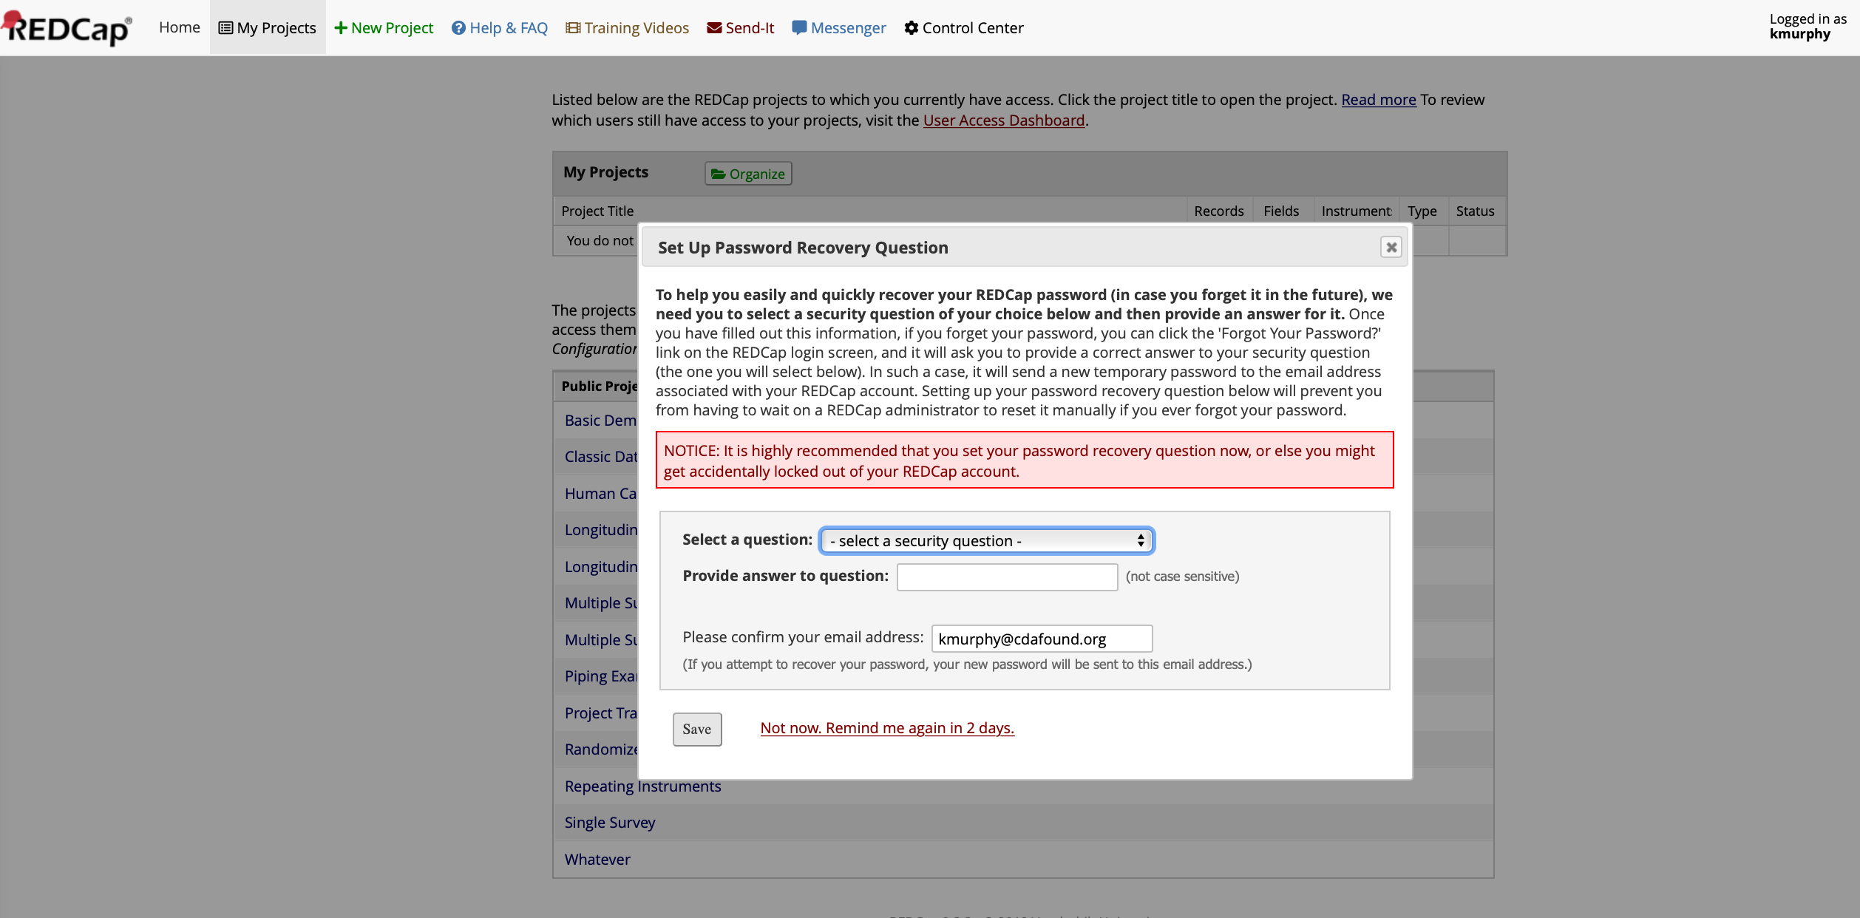
Make sure the Administrator sets up a Recover Question

Slide 29
Add all Users necessary for the
Program to the System

Slide 30
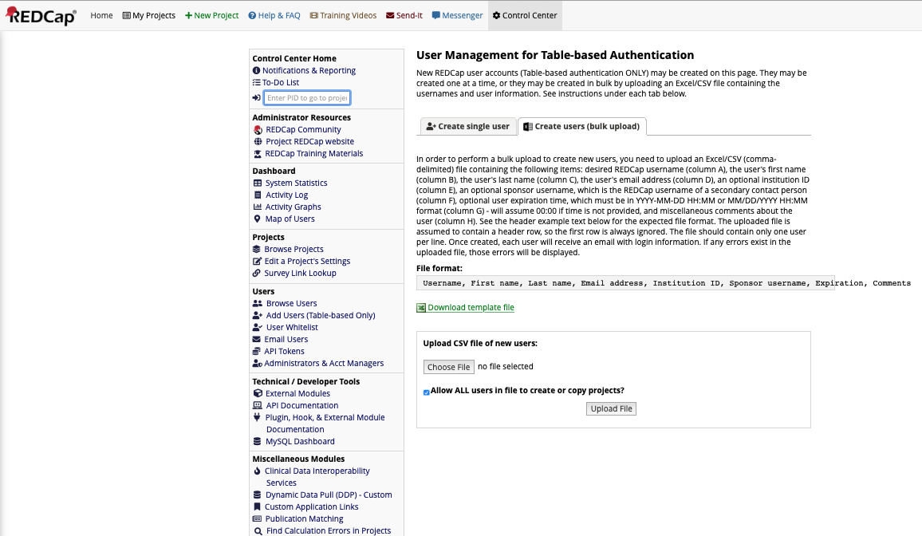
You can add users in bulk using the template/structure
(or individually on the “Create single user” tab)

Slide 31
Upload the developed XML Project into the REDCap Installation

Slide 32
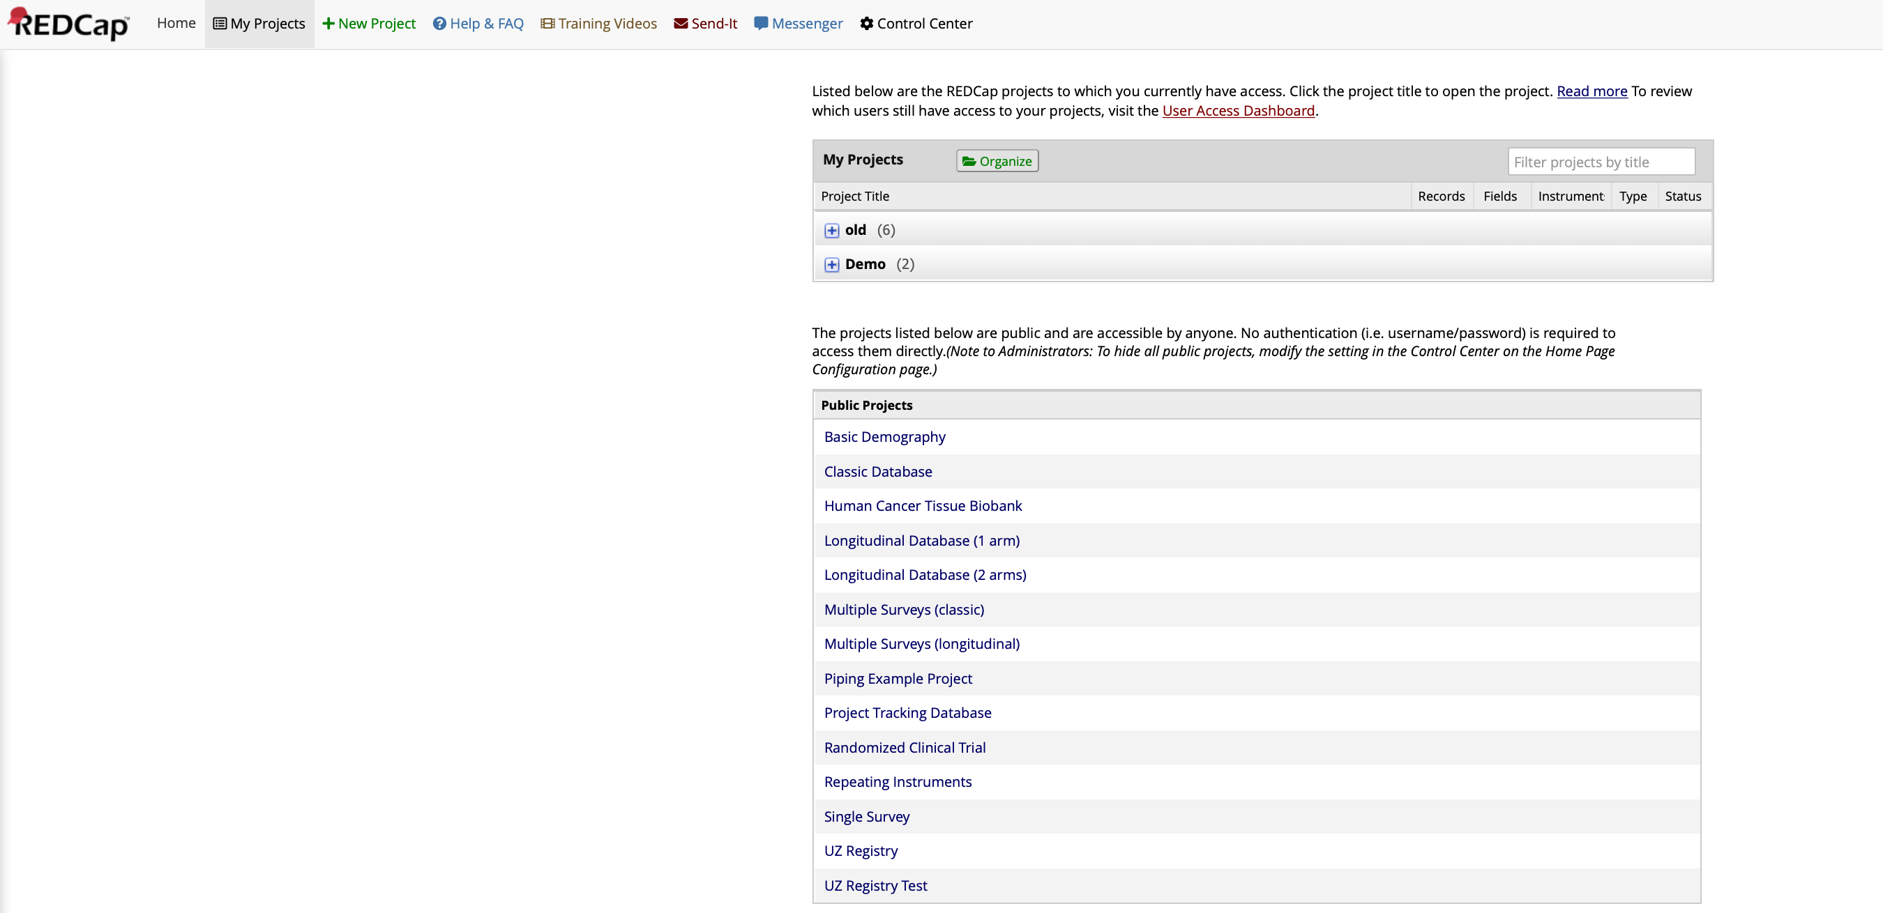
Select “+ New Project” from the upper menu bar

Slide 33
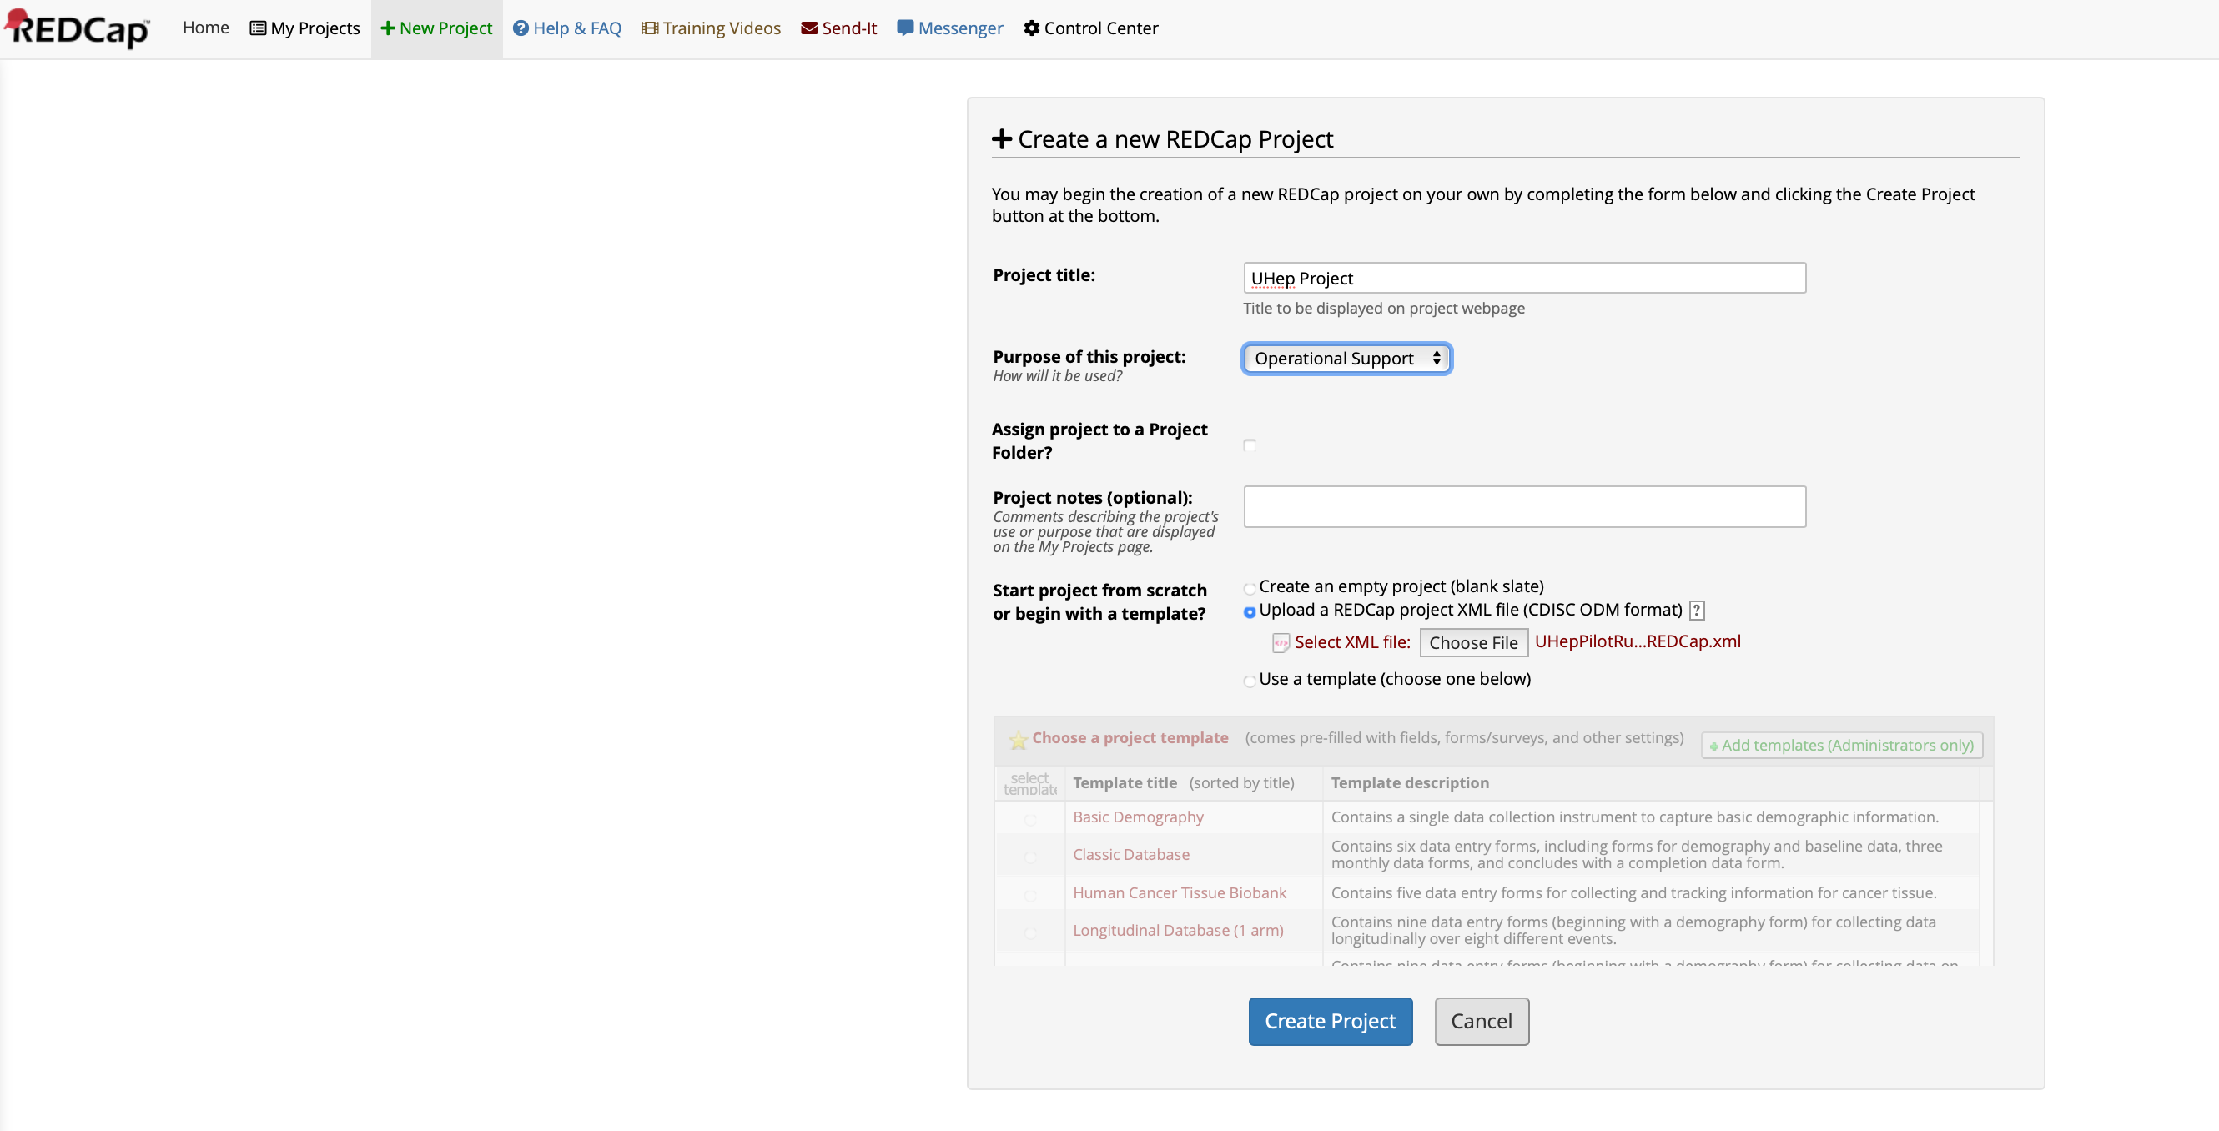
Add the project from the XML File
1.) Add a title for the project
2.) Select the purpose
3.) Select the “Upload a REDCap project XML file
(CDISC ODM format)” option
4.) Hit the “Choose File” button and
navigate to select the:
UHepPilotRussian_2019-09-26_2036.REDCap.xml
file you downloaded
5.) Hit Create Project

Slide 34
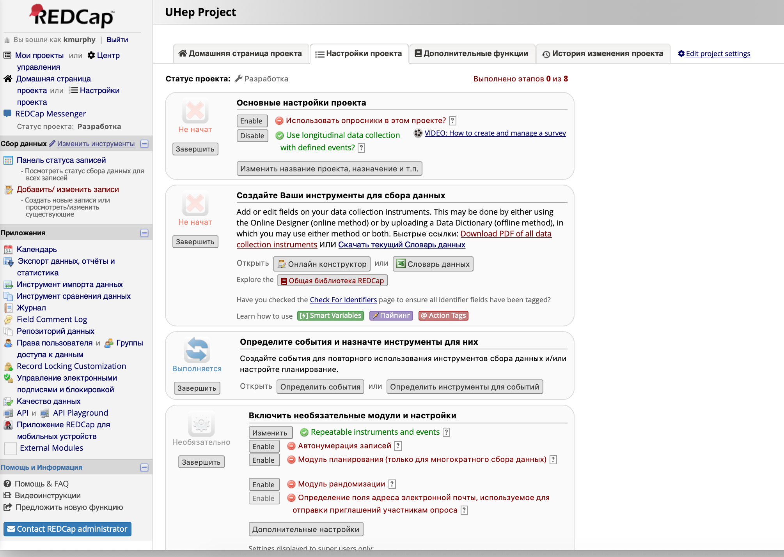
Your project should be successfully created

Slide 35
Change the Project’s Default Language
(if it is not already in the correct language)

Slide 36
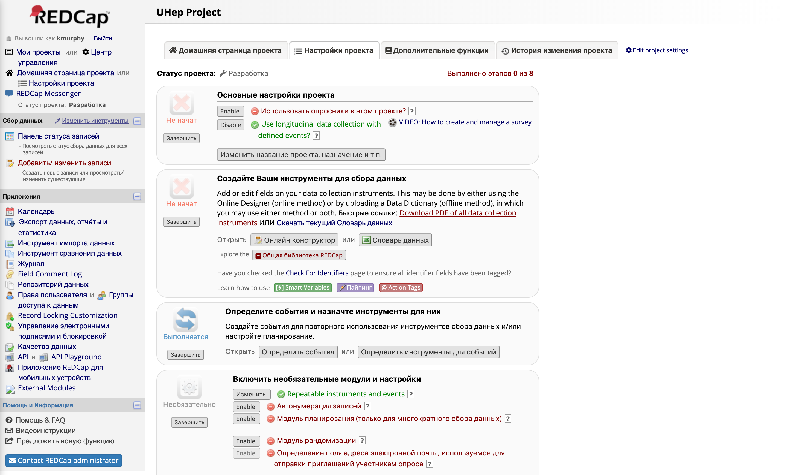
Ensure the language of the Project is set to Russian – go to “Edit Project Settings” and modify

Slide 37
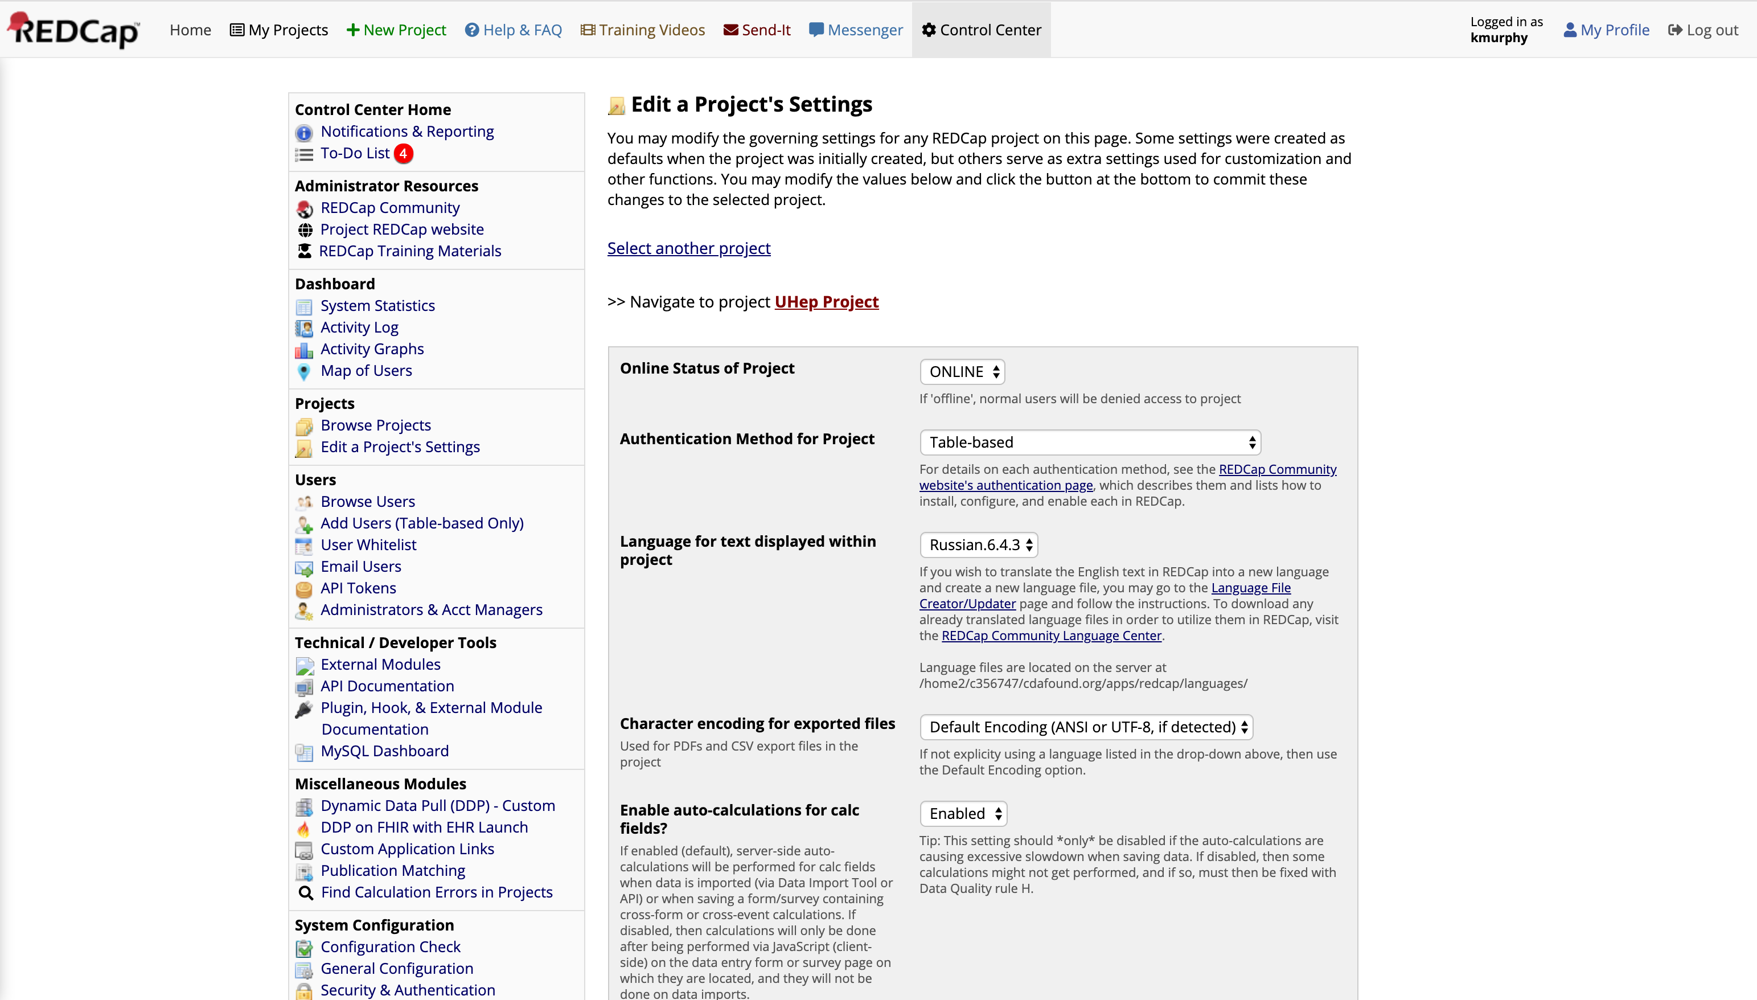
Use the Dropdown to select the appropriate language

Slide 38
Assign System Users to the Project

Slide 39
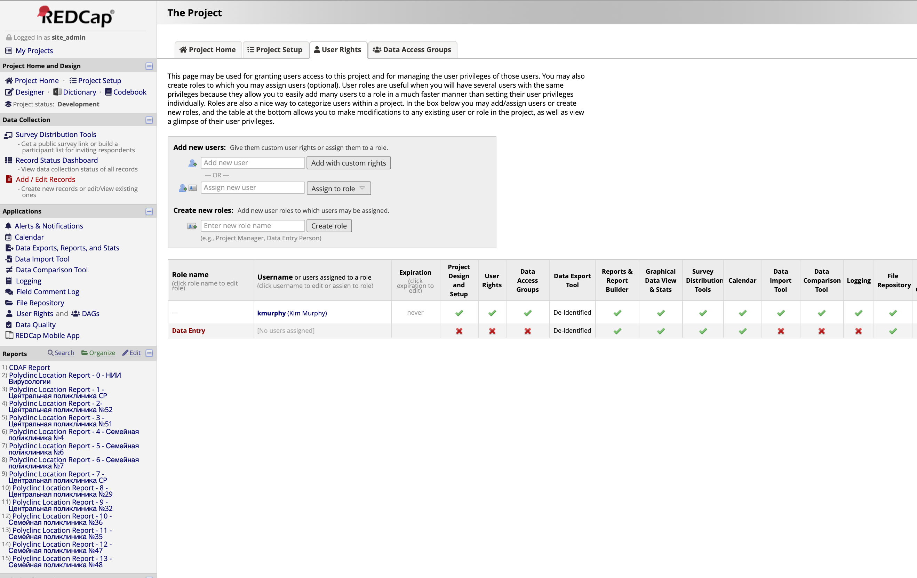
Add System Users to the Project, assigning the necessary privileges
Users can be added and
assigned to a pre-defined
role or provided custom
rights
“Data Entry” created for the
Project as an example of a
Custom limited role

Slide 40
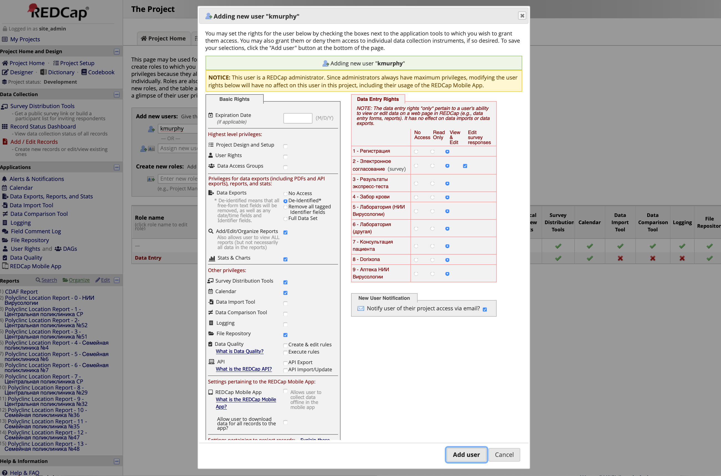
Custom settings should be carefully selected to ensure security

Slide 41
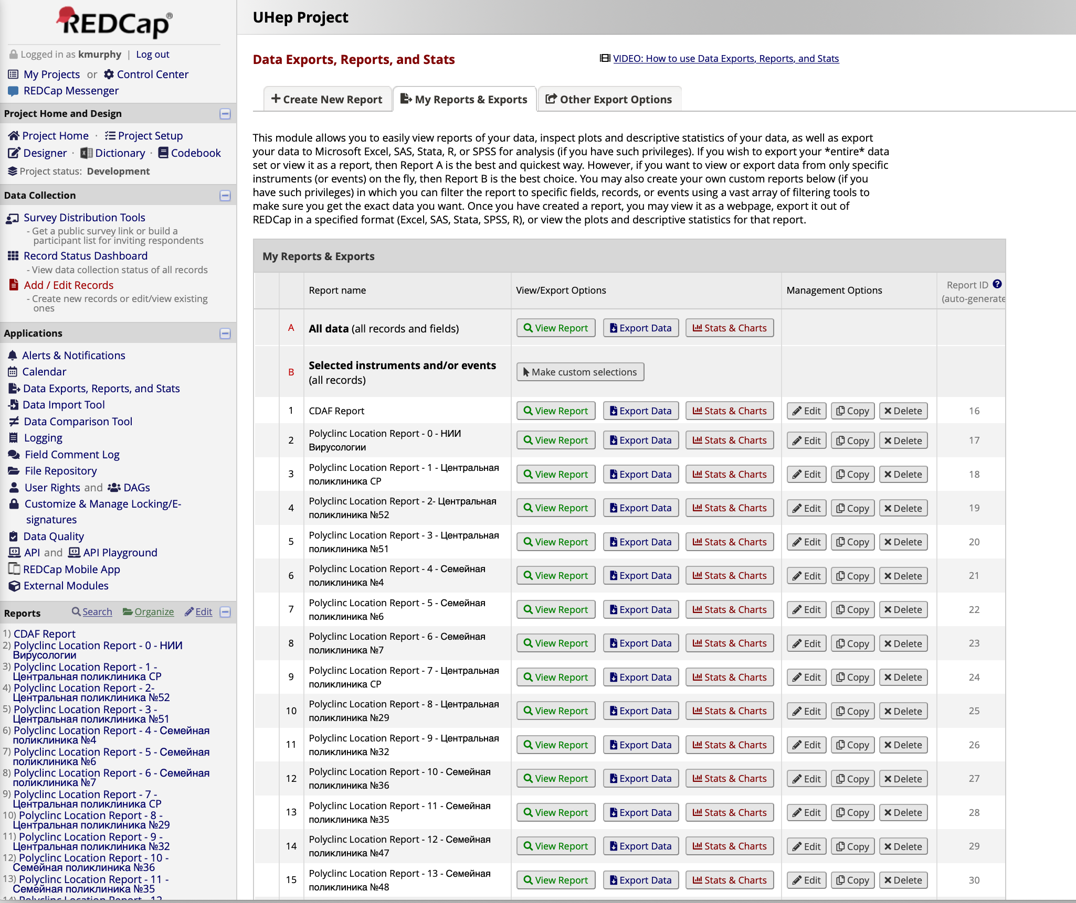
The Project includes Defined Reports which can be used to analyze the progress of the Program
Reports can be modified
or created anew

