Slide 1
REDCap File Upload Settings

Slide 2
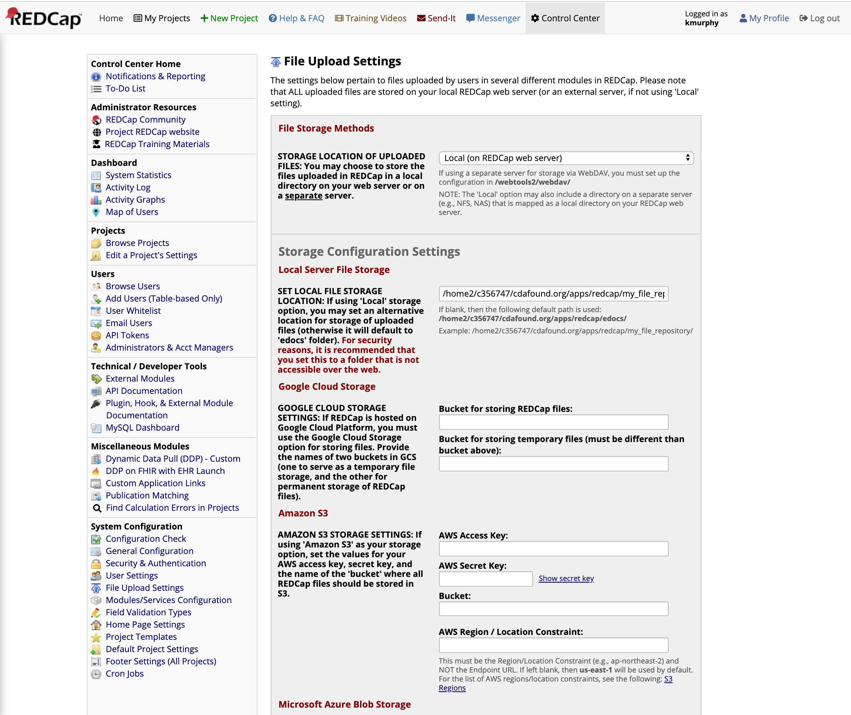
In the Control Center, select
“File Upload Settings”

Slide 3
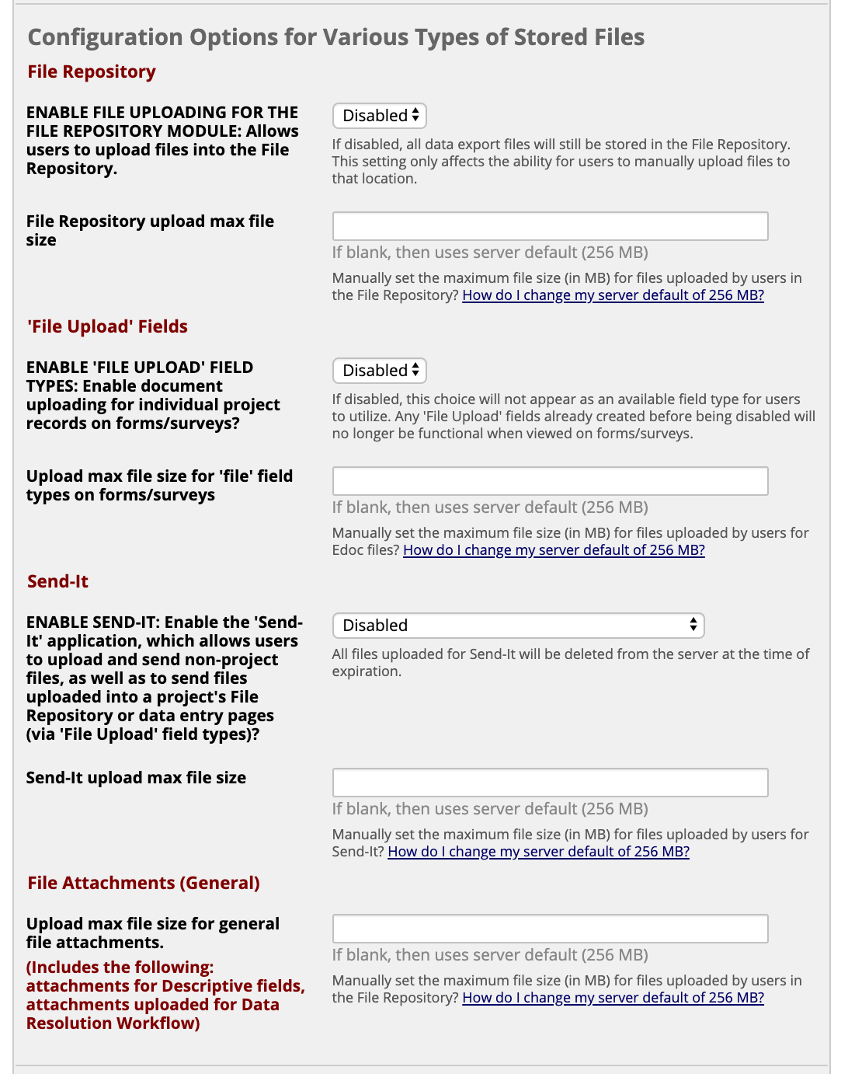
Under “Configuration Options for Various Types of Stored Files” you can “Disable” file uploading

