Slide 1
Add REDCap Pharmacist User For Really Sophisticated Patient Registry

Slide 2
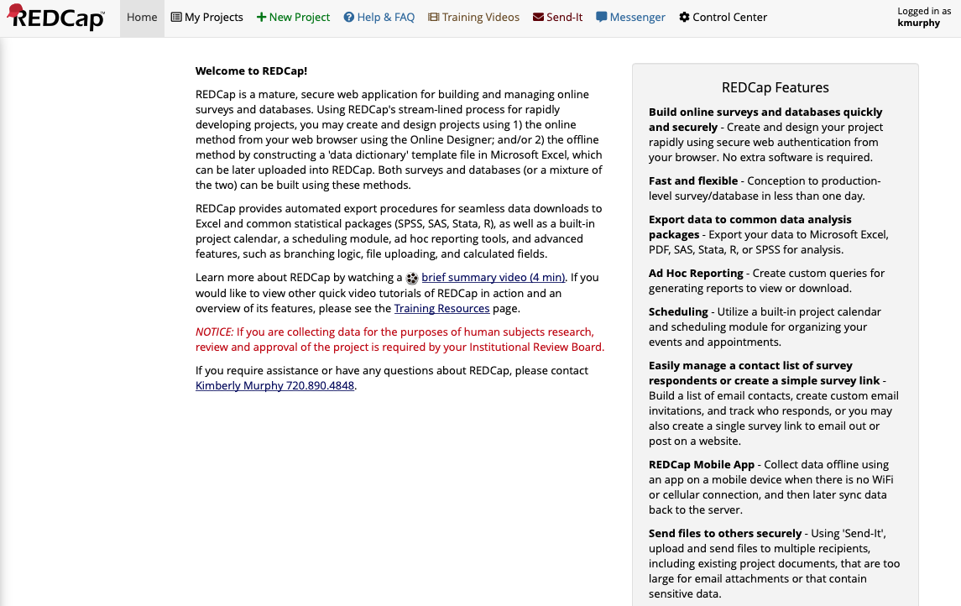
Open REDCap and select Control Center

Slide 3
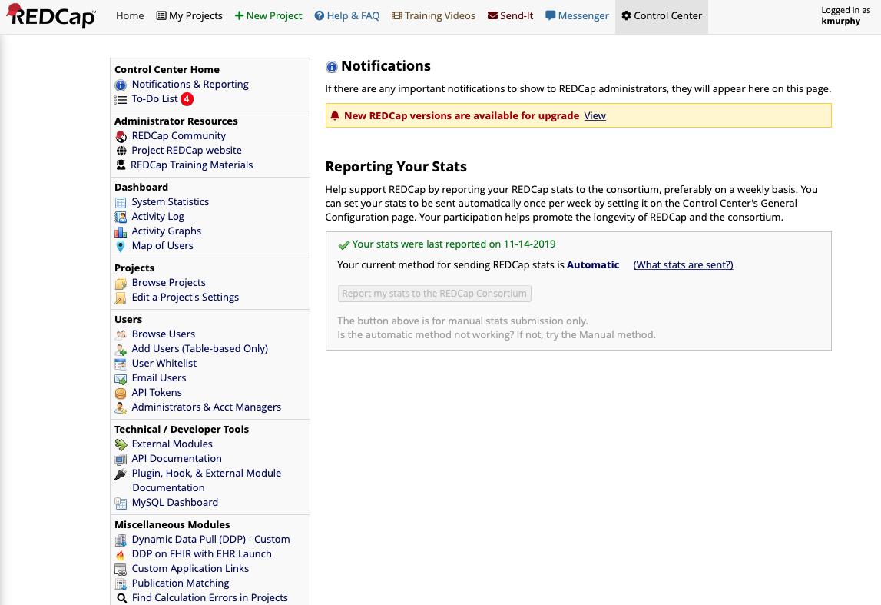
Select Add Users

Slide 4
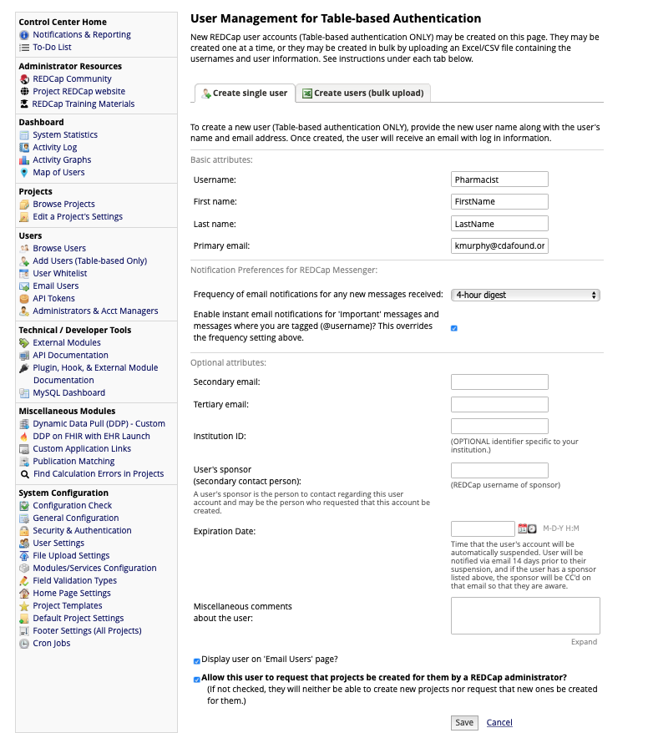
Add a Pharmacist test User and hit Save button
(use your email or one you have access to so you can verify access privileges)

Slide 5
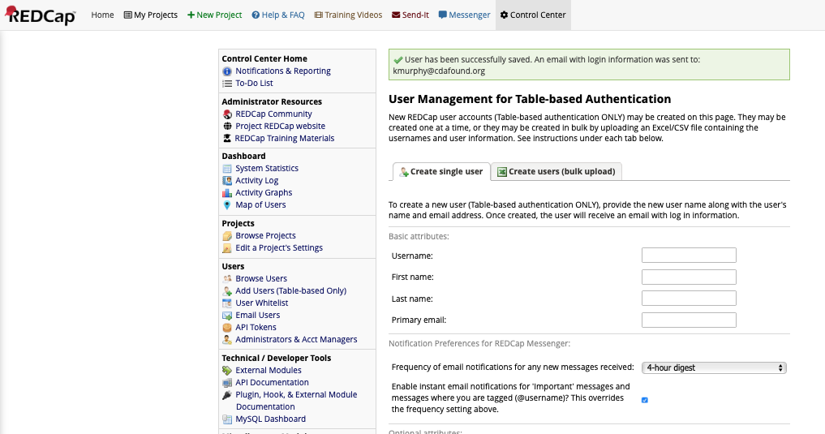
Hit Browse Users

Slide 6
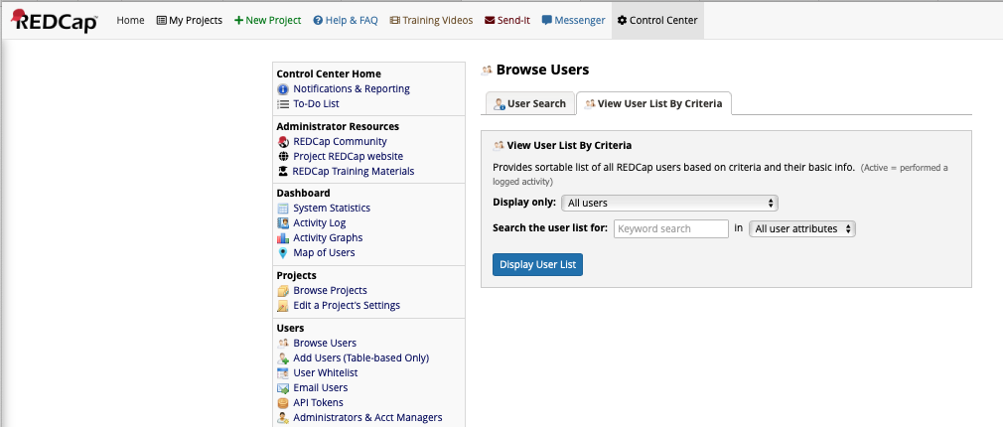
Select View User List By Criteria and hit Display User List button

Slide 7
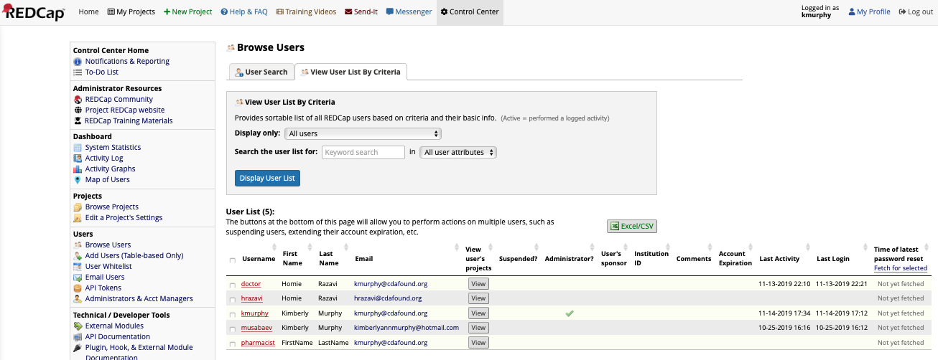
Your user should be added to the system
(you should create a password from the email generated by the system so you can later login as this user)
Select this user by hitting the username

Slide 8
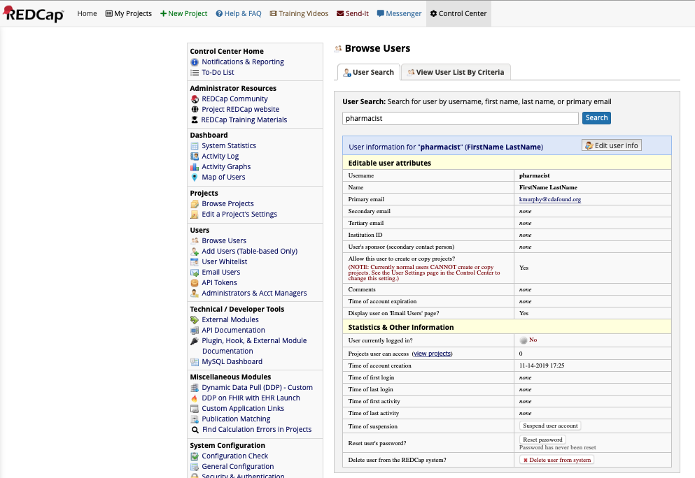
Edit the user permissions by selecting Edit user info

Slide 9
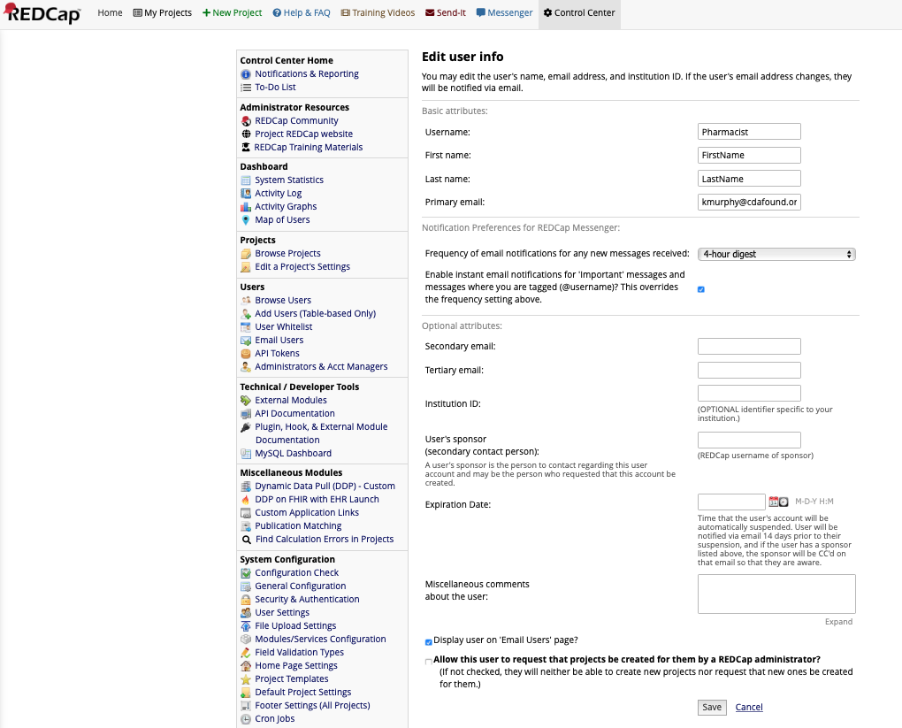
Uncheck “Allow this user….” to disallow the user from creating projects
Confirm and
hit “Save”

Slide 10
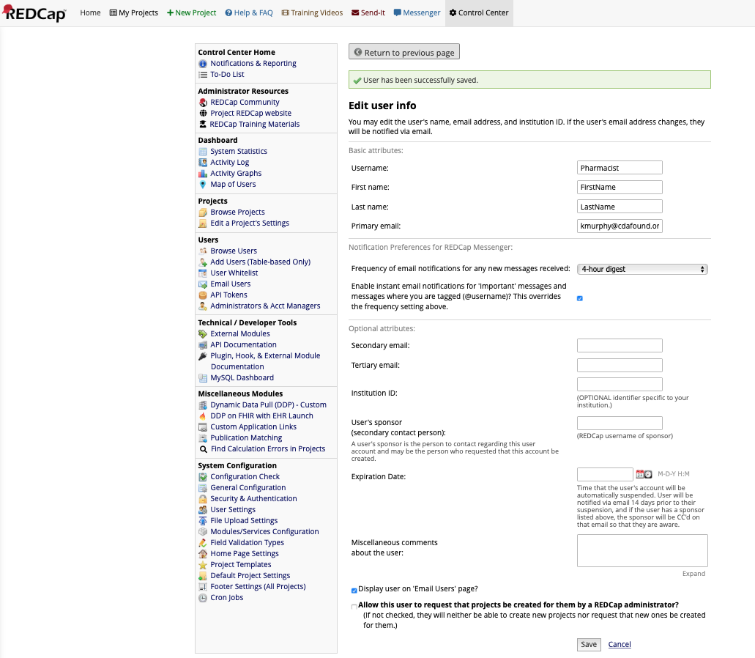
Select My Projects and select the your project

Slide 11
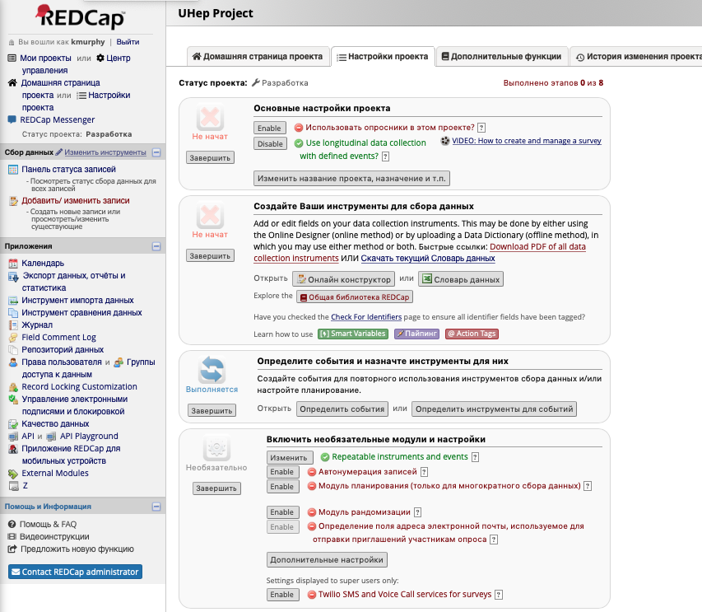
Select the User setup link

Slide 12
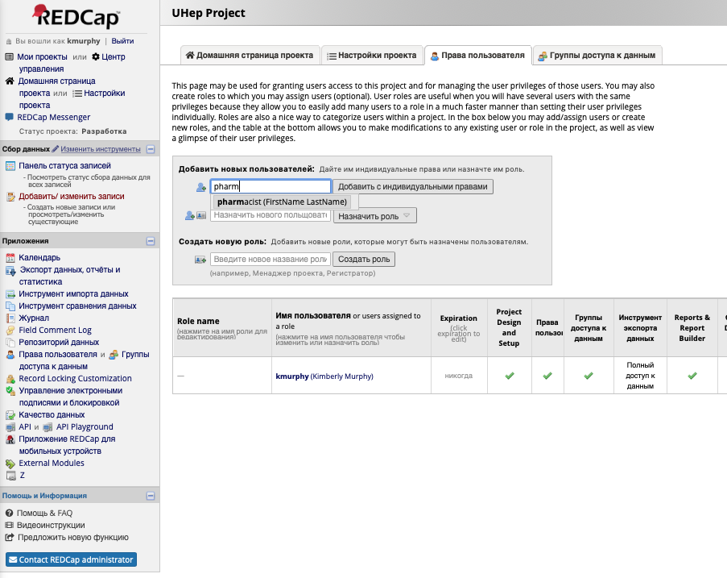
Type in the username, select them then hit the button
to add the user to the project and setup their access rights

Slide 13
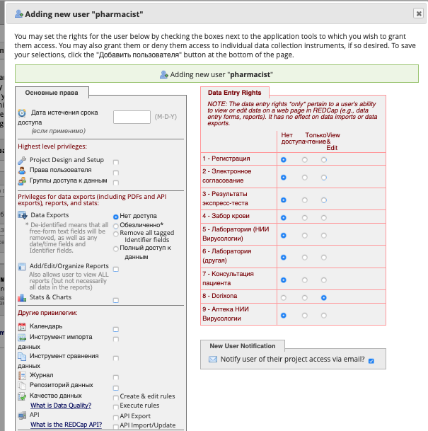
Setup the user with only the essential permissions for their role (see below) and hit Save

Slide 14
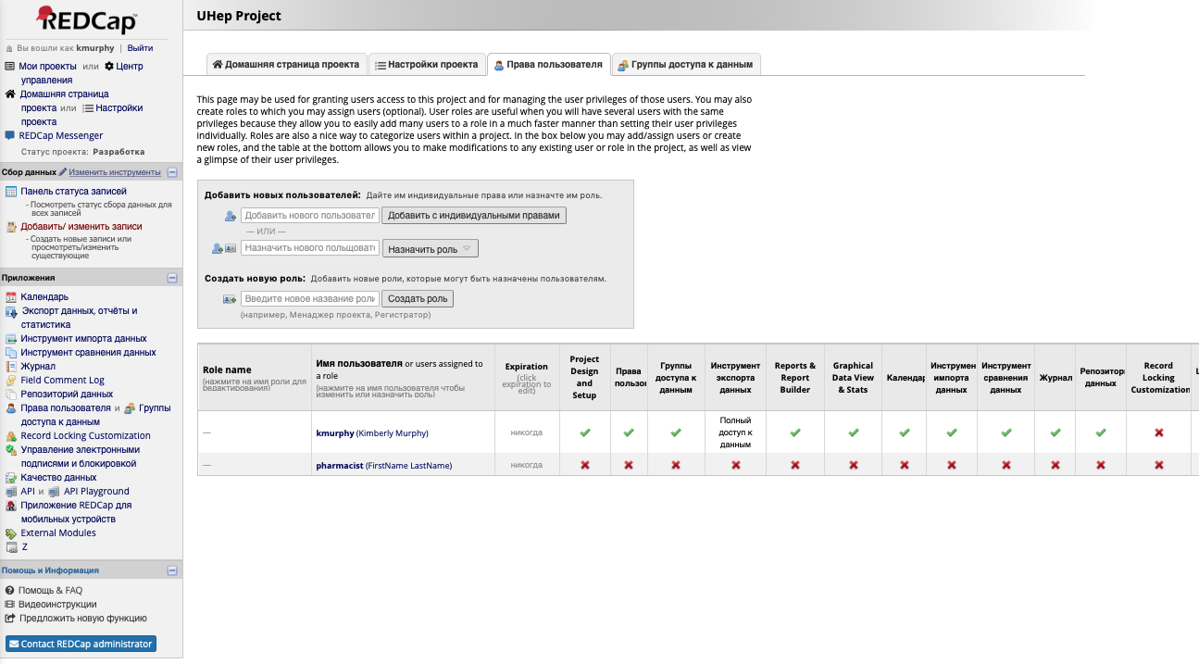
The user is now part of the project but in a scope limited to their role

Slide 15
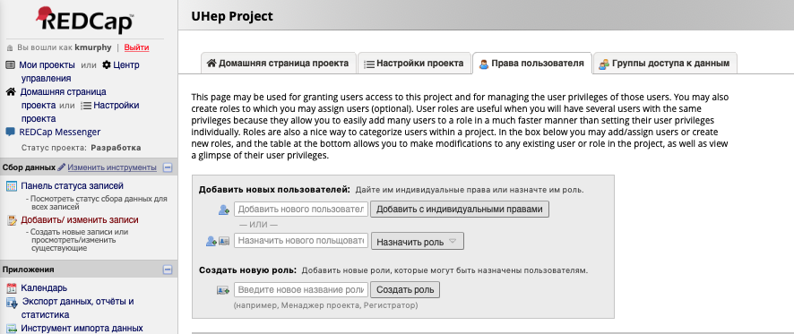
You may now logout of the system

Slide 16
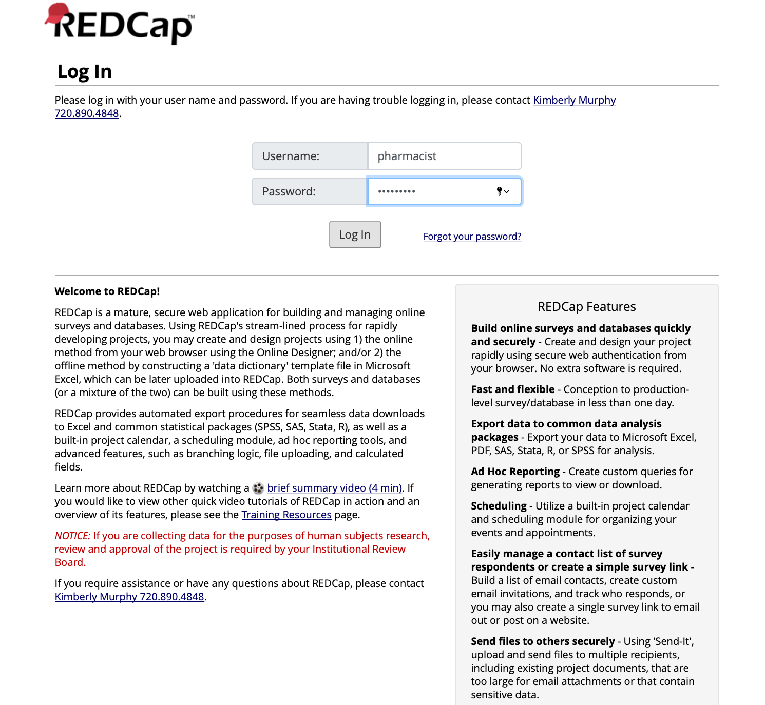
Log back in using the password you set up for the Pharmacist user

Slide 17
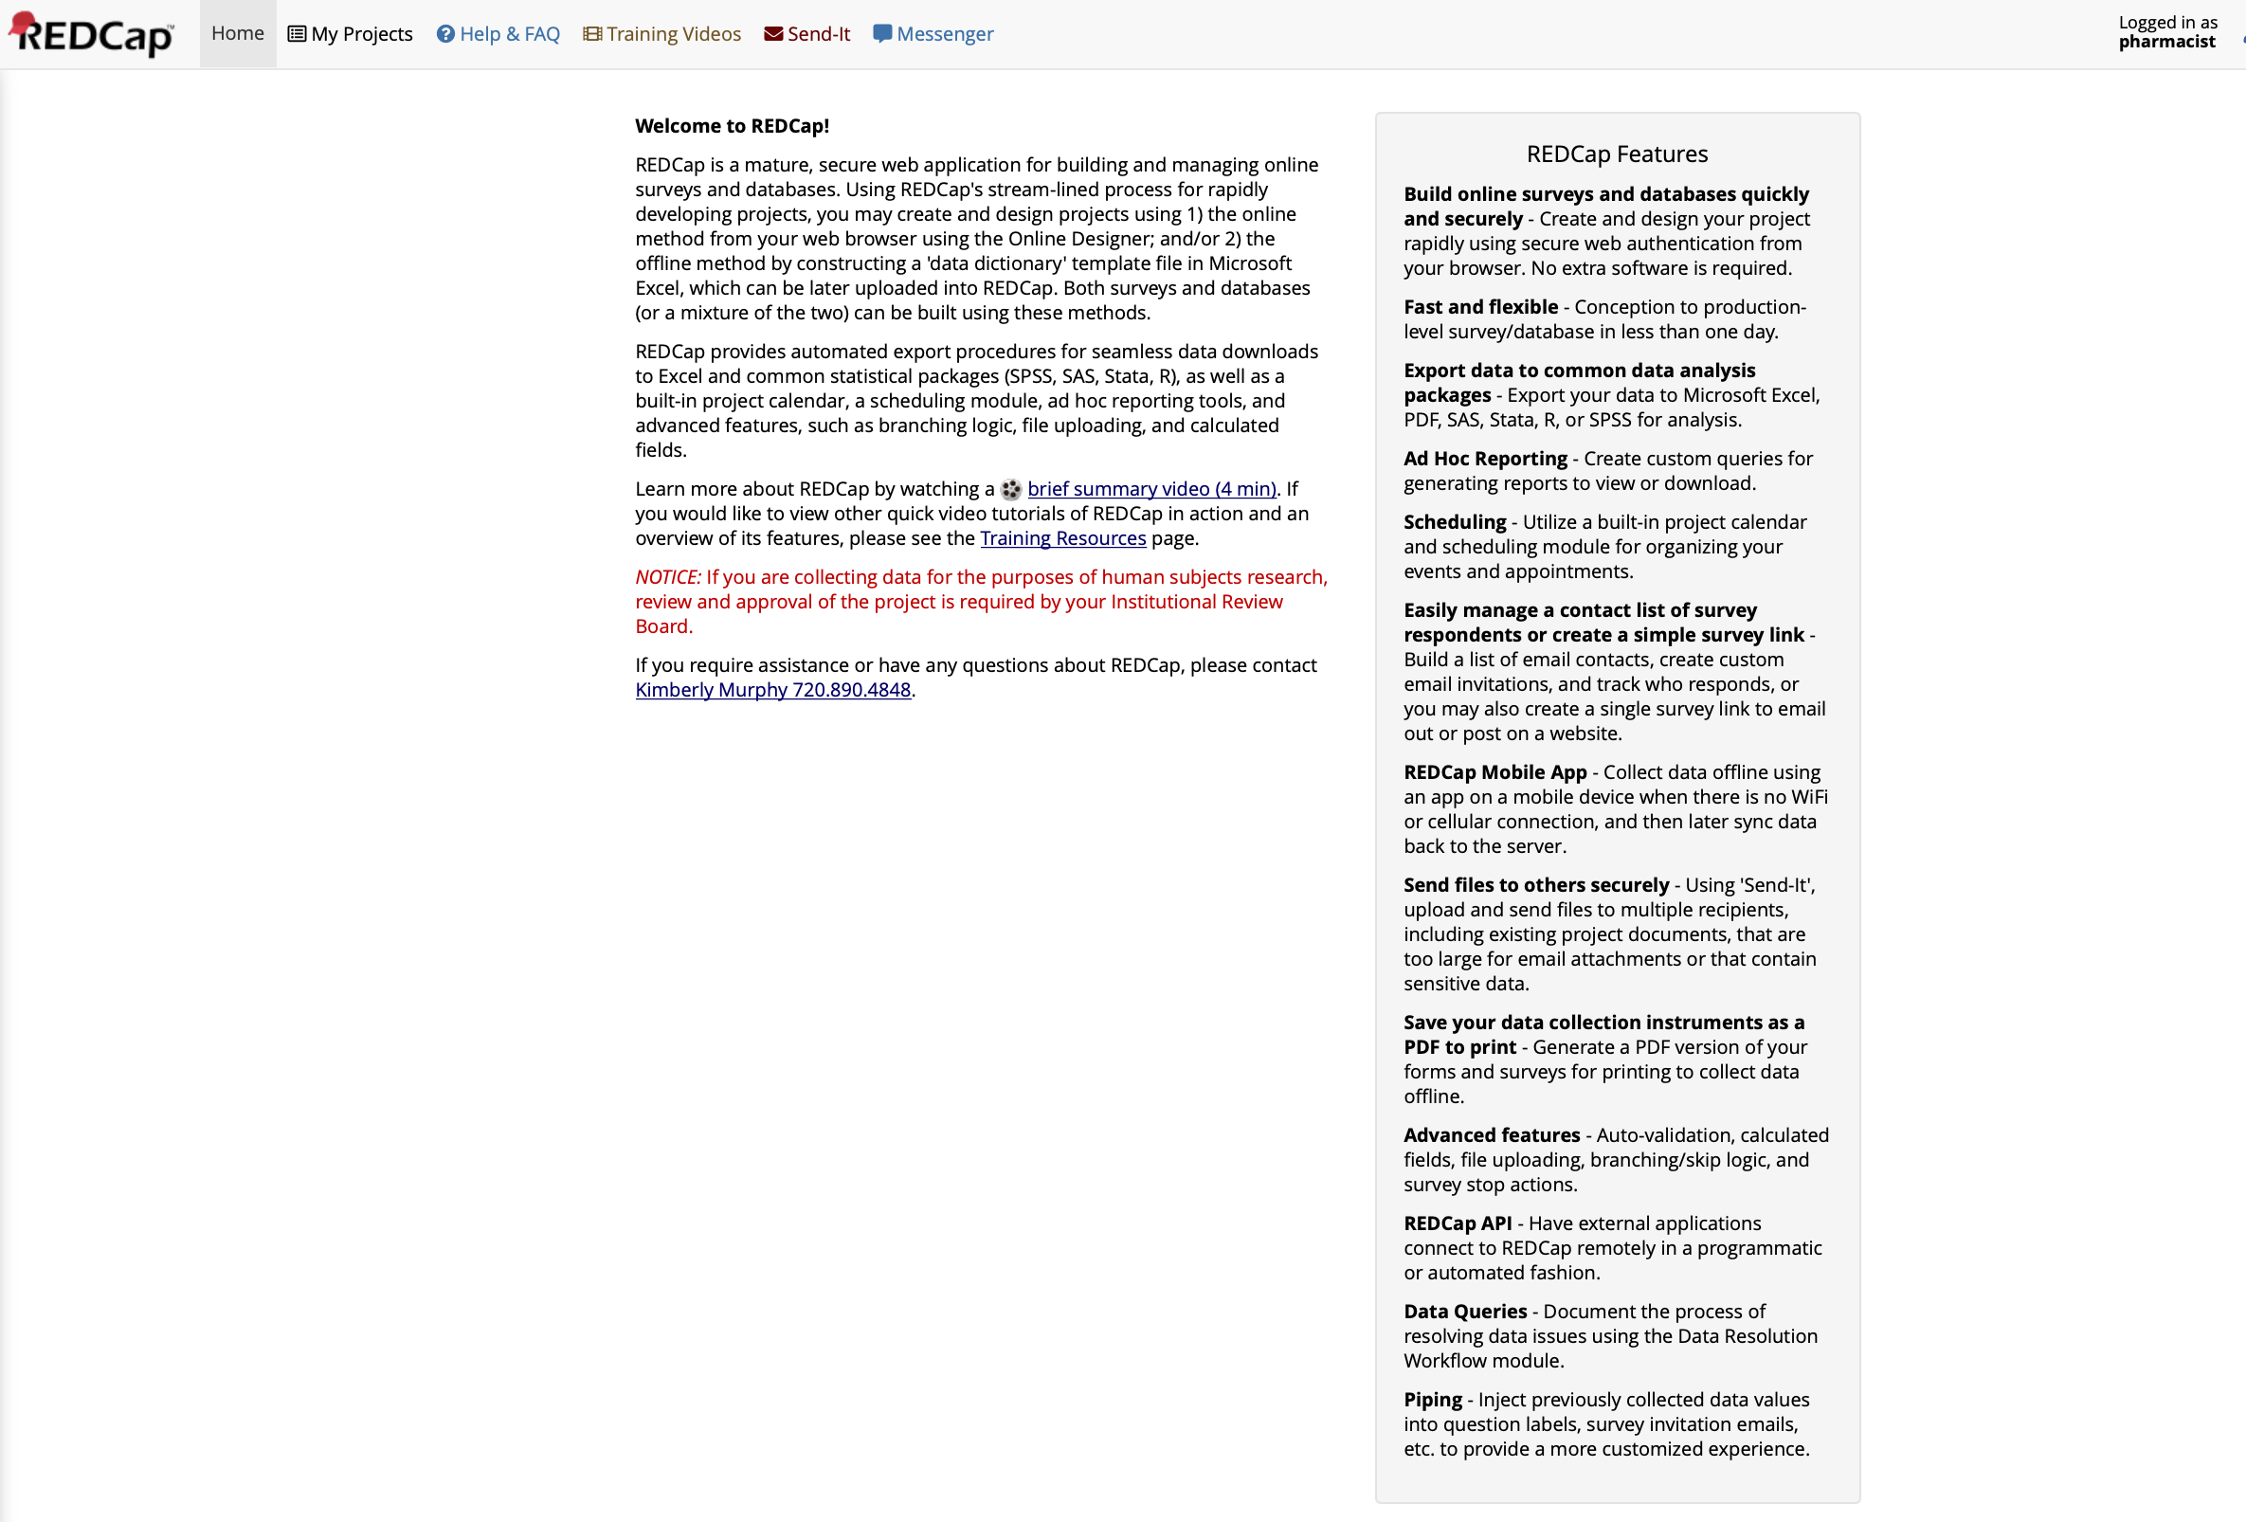
Once logged in, select My Projects and the UHep project

Slide 18
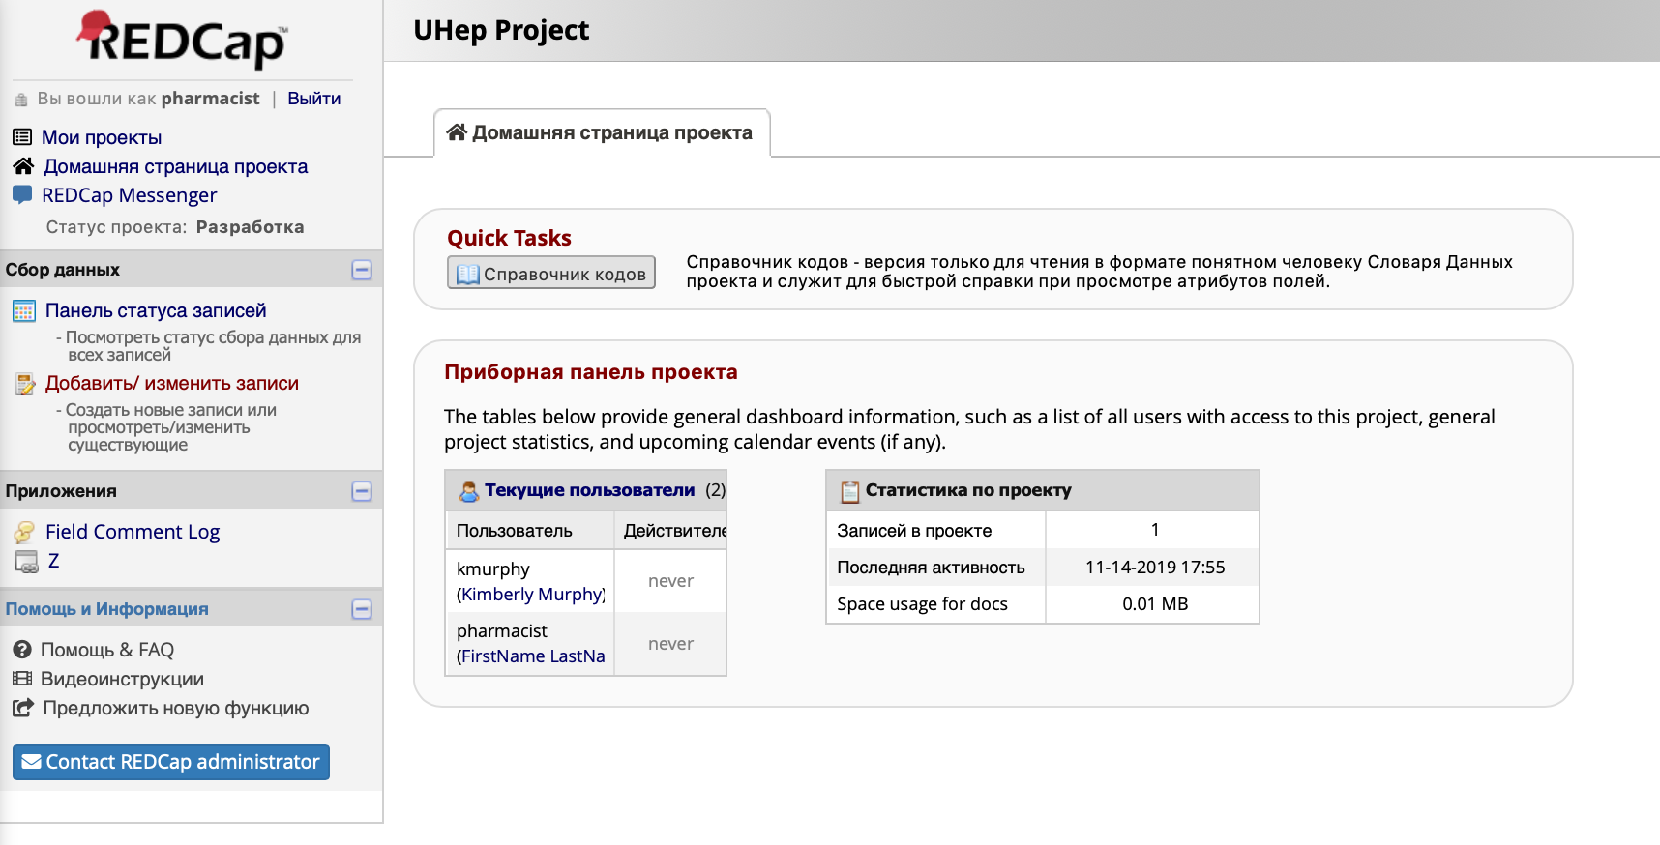
Now you can test access for all the links presented in the report for 6.1-6.3

