Slide 1
REDCap Installation –
Change Language

Slide 2
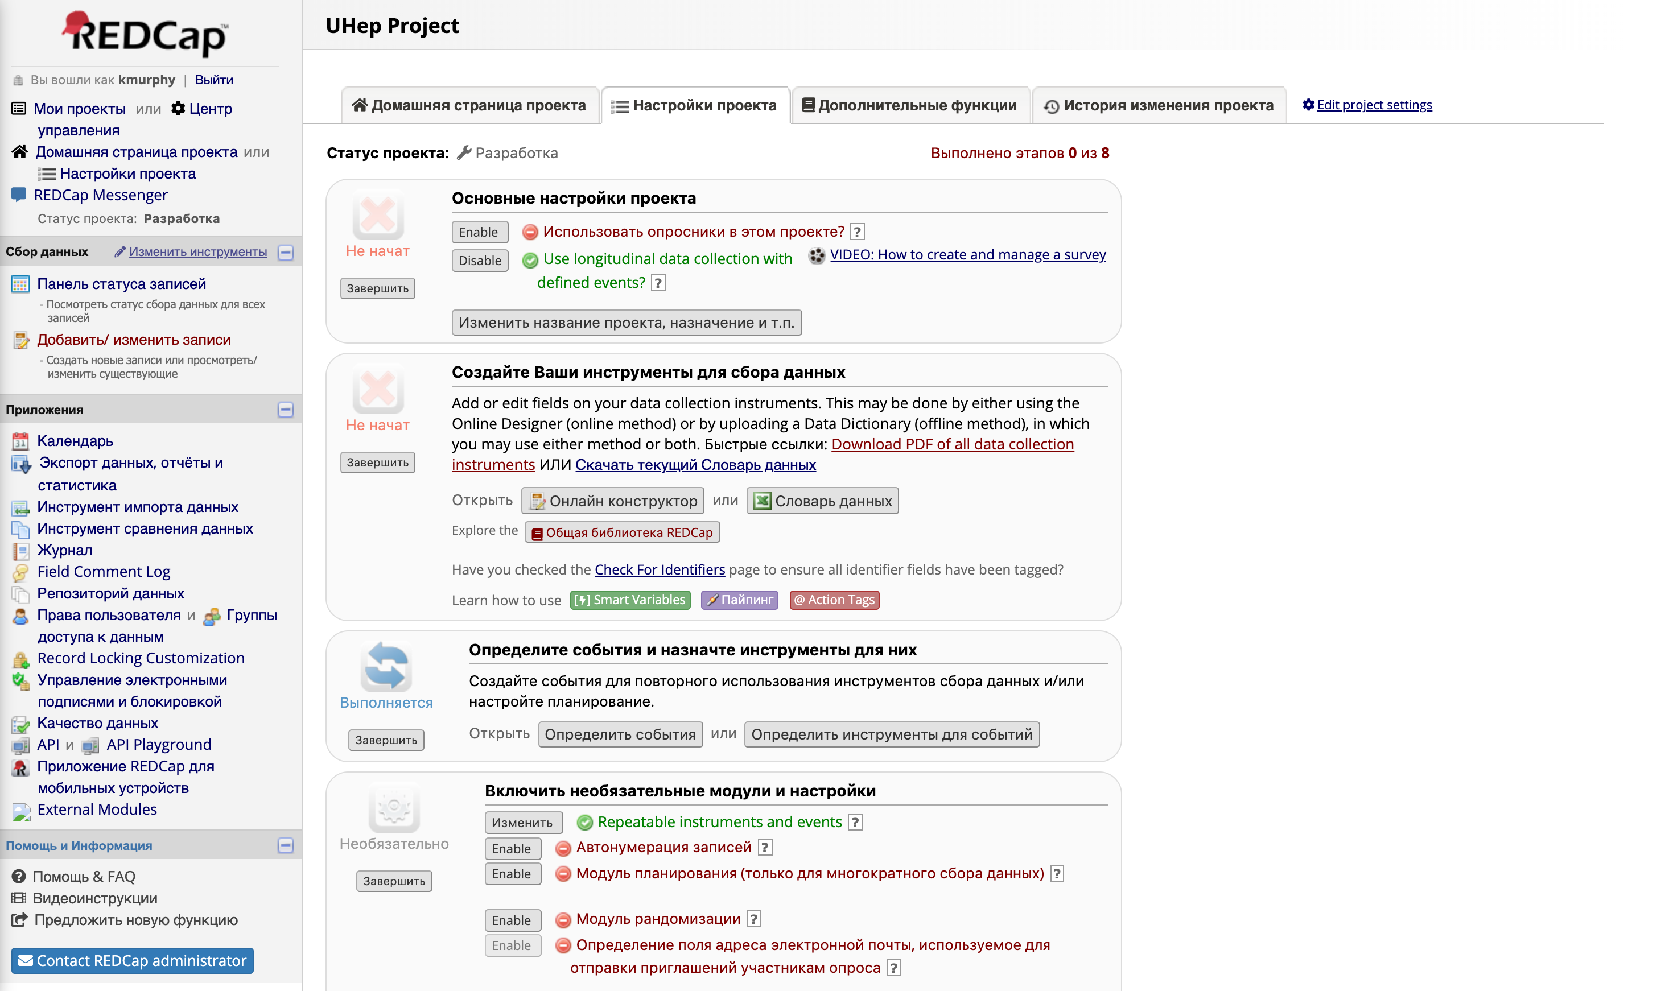
Ensure the language of the Project is set to Russian – go to “Edit Project Settings” and modify

Slide 3
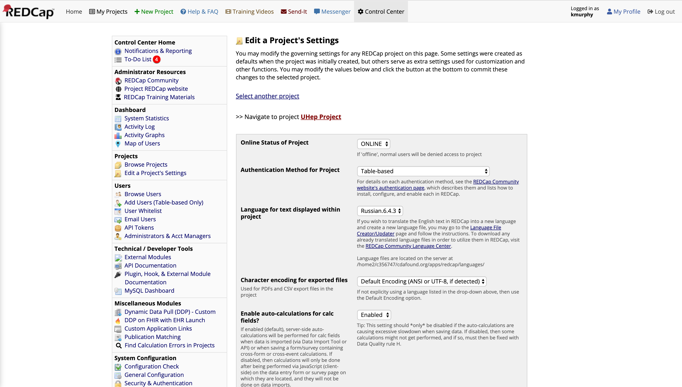
Use the Dropdown to select

