Slide 1
REDCap Add Fields to Reports

Slide 2
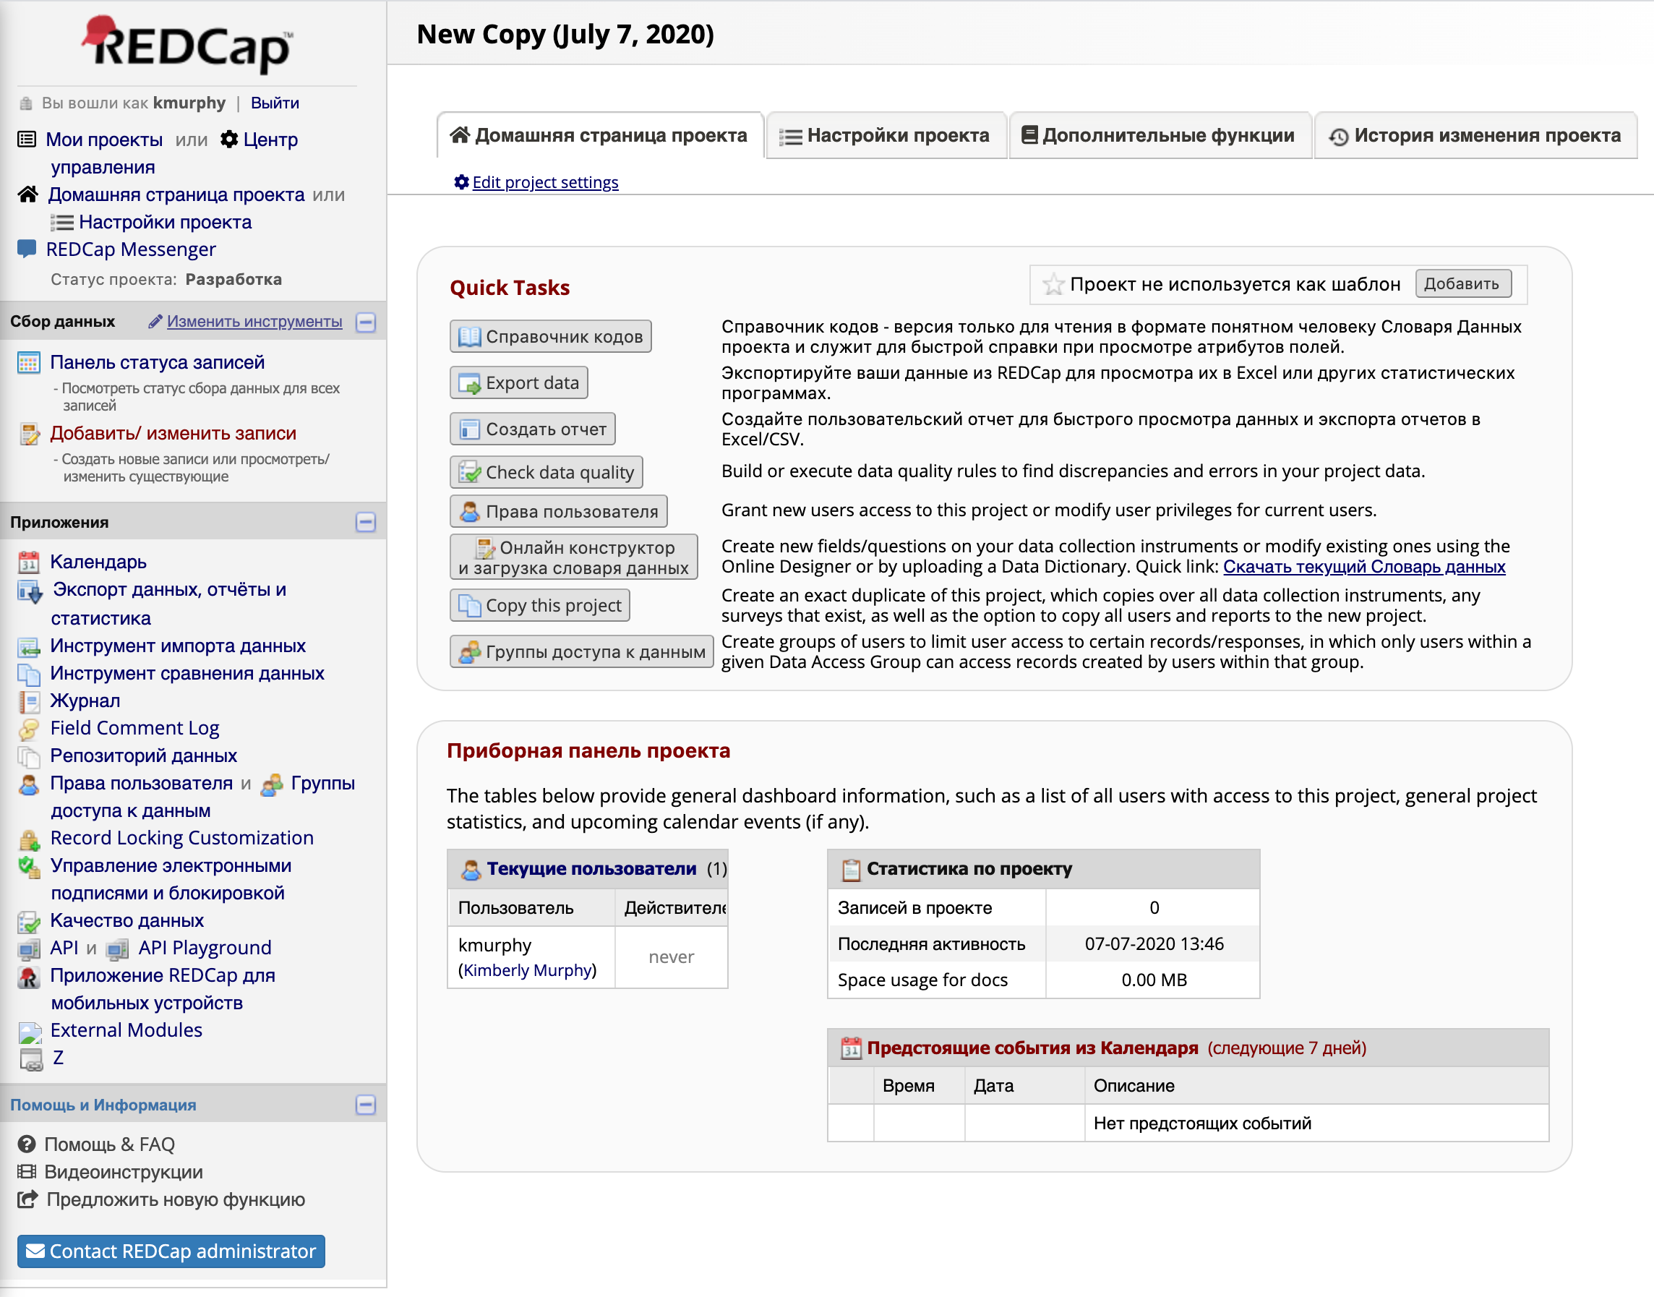
Go to the Project Home and select “Export data”

Slide 3
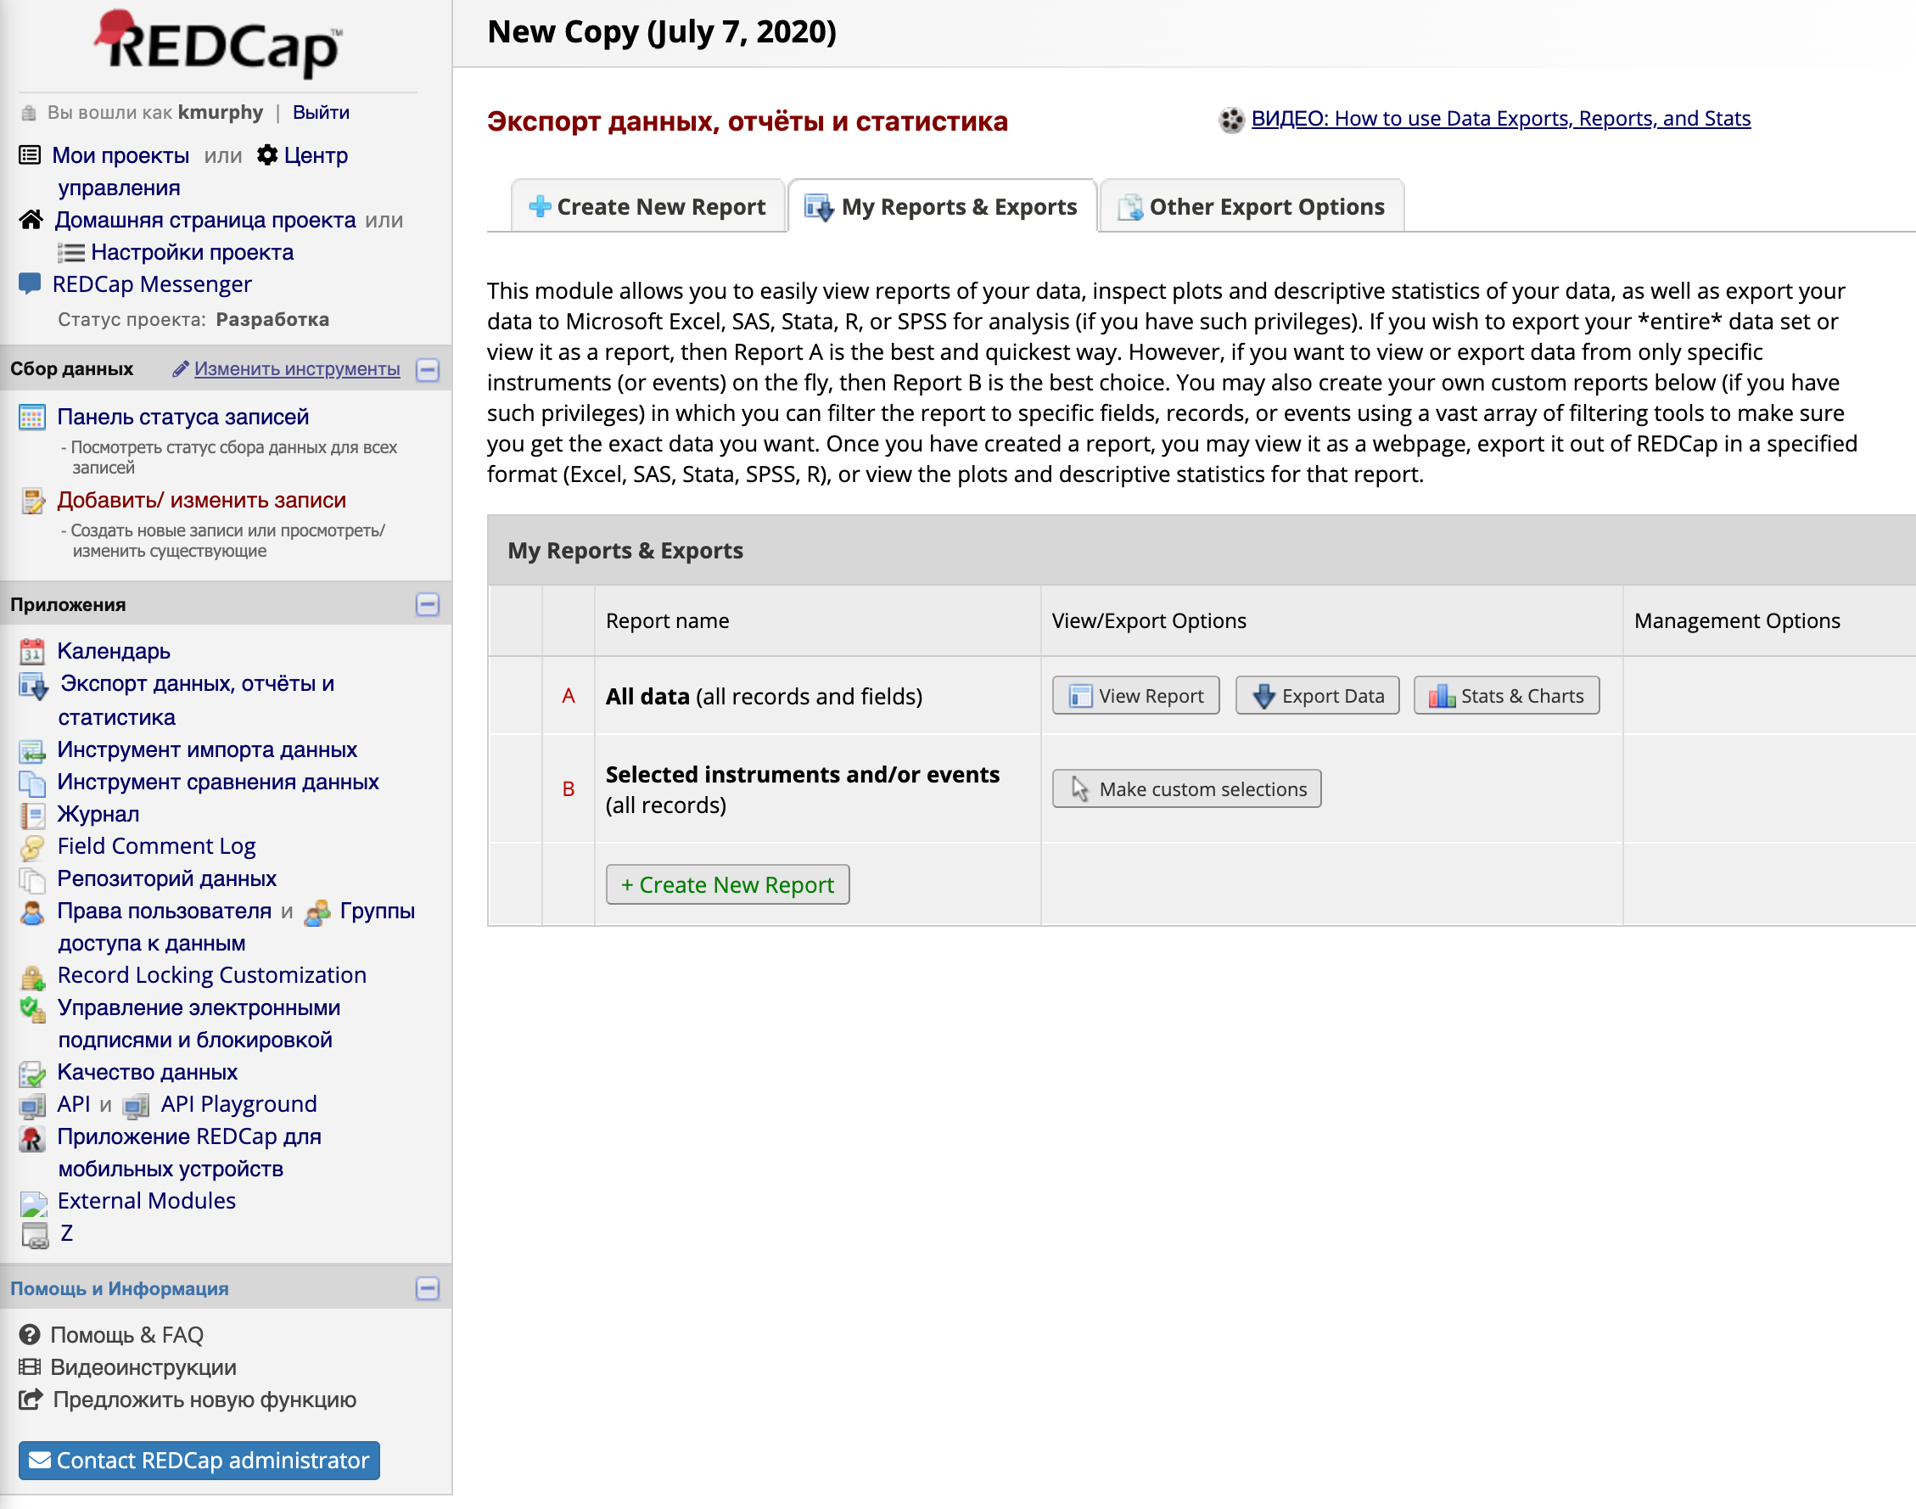
Select “Create New Report”

Slide 4
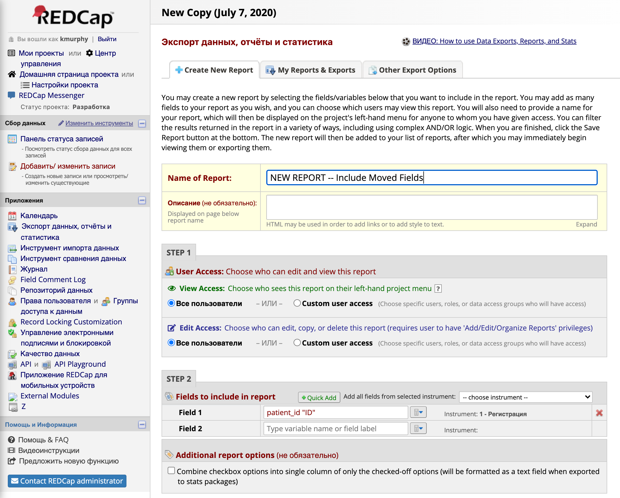
Name the report and select “Quick Add

Slide 5
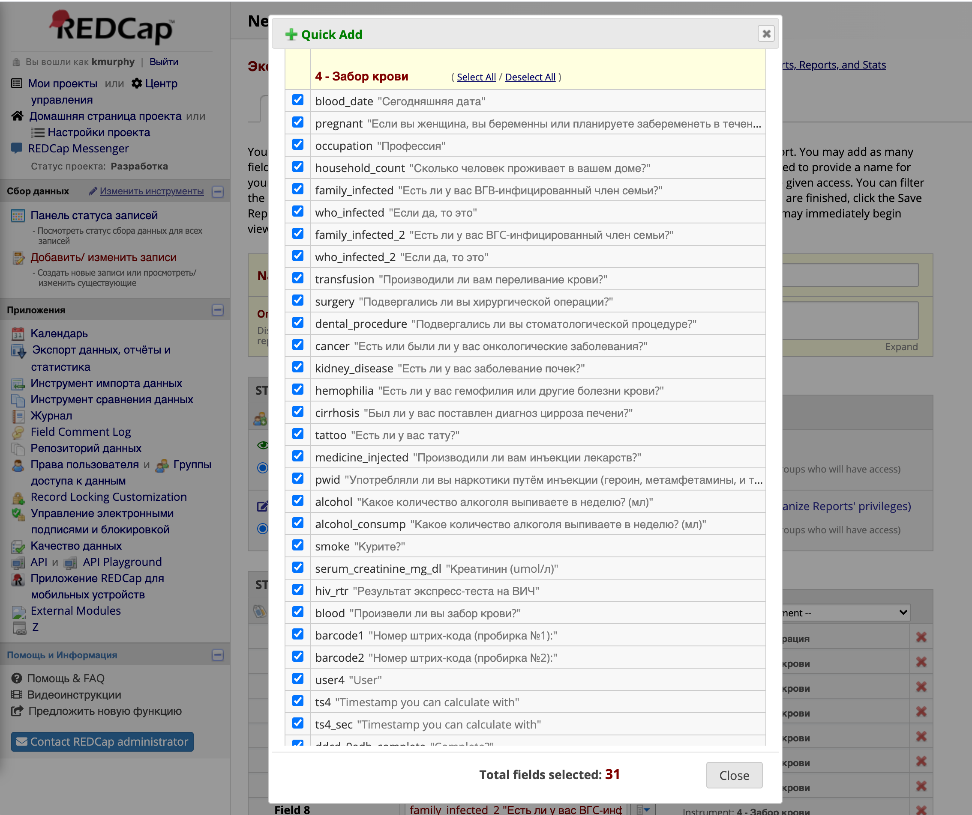
Hit “Select All” for each instrument, then uncheck any personal patient ID fields Hit “Close” when finished

Slide 6
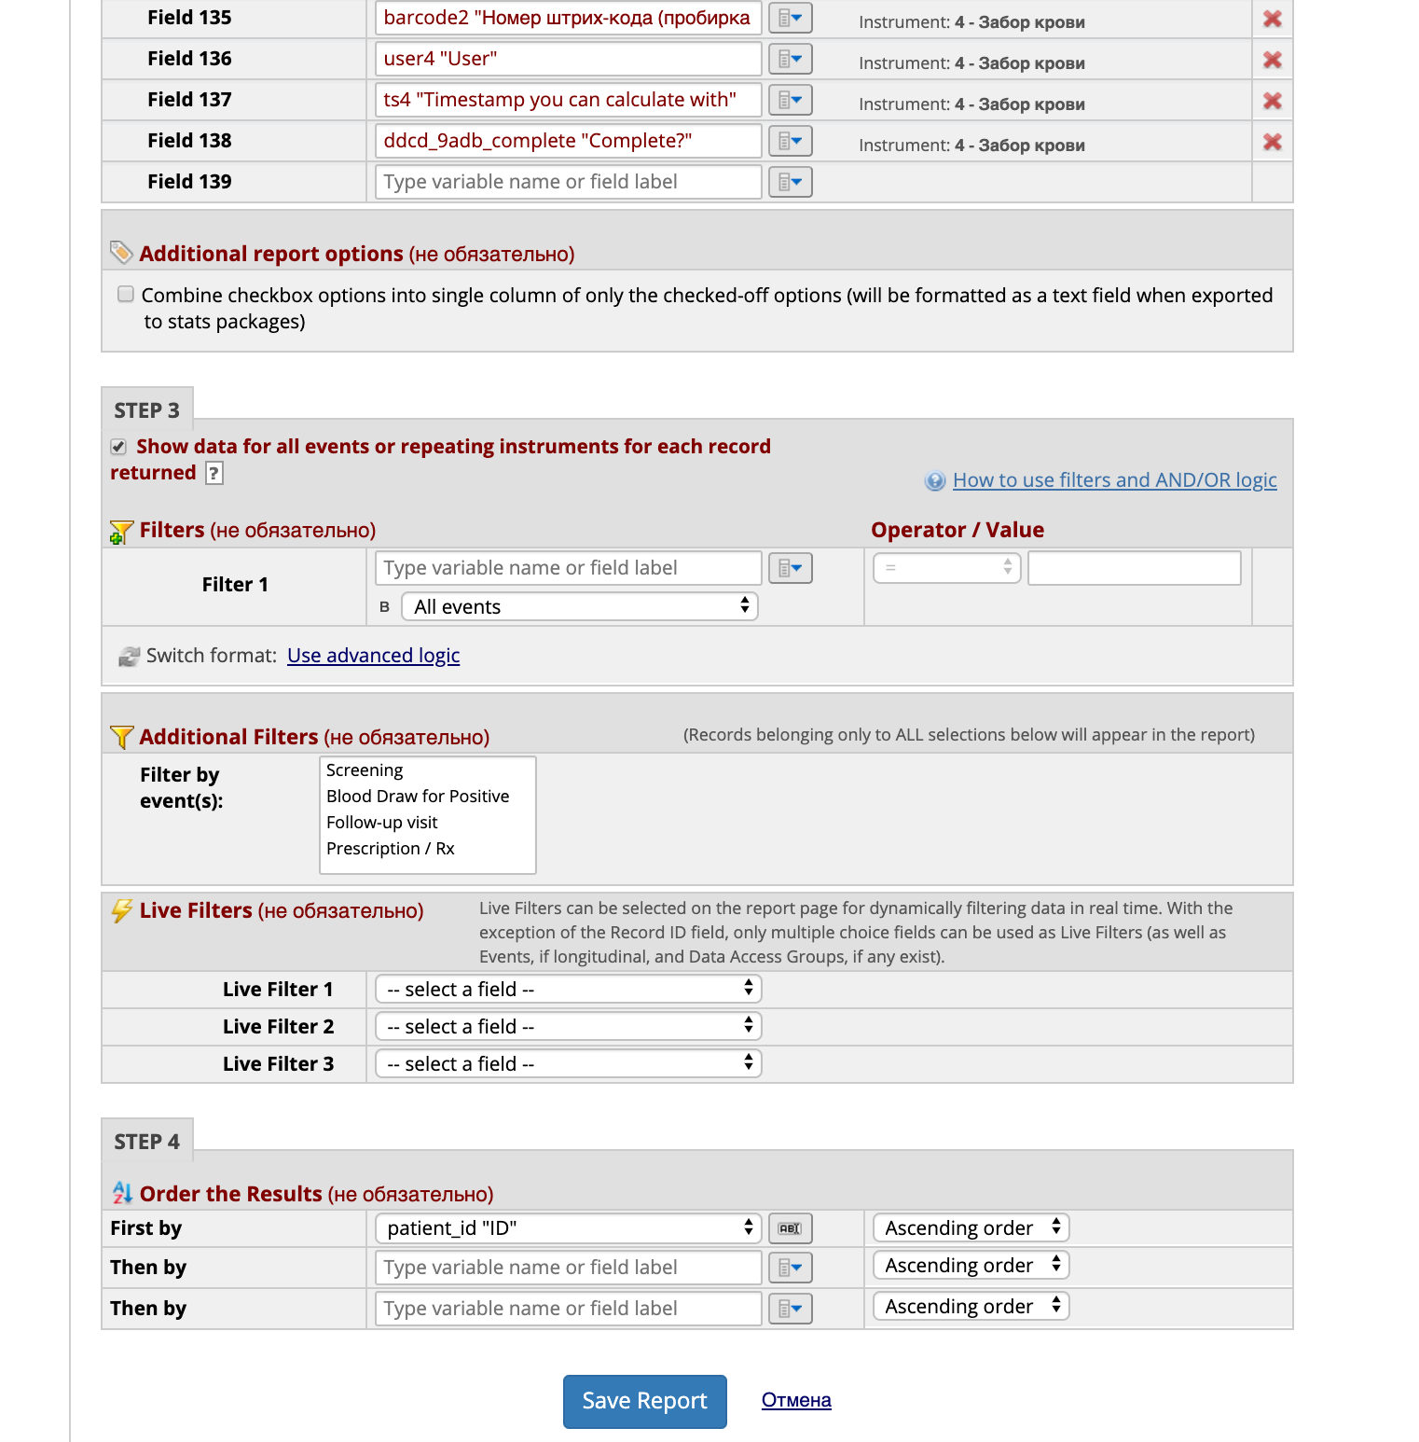
Scroll down to below Step 4 and hit “Save Report”

Slide 7
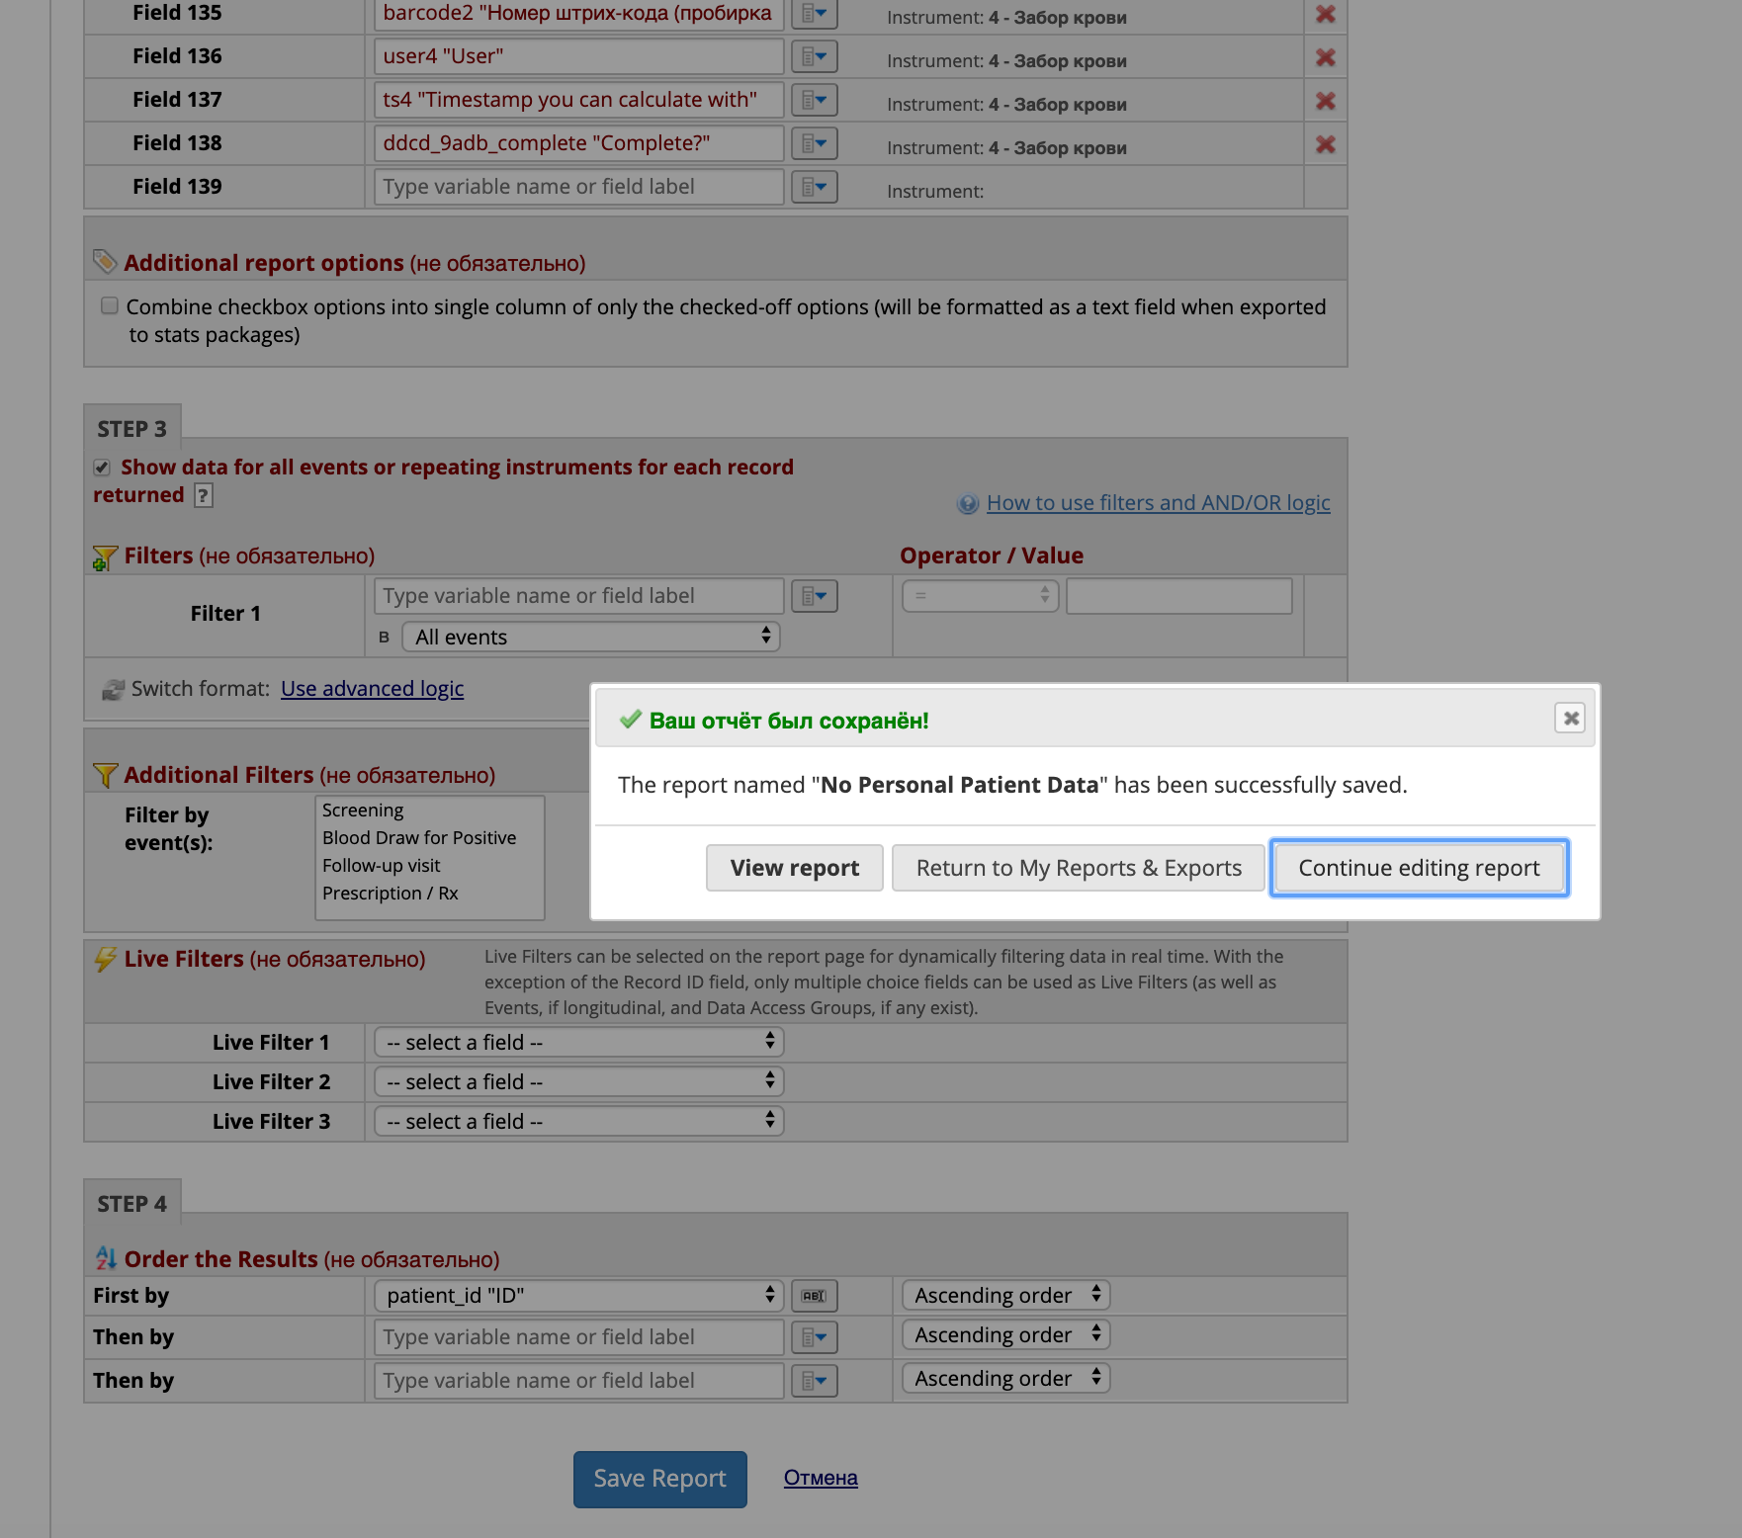
You may view the report to ensure all patient personal data has been removed (you can edit the report to omit any additional fields)

Slide 8
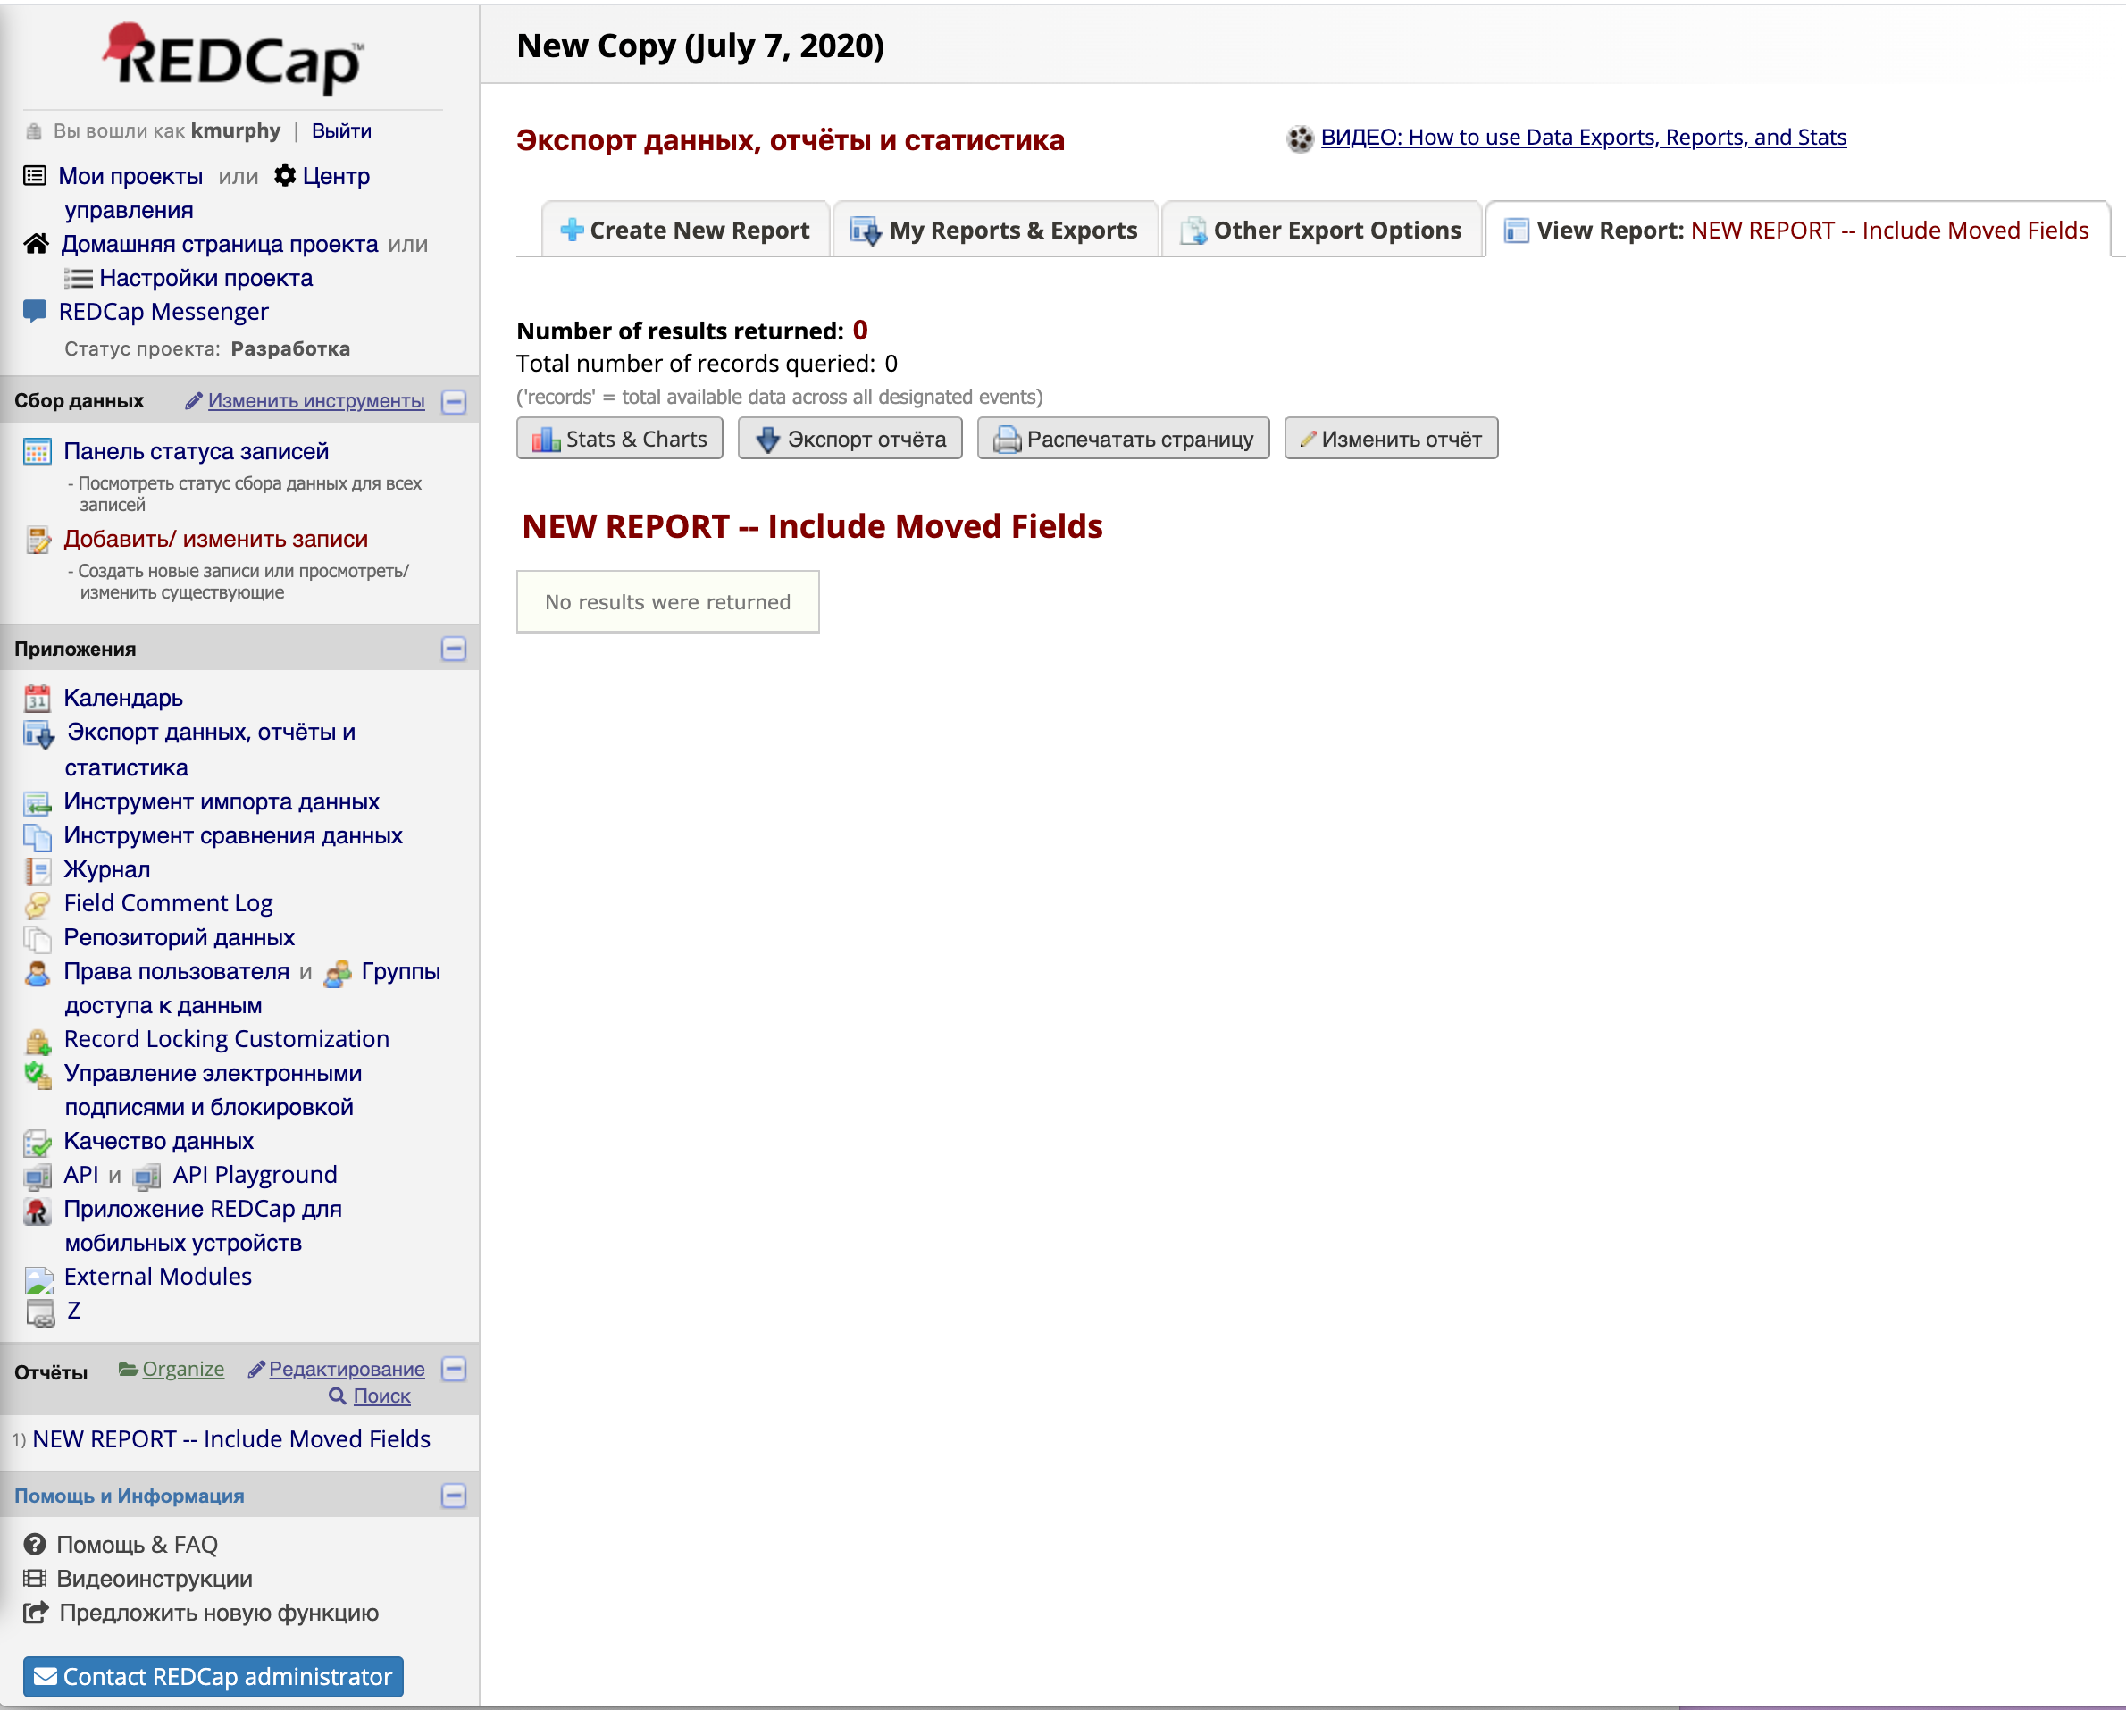
The Deidentified Report can be accessed for export

